Slide 1
Information Management Update
29 October 2022
Vera Lee Sharoff, Director Information Management
v.sharoff@ieee.org

Slide 2
Agenda
vTools Home Page
vTools Events
Changes to the GoogleApps@ieee offering

Slide 3
vTools Home Page
Overview

Slide 4
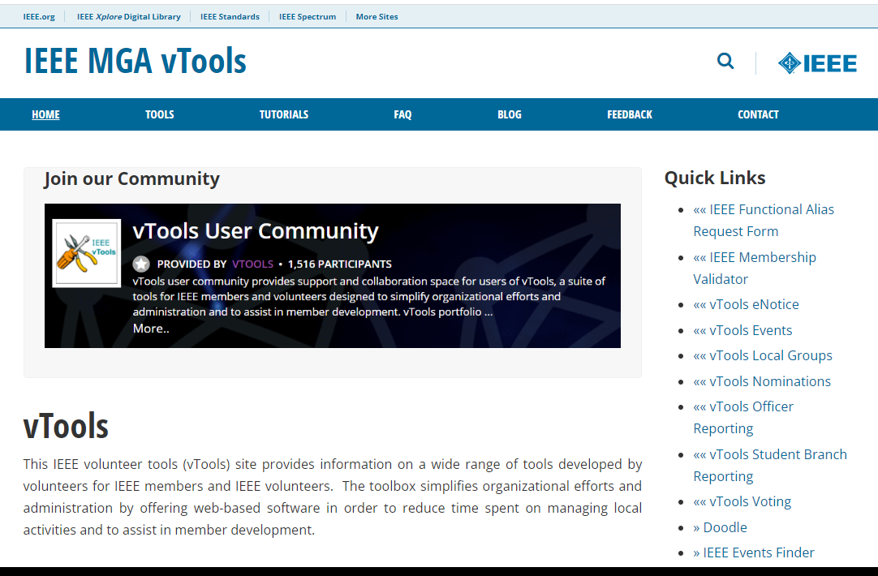
vTools Website
vTools.ieee.org
https://vtools.ieee.org/

Slide 5
vTools Events
Overview

Slide 6
Who Can Access vTools Events?
Automatic access is granted for the following roles
Region Executive Committee Members
Region Directors
Region-level Representatives (e.g. Students, YP, WIE)
Section Officers
Chair, Vice Chair, Secretary, Treasurer
Membership Development (MD) Chair
Newsletter Editors
SAMIEEE Recipient
Webmasters
Geographic Council Officers
Chair, Vice Chair, Secretary, Treasurer
Membership Development (MD) Chair
Chapter Chairs
Student Branch Chairs and Branch Chapter Chairs
HKN Executive Committee Members (includes Advisor, Counselor)
vTools Coordinators
* Does not require active IEEE membership

Slide 7
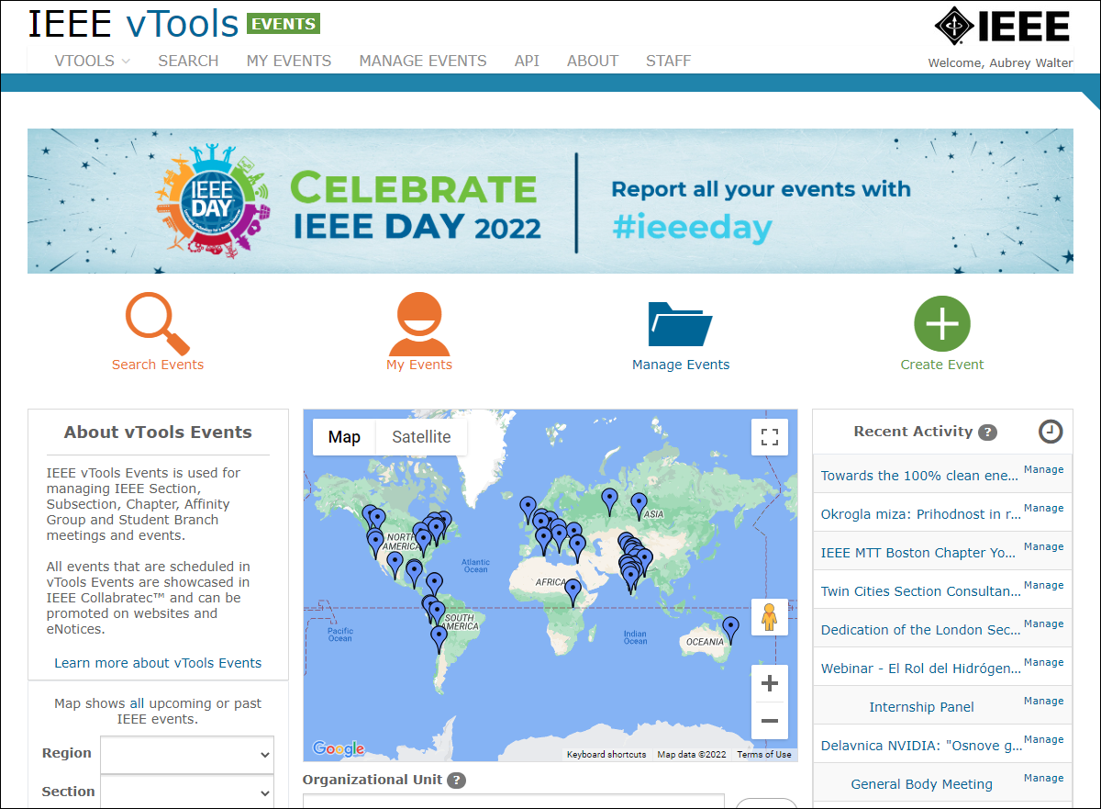
Events
https://events.vtools.ieee.org
Create and Promote Local Meetings and Events
Setup Registration with or without Payment
Send eNotice Invitations
Manage EventS
Report meetings/events to IEEE headquarters (L31)
Utilize data Feeds
Promote on Twitter, Facebook, LinkedIn

Slide 8
Events
https://events.vtools.ieee.org
Create and Promote Local Meetings and Events
Sign in
You must be signed in to schedule an event
The list of Organizational Units is Presented
You can choose other OUs as co-hosts
Enter meeting details
Start time
Time Zone
Description
Agenda
Key Words*
Location / Virtual Meeting Information
Speaker Information

Slide 9
Events
https://events.vtools.ieee.org
Setup Registration
With or Without Fees
Collect registration fees
Connected to Concentration Banking Accounts (NextGen)
Monies collected are automatically deposited in the OU’s Concentration banking account Can be connected to local accounts outside of US and Canada
Both methods use PayPal as the Payment Processor
Fees can be based on member grade
Define Early Bird period with special rates

Slide 10
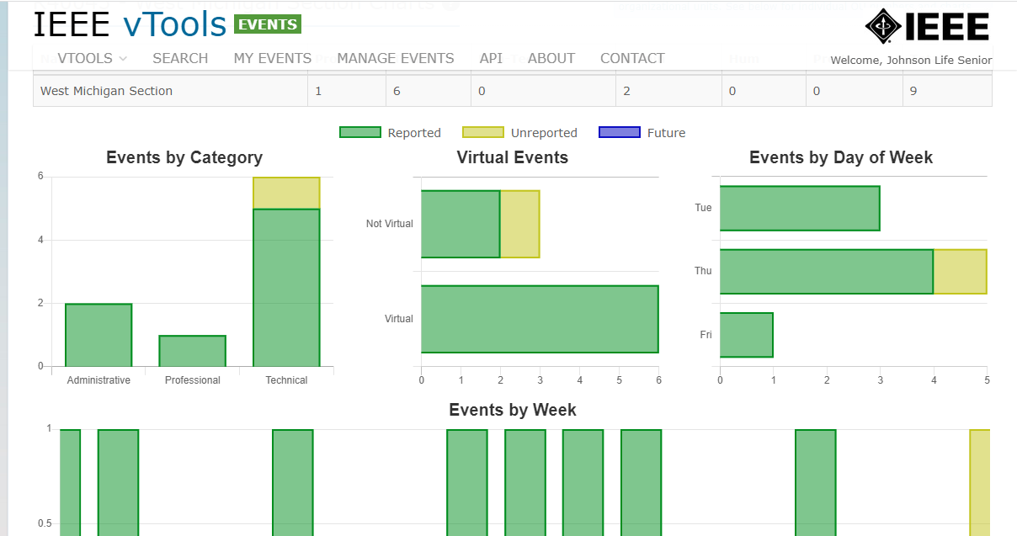
Events
https://events.vtools.ieee.org
Send eNotice Invitations
Generates an eNotice from Event information
Can send email to the entire OU or just to registered guests
eNotices are not automatically sent to all Co-Host OUs, but are moderated by staff to limit spamming
Manage Event
Search Events (and download)
On Site: Take attendance, Print Meal Tickets, Name Tags
View Event Activities
By Category
Popular day of the week
Report Filed or Not

Slide 11
vTools
Event Activity Dashboard – Phase I
Select any geographic organizational unit and year to filter event activities.
Initial result includes a composite of all activity of the OU
Section plus all related OUs (Chapters, Affinity Groups, Student Branches etc…)
Events by category, Virtual events, by day of week and by week across one year
Breakdown information below includes:
Event category count (Professional, Technical, Non-Technical, Administrative, Humanitarian, Pre-U STEM)
Drill to the same available views as seen on the parent view
http://events.vtools.ieee.org
Notes:
Event Categories are: Professional, Technical, Non-Technical, Administrative, Humanitarian, Pre-U STEM
Breakdown will show activity for all subunits in one view. Screenshot on following page

Slide 12
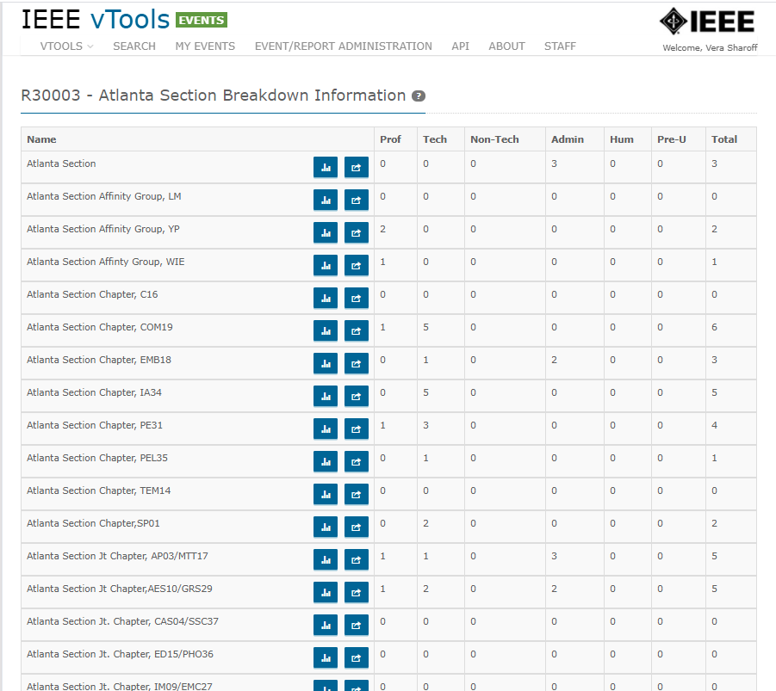

Slide 13
vTools
Event Activity Dashboard – Phase 2
Select any Society and year to filter event activities.
Initial result includes a composite of all activity of the Society
Chapters
Events by category, virtual events, by day of week and by week across one year
Breakdown information below includes:
Event category count (Professional, Technical, Non-Technical, Administrative, Humanitarian, Pre-U STEM)
Drill to the same available views as seen on the parent view
Reminder to submit L31 after Event happens
http://events.vtools.ieee.org

Slide 14
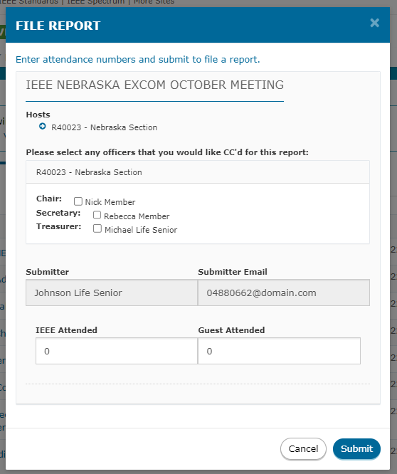
Events
https://events.vtools.ieee.org
Report meetings/events to IEEE headquarters (L31)
If Event was scheduled in the vTools Events, simply add the number of members and guests.

Slide 15
Events
https://events.vtools.ieee.org
Utilize data Feeds
Automatically, all events are feed to Collabratec and the IEEE App
Data feeds are available is HTML, RSS to be consumed by local website calendars
Webinabox
Promote on Twitter, Facebook, LinkedIn

Slide 16
Resources
Some helpful websites/other resources
vTools Homepage - information about vTools and other services
vTools Knowledgebase - tutorials and FAQs related to each vTools application
vTools Blog - information regarding releases, patching, and outages
MGA Home Page - information about MGA, operations, volunteer resources, and lots of other helpful things
Section Roster - access to IEEE committee and board membership rosters throughout the organization

Slide 17
vTools Accomplishments for 2022
Events
Event Report Reminders - following an event, event administrators will receive a reminder to report the event at 3 days and 7 days following the event, with a link directly to report the event.
Event Activity dashboard now supports showing event activity statistics for societies.
ExCom CCs on event report confirmations - when reporting an event, the reporter now has the option of CC’ing organizational unit and/or section ExCom officers.
Adding a checkbox to indicate if the event is a Women in Engineering (WIE) Event
Adding custom tagging to the event based on the host OU
Re-ordering of the Events form
Added a banner for IEEE Day, and map is showing only events tagged with #IEEEDay

Slide 18
G-Suite Transition

Slide 19
G-Suite Transition to Google Workspace
IEEE members (all grades including students) currently can request an IEEE managed and branded version of G-Suite as a member benefit in regions where the software is available.
Provides access to Gmail, Calendar, Limited Google Drive storage, Google office tool suite, Video Conferencing, and other tools.
Approximately 115,000 current, active IEEE member G-Suite accounts.
G-Suite tools are used extensively by staff and volunteers.
IEEE’s past utilization of G-Suite has been free under Google’s Non-Profit pricing.
In January 2022, Google announced that it was terminating its current G-Suite offering and moving all customers to Google Workspace starting 1 May 2022.
This ended the current tier of free access for large non-profit organizations.
IEEE was required to contract for licenses for member access to continue providing these tools.

Slide 20
Google Workspace Update
In negotiations with Google, Google provide IEEE with an 80% discount for member accounts and deferred any changes in member accounts until Q3 2023.
IEEE explored alternative approaches/vendors to provide email and tools to volunteers, but all options considered were cost prohibitive or resulted in a significant loss of capability to members (e.g. offering ieee.org email aliases rather than a full email account and desktop tool suite).
For over 90% members, the conversion from G-Suite to Google Workspace will not be noticeable.
Following account conversion, member accounts will be limited to 2GB of storage for email and files. This storage cannot be expanded. This situation impacts 9,506 accounts.
On 4 August, IEEE members with email accounts close to or over 2GB were notified to begin considering ways to reduce their storage utilization over the coming year. IEEE staff is preparing to assist members in downloading stored data to other services.
For volunteers who are currently storing IEEE data (for Sections, Societies, Committees or other groups) in their IEEE email accounts, a request can be made for large capacity online shared drives to store working documents or archives.
If contacted by members with concerns over this conversion, please refer queries or concerns to the IEEE Contact Center for resolution.

Slide 21
MGA Information Management (MGA-IM) Team Contact Info
Need help? Reach out anytime!
Vera Sharoff, Director, MGA-IM: v.sharoff@ieee.org | 732-562-5509
Eugene Khusid, Sr Program Manager, MGA-IM: y.khusid@ieee.org | 732-465-5831
Khanh Luu, Sr Information Management Analyst: k.n.luu@ieee.org | 732-562-6385
Mona Li, Sr Information Management Business Analyst: m.li@ieee.org | 732-562-5553
Aubrey Walter, vTools Project Manager: a.l.walter@ieee.org | 732-465-6673
Jesse Mueller, vTools Lead Developer: jesse.mueller@ieee.org | 323-639-3236
Or you can email our team alias: mga-im@ieee.org

