Slide 1
Accounting Update IEEE MGA Treasurer Training
Srivathsava Madhugiri,
Director Corporate Accounting October 29, 2022

Slide 2
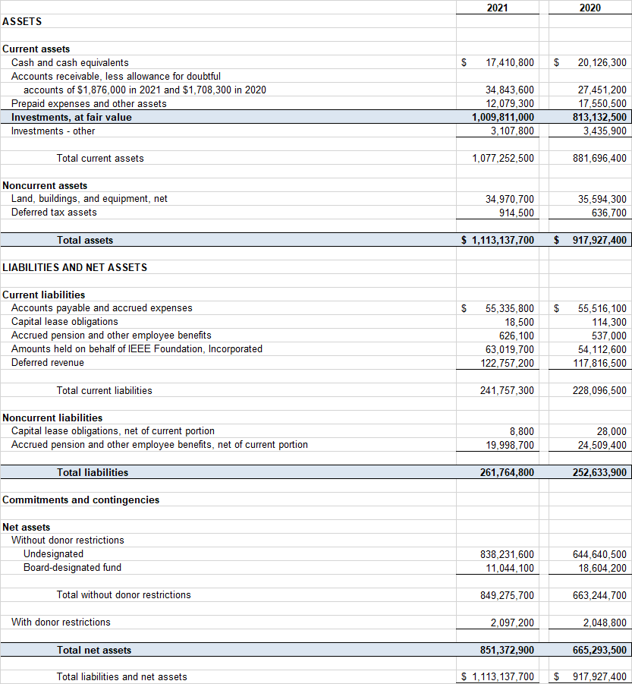
IEEE Consolidated Statement of Financial Position
2

Slide 3
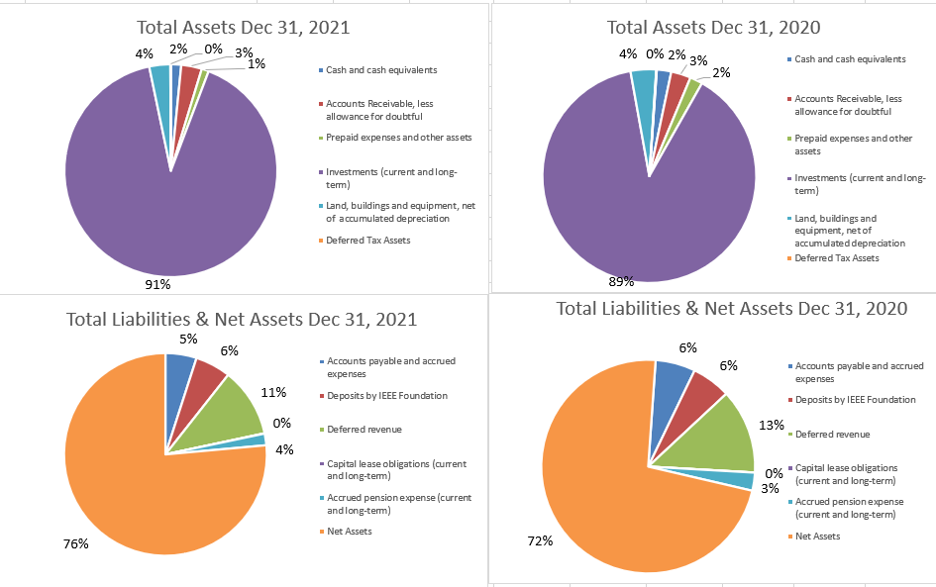
IEEE Statement of Financial Position Total Assets, Liabilities, and Net Assets as of December 31, 2021 and 2020
3

Slide 4
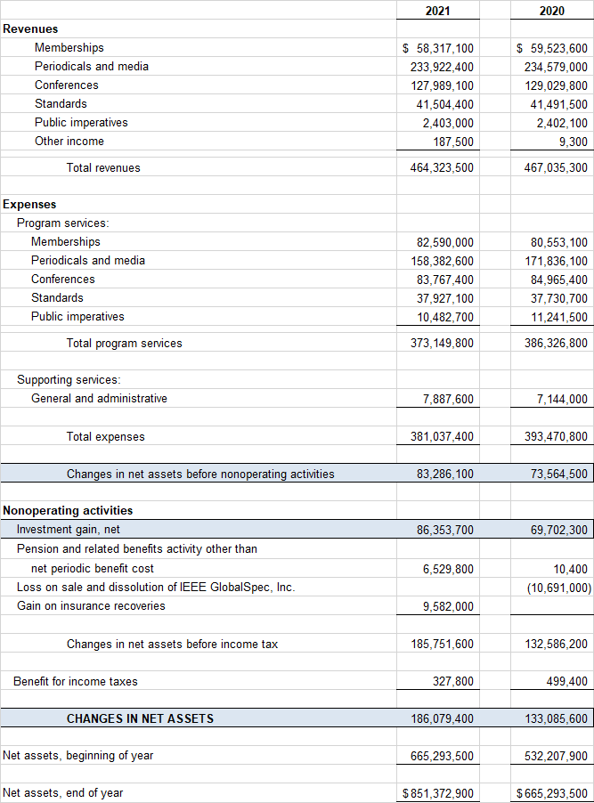
IEEE Consolidated Statement of Activities
4

Slide 5
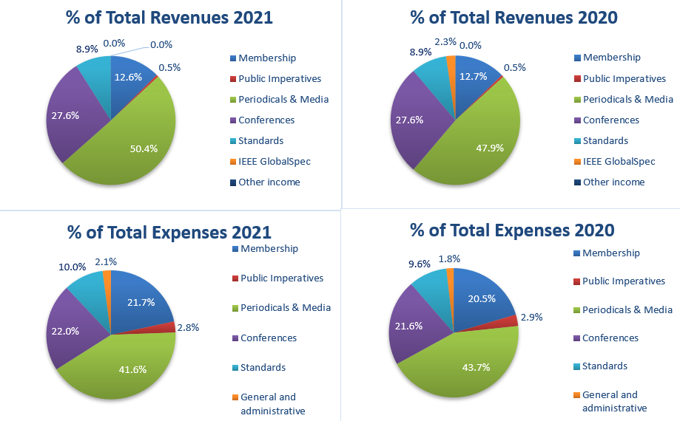
The Statement of Activities: Line of Operations (“LoO”) Format
5

Slide 6
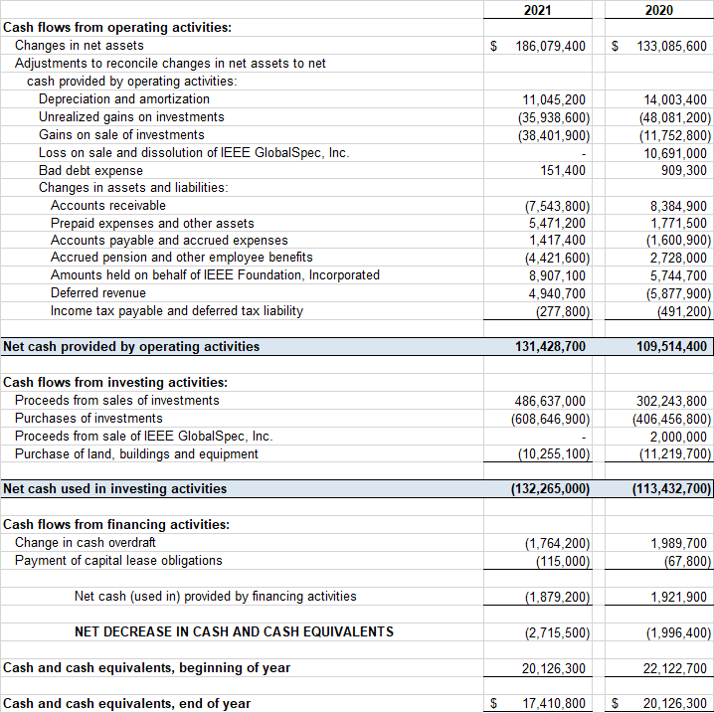
IEEE Consolidated Statement of Cash Flows for the Year Ended December 31, 2021 and 2020

Slide 7
2021 Auditors Opinion

Slide 8
Questions?

