Slide 1
How to Conduct a Risk Assessment
Developed by: Frank M Giannattasio, MBA, ARM
Senior Manager, Enterprise Risk & Business Continuity Management
ORIMS (Office of Risk & Insurance Management Services)

Slide 2
Workshop Objective
learn what risk is,
how to classify risk,
risk categories and characteristics,
how to conduct a risk assessment.

Slide 3
An interesting thought…
“The cost of responding to unanticipated problems is always much larger than the cost of risk responses planned well in advance.”
Author Unknown
“It ain’t what you don’t know that gets you into trouble, it’s what you know for sure that just ain’t so.”
    Mark Twain

Slide 4
Risk Assessment Workshop
So what is the first step? Where do we begin?
We need to start with an explanation of what we mean by “risk.”

Slide 5
Risk Assessment Workshop
What is a risk?
Any ideas?
What do you think it is?

Slide 6

What is Risk?
According to Merriam Webster, risk can be identified as:
Possibility of loss or injury
Someone or something that creates or suggests a hazard
The chance of loss or perils in an insurance contract

Slide 7

What is the IEEE Definition of Risk?
IEEE definition of risk include:
The combination of the probability of an event and its consequences
The opportunities, uncertainties, threats, and barriers to which IEEE must respond in order to achieve its objectives

Slide 8

Where Can We Find Risk?
Risk is inherent in all types of undertaking and may carry the potential for benefit or be a threat to success

Slide 9
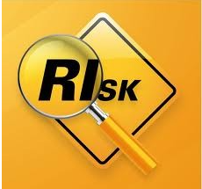
How Do We Classify Risk?
Risk can be defined as:
The combination of the probability of an event and its consequences
The opportunities, uncertainties, threats, or barriers to which IEEE must respond in order to achieve its objectives

Slide 10

Risk in the Business World
Let’s review where we find risk in the business world
External
Exposure to uncertainty affecting the communities served by IEEE (Members, Volunteers)
Financial risks
Exposure to uncertainly regarding the management and control of the finances of the organization (Conference Banking, Cash Reserves)
Exposure to loss arising from damage to property or from fortuitous acts typically include the perils covered by insurance (Fire in Building, Injury to Visitors in Offices)

Slide 11

Risk Categories
Human Assets: Exposure to uncertainty related to compliance with personnel policies and procedures, employee morale, and organizational culture
Legal/Regulatory Compliance: Exposure to uncertainty related to laws, statues, and administrative regulations that govern how IEEE operates. (PCI compliance issues, State and Federal Laws)
Operational: Exposure to uncertainty related to day-to-day business activities (Reduced membership, Loss of sales of publications)
Reputational: Exposure to uncertainty related to brand, perceived value, organizational status, and public perception and trust (Media related issues)
Strategic: Exposure to uncertainty related to long-term policy directions of the organization. These are ‘big picture’ risks (Electronic publishing, handheld delivery of products)

Slide 12
Characteristics of Risk
There are two characteristics of risk:
Probability and severity
Probability ranges from Unlikely to Definite
Severity ranges from Insignificant to Catastrophic

Slide 13
Risk Probability
A risk can be classified under one of the five categories:
Definite: Almost certain, high probability
Likely: Something that may happen, better than 50/50
Occasional: Risks which have a near 50/50 chance
Seldom: Risks that have a low chance of occurrence but still can not be ruled out completely
Unlikely: Rare and exceptional risks, less than 10% chance.

Slide 14
Risk Severity
The consequences of a risk define its severity and can fall into five categories:
Catastrophic: highest level, deal breakers, priority #1
Critical: Significantly large consequences
Moderate: Not a great threat, but considerable
Marginal: Some risk, not too significant
Insignificant Near negligible

Slide 15
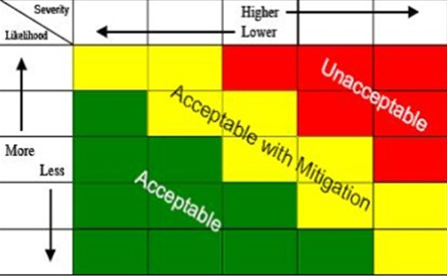
Risk Management Matrix
Using the estimated probability and severity,
we are able to identify potential risk impact

Slide 16
The Risk Universe
The Risk Universe was designed to present the IEEE risk portfolio in the form of risk statements, grouped by major categories: Strategic, Operations, Financial/Reporting and Legal/Compliance.
The Risk Universe was revised to include a visual indicator of the estimated probability & severity and the Heat Map was developed.

Slide 17
How to perform a risk assessment?
Review the Risk Universe
Are there any risks to the business that could negatively impact the achievement of our strategic goals?
Are those risks identified in the Risk Universe?
Is there a risk that is not identified?
What is that risk?

Slide 18
How to complete the Risk Universe
Review each statement in the risk universe and decide if it is a risk to your unit
For each statement that is a risk, determine the severity of the risk
Apply the heat map color to signify the risks that pose the greatest impact to your unit versus those have the least impact
Not every statement may apply to your unit
HEAT MAP
mission critical, high risk impact
significant impact, requires attention
moderate impact, needs attention
least impact, lower priority than top 3

Slide 19
IEEE Risk Universe for (unit name here)

Slide 20
QUESTIONS?
If you have any questions or wish to discuss this in greater detail, please contact:
      orims@ieee.org

