Slide 1
Information Management Update
21 October 2023 Vera Lee Sharoff Sr. Director Information management v.sharoff@ieee.org

Slide 2
Agenda
vTools Home Page
vTools Events
Changes to the GoogleApps@ieee offering
Who we are
Resources

Slide 3
vTools Home Page
Overview

Slide 4
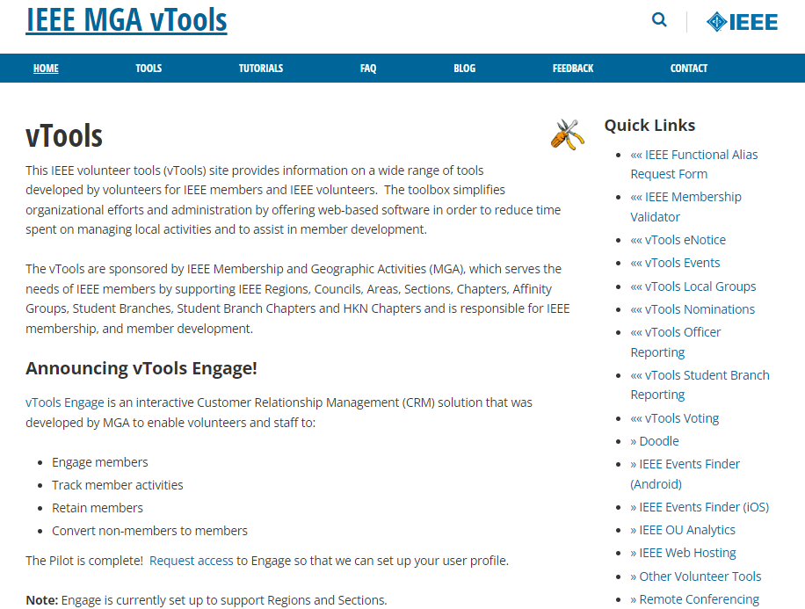
https://vtools.ieee.org/

Slide 5
vTools Events
Overview

Slide 6
Who Can Access vTools Events?
Automatic access is granted for the following roles
Region Executive Committee Members
Region Directors
Region-level Representatives (e.g. Students, YP, WIE)
Section Officers
Chair, Vice Chair, Secretary, Treasurer
Membership Development (MD) Chair
Newsletter Editors
SAMIEEE Recipient
Webmasters
Geographic Council Officers
Chair, Vice Chair, Secretary, Treasurer
Membership Development (MD) Chair
Chapter Chairs
Student Branch Chairs and Branch Chapter Chairs
HKN Executive Committee Members (includes Advisor, Counselor)
vTools Coordinators
* Does not require active IEEE membership

Slide 7
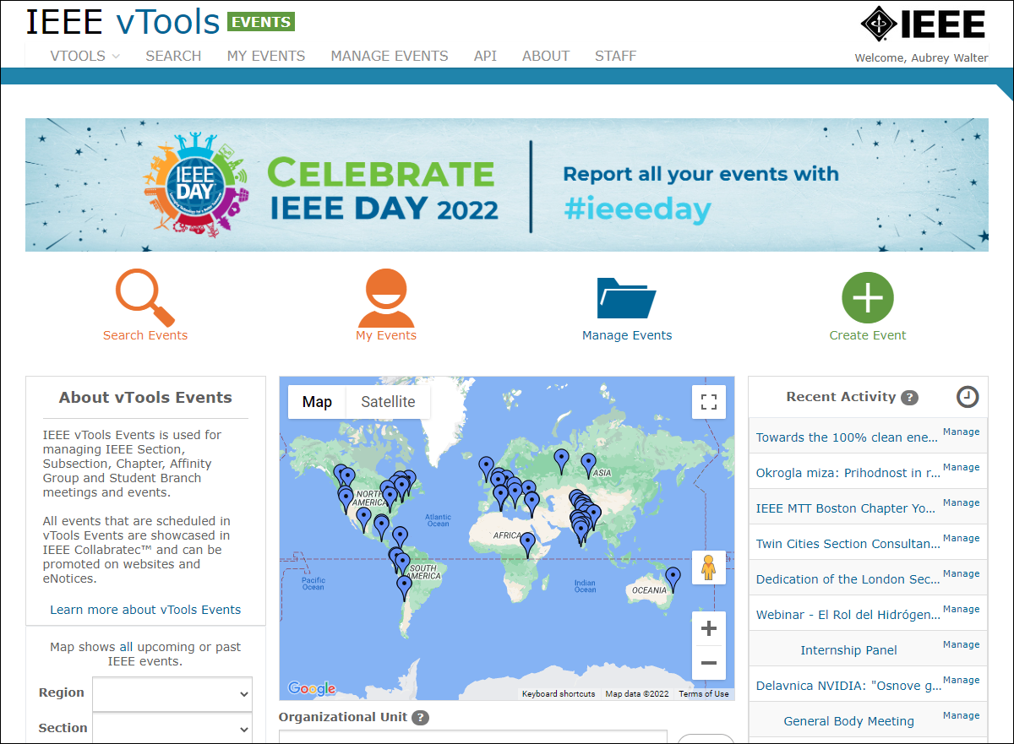
Events
https://events.vtools.ieee.org
Create and Promote Local Meetings and Events
Send eNotice Invitations
Search / Manage Events
Report meetings/events to IEEE headquarters (L31)
Utilize data feeds for website calendars
Promote on Twitter, Facebook, LinkedIn

Slide 8
Events
https://events.vtools.ieee.org
Create and Promote Local Meetings and Events
Sign in
You must be signed in to schedule an event
The list of Organizational Units is Presented
You can choose other OUs as co-hosts
Enter meeting details
Start and end time
Time Zone
Description
Agenda
Key Words*
Location / Virtual Meeting Information
Speaker Information (new – add multiple speakers!)

Slide 9
Events
https://events.vtools.ieee.org
Setup Registration
With or Without Fees
Collect registration fees
Connected to Concentration Banking Accounts (NextGen)
Monies collected are automatically deposited in the OU’s Concentration banking account Can be connected to local accounts outside of US and Canada
Both methods use PayPal as the Payment Processor
Fees can be based on member grade
Offer Early Bird period with special rates

Slide 10
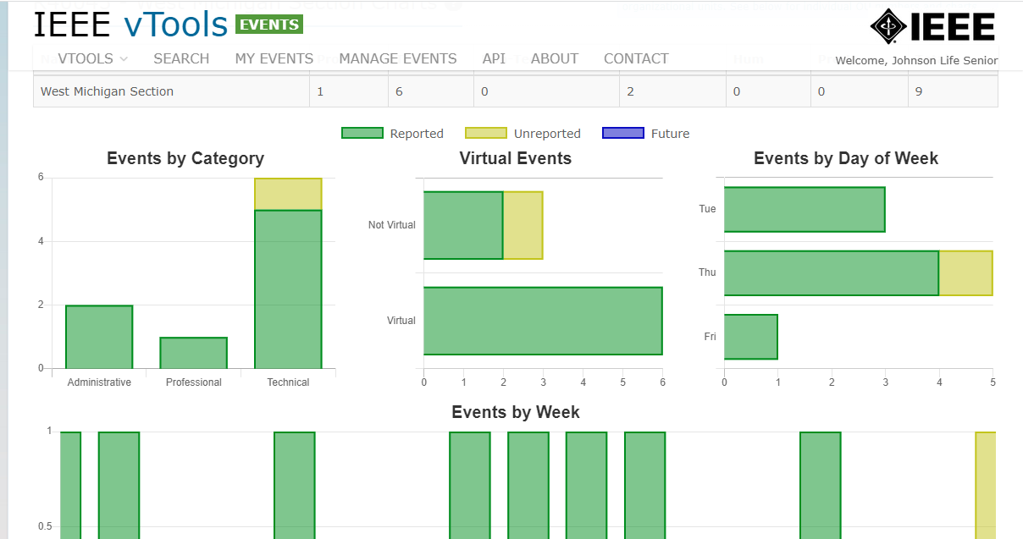
Events
https://events.vtools.ieee.org
Send eNotice Invitations
Generates an eNotice from Event information
Can send email to the entire OU or just to registered guests
eNotices are not automatically sent to all Co-Host OUs, but are moderated by staff to limit spamming
Manage Event
Search Events (and download)
On Site: Take attendance, Print Meal Tickets, Name Tags
View Event Activities
By Category
Popular day of the week
Report Filed or Not

Slide 11
vTools
Event Activity Dashboard
Select any geographic organizational unit or Society and year to filter event activities
Initial result includes a composite of all activity of the OU
Section plus all related OUs (Chapters, Affinity Groups, Student Branches etc…)
Events by category, Virtual events, by day of week and by week across one year
Breakdown information below includes:
Event category count (Professional, Technical, Non-Technical, Administrative, Humanitarian, Pre-U STEM)
Drill to the same available views as seen on the parent view
http://events.vtools.ieee.org
Notes:
Event Categories are: Professional, Technical, Non-Technical, Administrative, Humanitarian, Pre-U STEM
Breakdown will show activity for all subunits in one view. Screenshot on following page

Slide 12
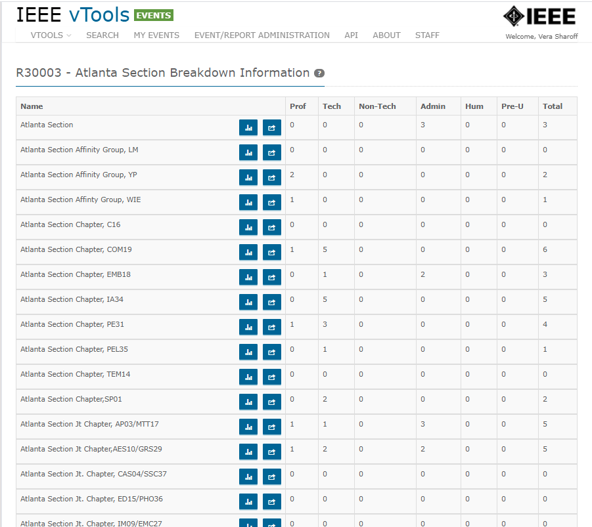

Slide 13
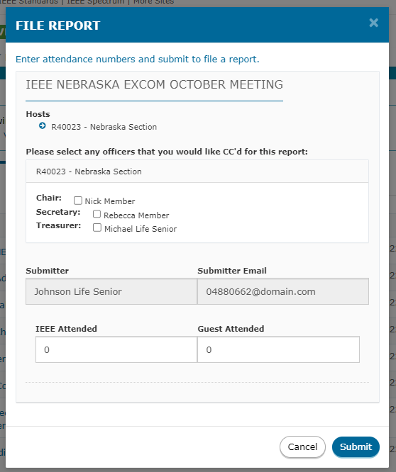
Events
https://events.vtools.ieee.org
Report meetings/events to IEEE headquarters (L31)
If Event was scheduled in the vTools Events, simply add the number of members and guests.

Slide 14
Events
https://events.vtools.ieee.org
Utilize data Feeds
Automatically, all events are feed to Collabratec and the IEEE App
Data feeds are available in HTML and RSS to be consumed by local website calendars and Webinabox
Promote on Twitter, Facebook, LinkedIn

Slide 15
G-Suite Transition

Slide 16
GoogleApps@IEEE with Additional Storage
All IEEE members, including student members, can request an IEEE managed and branded version of Google account (country restrictions apply)
This includes access to a ieee.org email address, Google Calendar, Google Drive, Google office tool suite, Video Conferencing, and other tools.
Approximately 120,000 active members have IEEE Google accounts
GoogleApps@IEEE
IEEE’s past utilization of Google accounts has been free under Google’s Non-Profit pricing.
In 2022, Google changed its policy regarding nonprofit email accounts and is now charging IEEE an annual fee per account.

Slide 17
GoogleApps@IEEE with Additional Storage
With 120K+ member ieee.org google accounts, this has had a significant financial impact to MGA.
As a result of Google’s actions, the GoogleApps@IEEE offering continues, but the free subscription that is provided has a 5GB storage limit.
There are approximately 4,500 members/volunteers that were utilizing 5GB or more of storage.
Many email message were sent advising of the change, with instructions on how to reduce storage or move email to another account or provider before October 2023.
On 1 October, the accounts that remained near or over the limit started to receive warning messages from Google.
Ultimately, the accounts that are over the limit are not able to send or receive email from the ieee.org account.
We do not believe any data is lost.

Slide 18
GoogleApps@IEEE with Additional Storage
There is no ability for members/volunteers to buy additional storage directly from Google.
As such, we have developed a process which enables members/volunteers to have additional time to reduce storage or find other storage options.
The cost to maintain the additional storage for the upcoming year is $48 USD plus any applicable tax per member.
If selected by the member, we will offer the previous same access and storage capacity.
This can be purchased with IEEE Renewal or through the IEEE Contact Center
However, there is a significant increase in cost if we are to continue to offer this option next year.
As of 20 October, 461 members have subscribed.

Slide 19
Who We Are

Slide 20
ITCO and vTools Chairs
Adriaan Van Wijngaarden MGA Vice Chair – Information Management & ITCO Committee Chair
Marty Schulman vTools Committee Chair

Slide 21
Committee Members
IT Coordination and Oversight Committee
Adriaan van Wijngaarden | Chair | avw@ieee.org | North Jersey
Ron Jensen | Past Chair | r.jensen@ieee.org | Minnesota
Peter Nagy | Member | nagy.peter@hte.hu | Hungary
Irene Viana | Member | ipazos@ieee.org | Uruguay
Usman Munanwar | Member | usman.munawar.pk@ieee.org | Canada
Martin Schulman | vTools Chair | schulman@ieee.org | Virginia
vTools Committee
Martin Schulman | Chair | schulman@ieee.org | Virginia
Adriaan van Wijngaarden | Past Chair | avw@ieee.org | North Jersey
Ian MacMillan | Member | ian.macmillan@ieee.org | Colorado
George Michael | Member | gmixail@gmail.com | Egypt
Kung Chi Cinnati Loi | Member | c.loi@ieee.org | Canada
Murty Polavarapu | GUOS Liaison | murtyp@ieee.org | Virginia
10 non-voting Regional Information Management Coordinators

Slide 22
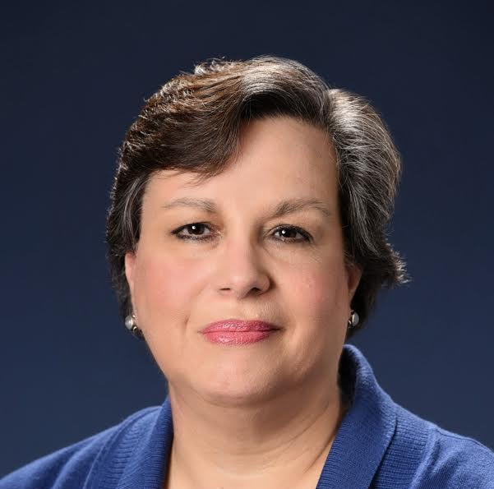
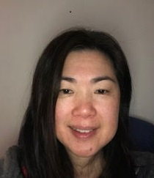
Your IEEE Staff Support
Vera Sharoff Senior Director MGA Information Management
Aubrey Walter vTools Project Manager | Ray Umali EWH, Surveys, Open Water | Kimberly Dante Oracle Service Cloud
Eugene Khusid – ITCO Staff Support, IBP, Collabratec | Jesse Mueller vTools Developer | Dorothy Norman Operations Specialist
Mona Li Project Manager | Terence Martinez OU Analytics, eNotice, WebEx | Stacey Waters Project Manager
Vera
Aubrey
Eugene
Mona
Ray
Jesse
Terence
Kim
Dorothy
Stacey

Slide 23
Resources
Some helpful websites/other resources
vTools Homepage - information about vTools and other services
vTools Knowledgebase - tutorials and FAQs related to each vTools application
vTools Blog - information regarding releases, patching, and outages
MGA Home Page - information about MGA, operations, volunteer resources, and lots of other helpful things
Section Roster - access to IEEE committee and board membership rosters throughout the organization
IEEE Annual Statistics
IEEE OU Analytics
Includes membership and subscriptions monthly statistics
Extensive map aggregate data

