Slide 1
IEEE NextGen Financial Reporting
For Geo Units
Lauren Jesch – Financial Analyst, MGA BFS
Vicky Li – Financial Analyst, MGA BFS
21 October 2023

Slide 2
Agenda
NextGen Access
Volunteer NextGen Dashboard
Work Breakdown Structure (WBS) & Expenditure & Revenue Types
NextGen Banking
Budget Report
Bank Account Transaction Entries
Tax Reporting
MGA Compliance Documents Portal
Annual Financial Reporting
NextGen Training
MGA Finance Team

Slide 3
NextGen Access
Access the NextGen Applications through the Volunteer Experience Dashboard via ieee.org/nextgen
Chairs, Treasurers, and Secretary/Treasurers have been granted access to NextGen
Position status should be current and updated via vTools at https://officers.vtools.ieee.org
Single Sign-on (SSO) by using your own IEEE’s User ID and Password
For new Chairs and Treasurers, the system will prompt them to set up the PingID multi-factor authentication (NextGen Technical Specifications)
Note: PingIDs can be reset by the IEEE IT Team only. Please send an email to
finance-solutions@ieee.org for assistance.

Slide 4
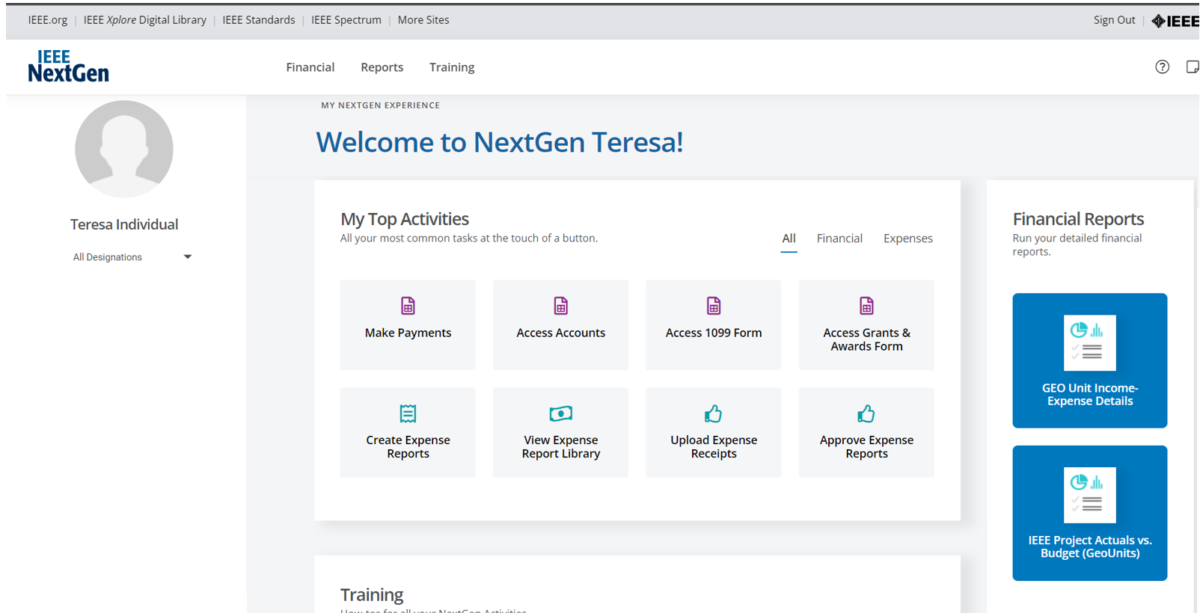
Volunteer NextGen Dashboard

Slide 5
Work Breakdown Structure (WBS) Tasks & Expenditure-Revenue Types
WBS Tasks Listing
The COA (Chart of Accounts) previously used in NetSuite is now the WBS which stands for Work Break Down Structure.
The equivalent of each account from the COA in the WBS is called a task. These tasks will be used to categorize transactions within the NextGen Systems.
Expense-Revenue Types Listing
The Expense & Revenue Types have been created in order to connect IEEE financials from different Business Units (Geo Units, Conferences, and Standards) and consolidate to the corporate financials without affecting the Geo Unit’s reporting.

Slide 6
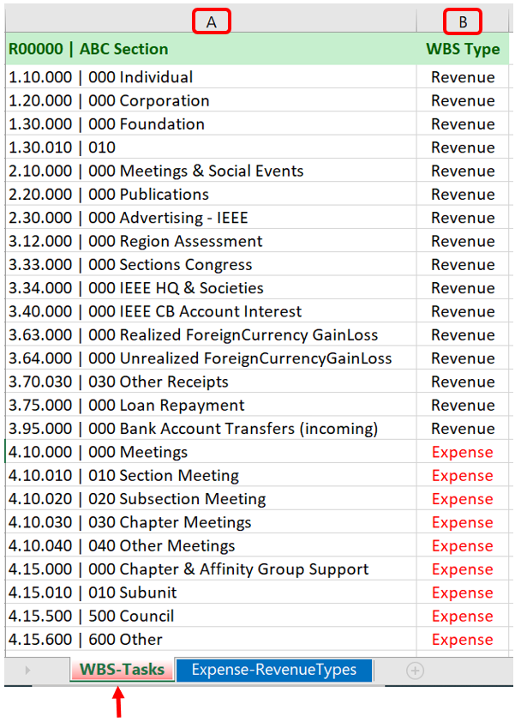
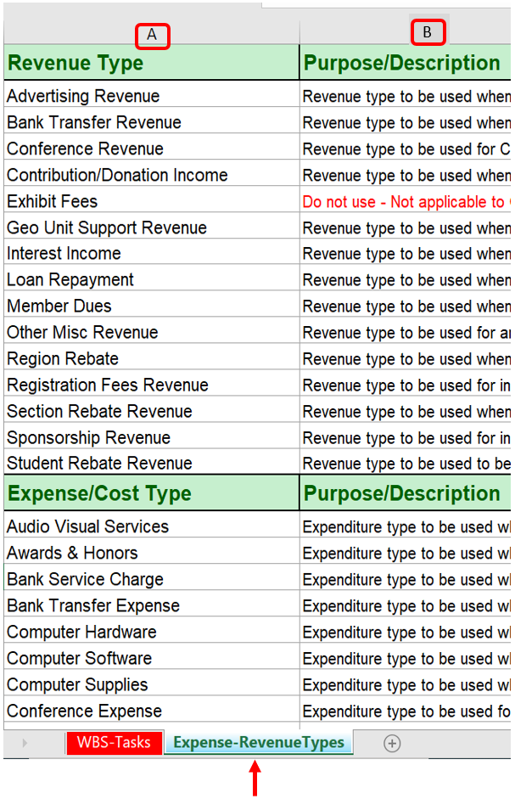
WBS Tasks Listing
Expense-Revenue Types Listing

Slide 7
NextGen Banking
Position status should be current and updated via vTools at https://officers.vtools.ieee.org
Access NextGen Banking through the Volunteer Experience Dashboard via ieee.org/nextgen
CB Bank Account Signature cards should be updated as soon as the Officer positions change. The IEEE Treasury Department manages the signature cards. Please send any inquiries regarding signature cards, Debit Card, or requests to open NextGen bank accounts to nextgenbanking@ieee.org

Slide 8
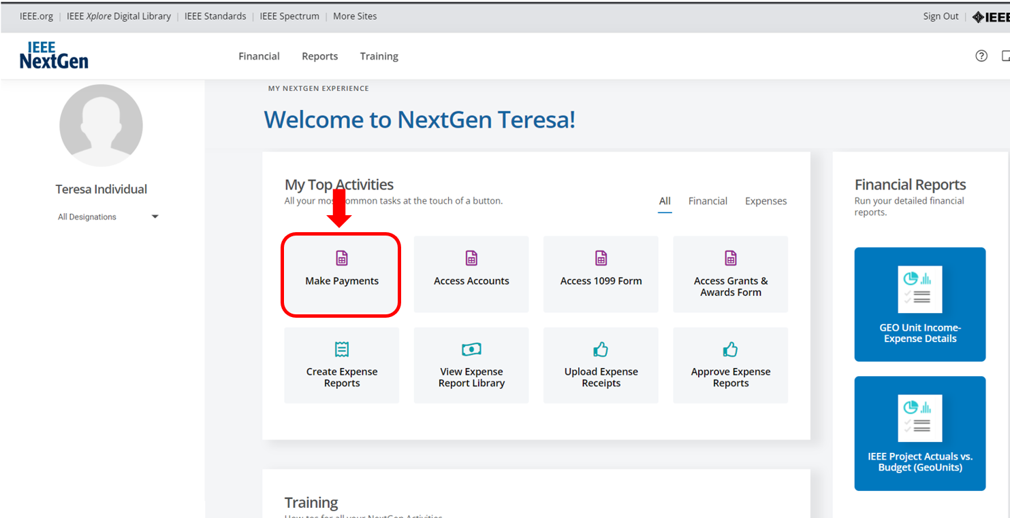
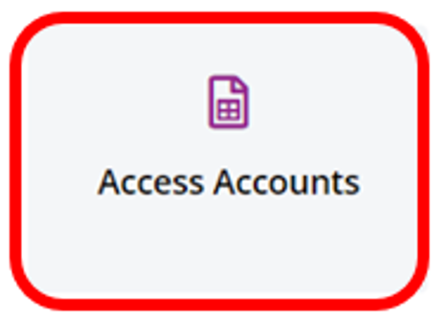
NextGen Banking

Slide 9
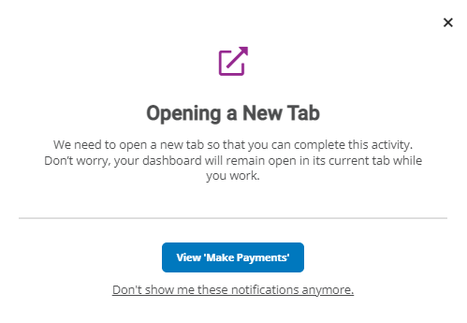
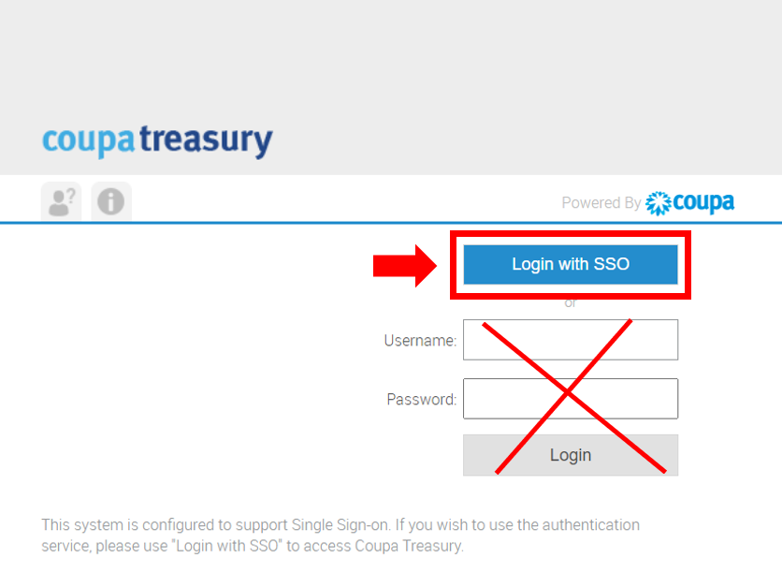
NextGen Banking Access
When clicking on any of the NextGen Banking tiles, another window will be displayed. Click on View ‘Make Payments’ (1).
If a second window is displayed, you don’t need to input your login credentials, instead you just need to click on the blue box labeled ”Login with SSO” and the login credentials will be populated automatically(2)
(1)
(2)

Slide 10
NextGen Banking
ACH Payments
Check Payment
Domestic Wire Payment
International Wire Payment
IC Payments
Account Balances – Cash Flows
Downloading Transactions into Excel format
Downloading Long-Term Investment Account Statements
Track Paper Checks
If you need assistance with NextGen Banking, please send an email to the MGA Finance Team at finance-solutions@ieee.org. We will be happy to assist you.

Slide 11
Budget Report
If you would like to upload the 2024 Budget for your Geo Unit, please send an email requesting the Budget Template to the MGA Finance Team at
finance-solutions@ieee.org.
Budgets for the 2024 Reporting Period can be uploaded to the NextGen Financials Cloud starting on January 2, 2024
Due to the busy reporting season, no 2024 Budgets will be uploaded during the month of February 2024
Budget uploads will resume starting on March 1, 2024

Slide 12
Bank Account Transaction Entries
The Bank Upload Template will be utilized to upload transactions from NextGen Banking and Local Bank Accounts to the NextGen Financials Cloud
CB Bank templates with all transactions as of Dec 31, 2023, and Local Bank Account templates will be sent to Geo Units starting on Jan 2, 2024, including the following:
WBS Task & Expenditure and Revenue Types Listings for each Geo Unit
Step-by-Step guide on how to complete the template
Information on where to send the complete templates

Slide 13
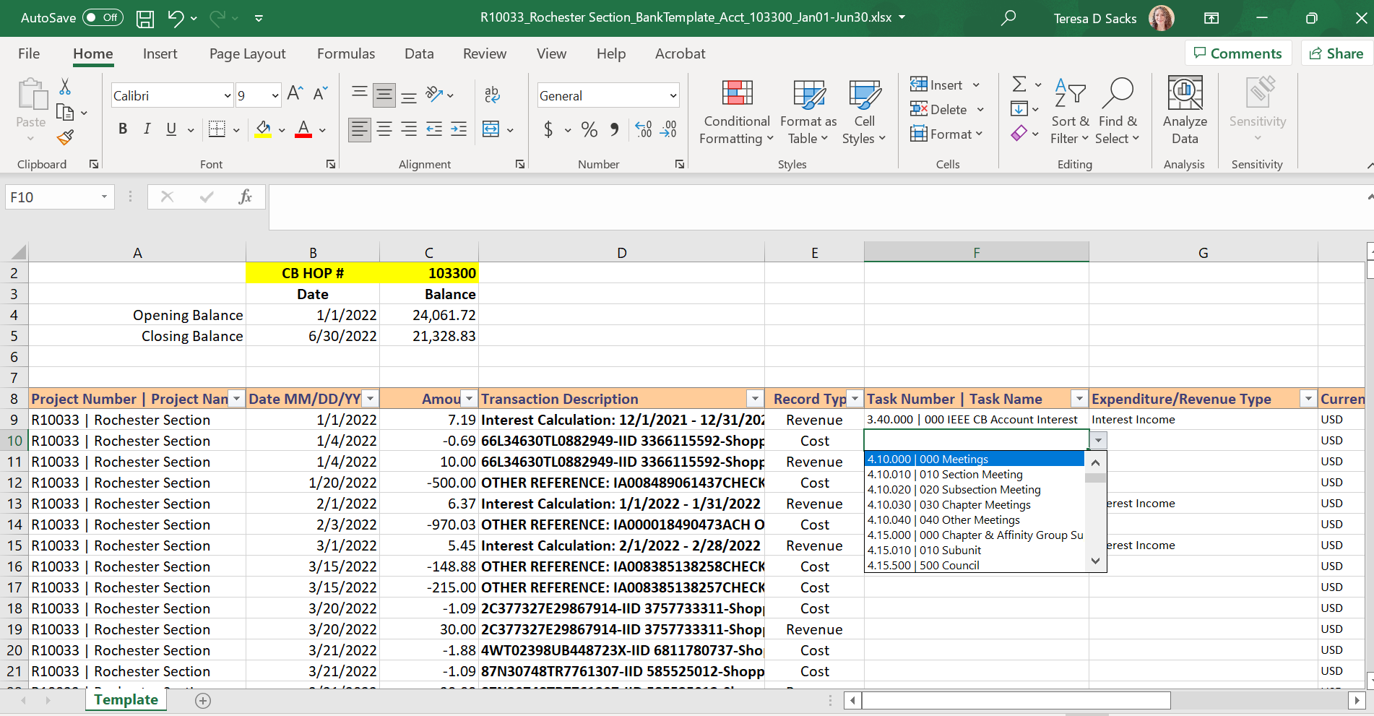
Bank Upload Template

Slide 14
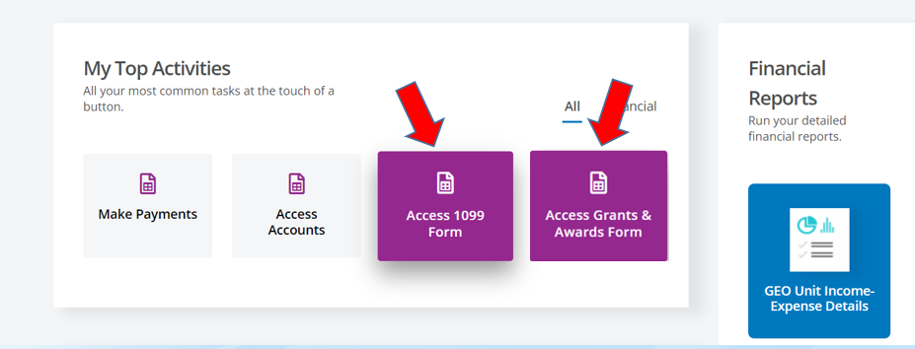
Tax Reporting
Payments such as awards, grants, honorariums, prizes, commission, hourly compensation, etc. must be reported to IEEE.
Expense reimbursements should not be included as long as the receipts and supporting documents are attached to the expense report
Each Form will have its own tile on the Volunteer Dashboard
1099 forms should be completed by Geo Units in Regions 1-6
Grants & Awards forms should be completed by Geo Units in Regions 7-10
10 January 2024 is the deadline for Geo Units to submit the Tax forms

Slide 15
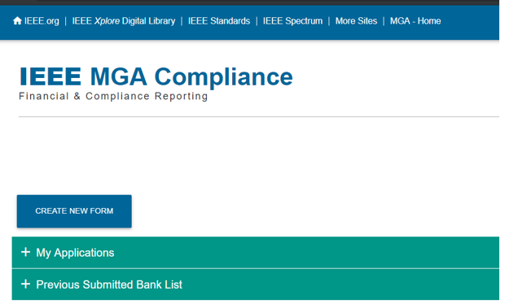
MGA Compliance Documents Portal
Geo Units are required to submit the compliance documents to IEEE
The MGA Compliance Portal for the 2023 Financial Reporting period will be available for Geo Units from January 1, 2024, to March 15, 2024
Access to the portal has been granted to Chairs, Vice Chairs, Treasurers, and Secretary Treasurers
The MGA Compliance portal includes the following:
Officer Information: Treasurer & Chair information
Audit Requirements: Relevant information regarding requirements & processes
Registration & Tax Compliance: Registrations with Government authorities, tax returns, etc.
Bank Account Disclosure: Authorized Signers & Local Bank Account statements
Additional Information: Compensation to individuals, office space, non-cash assets
Conferences/Events: Information regarding conferences sponsored by IEEE Societies

Slide 16
Annual Financial Reporting
Deadlines for 2023 Reporting Period
Third Friday of February (16 February 2024)
To qualify for the additional 10% rebate bonus
Last Day of February (29 February 2024)
To qualify for a rebate
Note: In addition to the financials, Geo Units must submit their Officer and Meeting reports in order to qualify for a rebate and 10% bonus. For information regarding deadlines, please contact the MGA Rebate Coordinator at mga-rebates@ieee.org.

Slide 17
Annual Financial Reporting
Reminder Emails for the 2023 Reporting Period
Financial Reporting first reminder including Tax Reporting was sent on Oct 13, 2023
Tax Reporting (1099 and Grants & Awards) second reminder to be sent on Nov 17, 2023
Tax Reporting (1099 and Grants & Awards) third and final reminder to be sent on Dec 22, 2023
Financial Reporting second reminder including the MGA Compliance Documents Submission via the web-portal to be sent on Jan 5, 2024
Note: The Financial Reporting Status for Region Treasurers via SmartSheet will be available on Jan 26, 2024

Slide 18
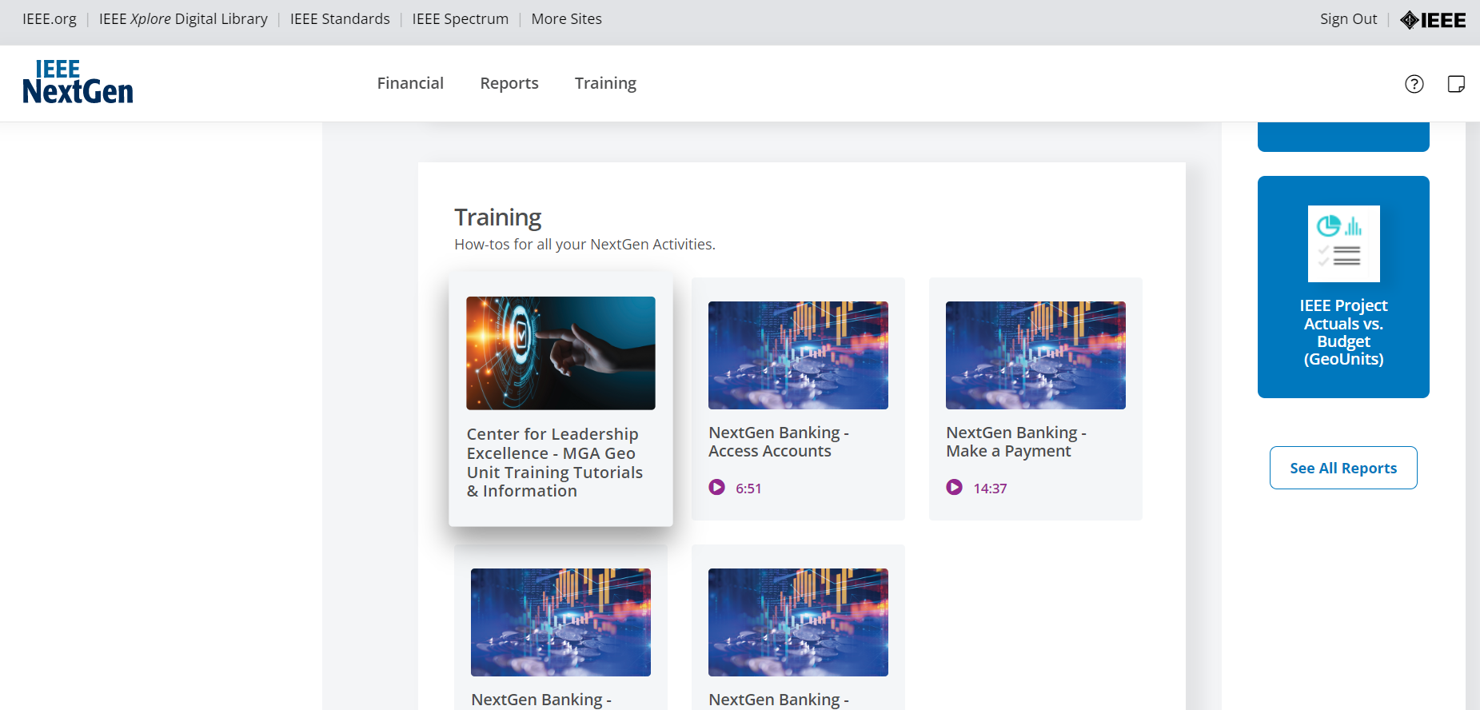
NextGen Training

Slide 19
NextGen Training
Banking Tutorials
ACH Payments
Check Payments
Domestic Wire Transfers
International Wire Transfers
IC Payments (CB to CB Transfers)
Account Balances
NextGen Banking Overview
Track Paper Checks
Download Investment Statement
Financials Cloud
https://ieee-elearning.org/CLE/
Bank Upload Template for CB Accounts
Bank Upload Template for Local Bank Accounts
Tax Reporting
1099 Tax Reporting for Regions 1-6
Grants & Awards Tax Reporting for Regions 7-10

Slide 20
MGA Finance Team
Teresa Sacks
Senior Manager, Business Financial Solutions
Tel: + 1 732-562-3962 Email: t.sacks@ieee.org
Financial Analysts
Lauren Jesch
Tel: +1 732-562-5321 Email: l.jesch@ieee.org
Regions: 1, 2, 6, 8
Vicky Li
Tel: +1 732 562 5596 Email: v.li@ieee.org
Regions: 3, 4, 5, 7, 9
Shravana Pandre
India Tel: 080 49 444394 Email: s.pandre@ieee.org
Region: 10
Contact us at finance-solutions@ieee.org

