Slide 1
NextGen Volunteer Adoption (NGVA) Ad Hoc Update
Gerardo Barbosa
NGVA Ad Hoc Committee Chair
21 October 2023

Slide 2
Contents
Committee Composition
Pilot Approach
High-Level Pilot Schedule
Iteration 1 Scope & Screenshots (completed)
Iteration 2 Scope & Screenshots (UAT in progress)
Iteration 3 Scope (development work in progress)

Slide 3
2023 Committee Composition
NextGen Volunteer Adoption Ad Hoc
Volunteers:
Gerardo Barbosa (Chair)
John Barr
Bill Fowlkes
Adam Jastrzebski
Joe Lillie
Joe Pennisi
Ken Pigg
Mary Ellen Randall
Jon Rosdahl
John Walz
Professional Staff:
Madhavi Alaparthy
Larry Bolsch
Morgan Cutts
Jon Gaughran
Sampath Heragu
Lori Keller
Anthony Patane
Tom Siegert
Linda Thiel
Priscilla Amalraj
Ray Borgone
John DeSimone
Donna Grey
Rich Jannuzzi
Barb Kmiec
Teresa Sacks
Suzanne Stiles
Mona Watekar
Notes:
Volunteers
Gerardo Barbosa (Chair)
John Barr
Bill Fowlkes
Adam Jastrzebski
Joe Lillie
Joe Pennisi
Ken Pigg
Mary Ellen Randall
Jon Rosdahl
John Walz
Madhavi Alaparthy
Priscilla Amalraj
Cherif Amirat
Larry Bolsch
Ray Borgone
Morgan Cutts
John DeSimone
Sampath Heragu
Jon Gaughran
Donna Grey
Rich Januzzi
Lori Keller
Barb Kmiec
Anthony Patane
Teresa Sacks
Tom Siegert
Suzanne Stiles
Linda Thiel

Slide 4
Pilot Approach
Pilot Approach:
Functionality will be developed in 6 iterations
Functionality will be validated incrementally and iteratively
There will be detailed specifications and acceptance criteria for each iteration
After each iteration, IEEE will review the outcome and will decide to either:
Continue to the next iteration as planned
Change course based on feedback from current iteration
Abort the Pilot altogether
Rollout Approach:
The functionality will be made available to the pilot participants in a test environment
Rollout to production will be at the successful completion of the pilot and will involve additional logistics
NextGen Volunteer Adoption Pilot - Sprint Iterations - Scrum (Agile Development)
Project Initiation (1-Aug to 4-Aug) | Iteration-1 | Iteration-2 | Iteration-3 | Iteration-4 | Iteration-5 | Iteration-6
 | 7-Aug to 6-Sept | 7 Sept to 6-Oct | 9-Oct to 27-Oct | 30-Oct to 17-Nov | 20-Nov to 8-Dec | 11-Dec to 22-Dec
W0 | W1-W5 | W5-W9 | W10-W12 | W13-W15 | W16-W18 | W19-W20

Slide 5
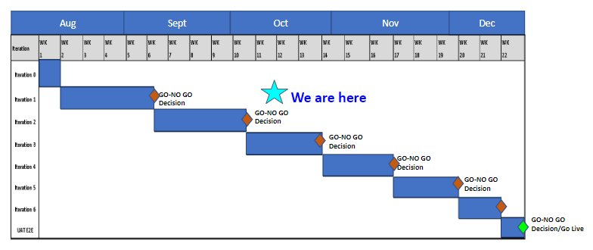
High-Level Pilot Schedule

Slide 6
Iteration-1 Scope
Downloading CB transactions from Coupa for the HOPs that the volunteer is entitled to
Viewing balances of the HOPs that the volunteer is entitled to
Downloading template for creating transaction files to upload
Downloading the tasks for a conference, Geo Units and Standards
Design and implementation of the transaction database

Slide 7
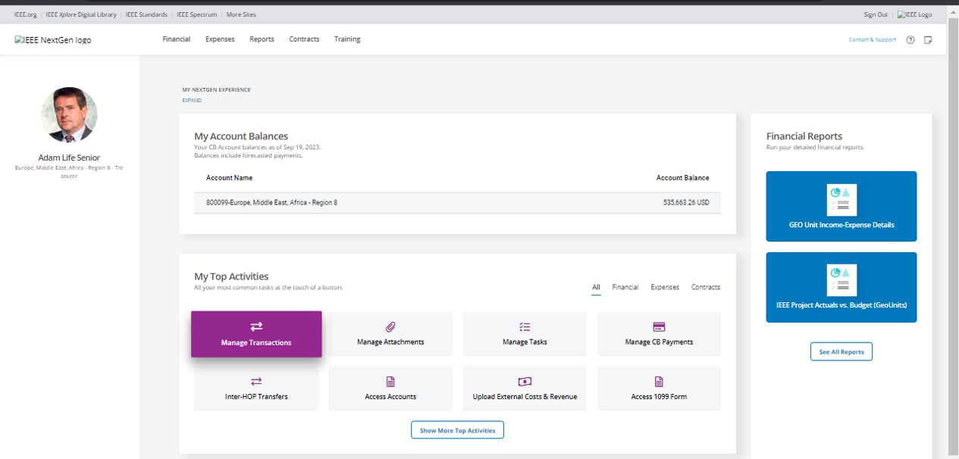
Manage Transactions Flow

Slide 8
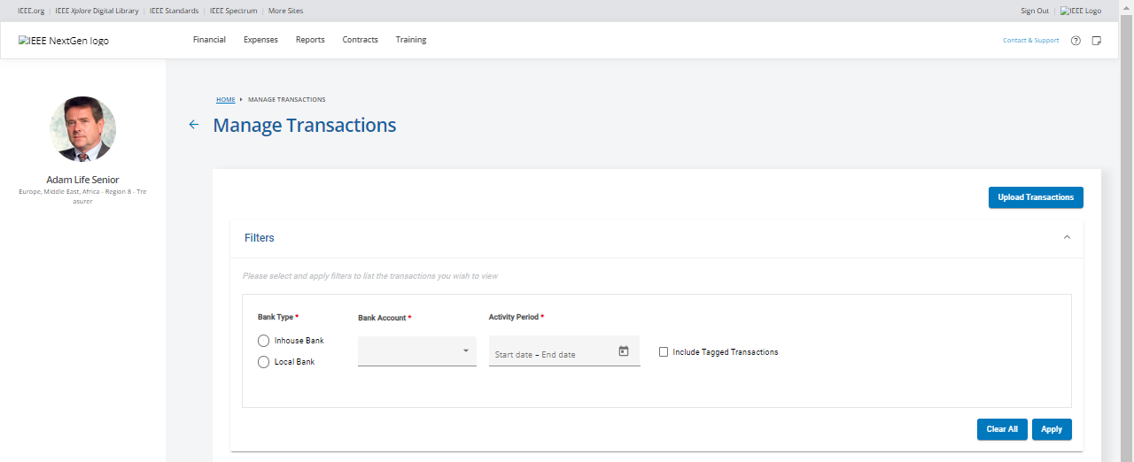

Slide 9
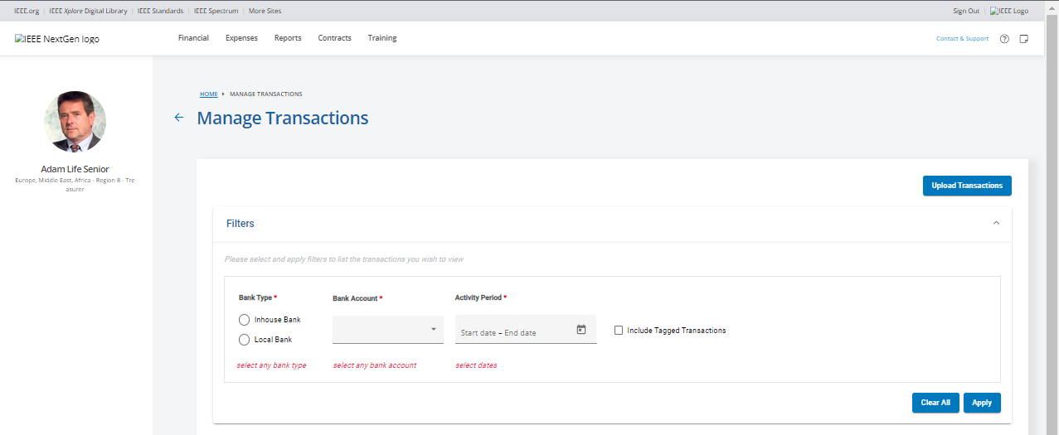

Slide 10
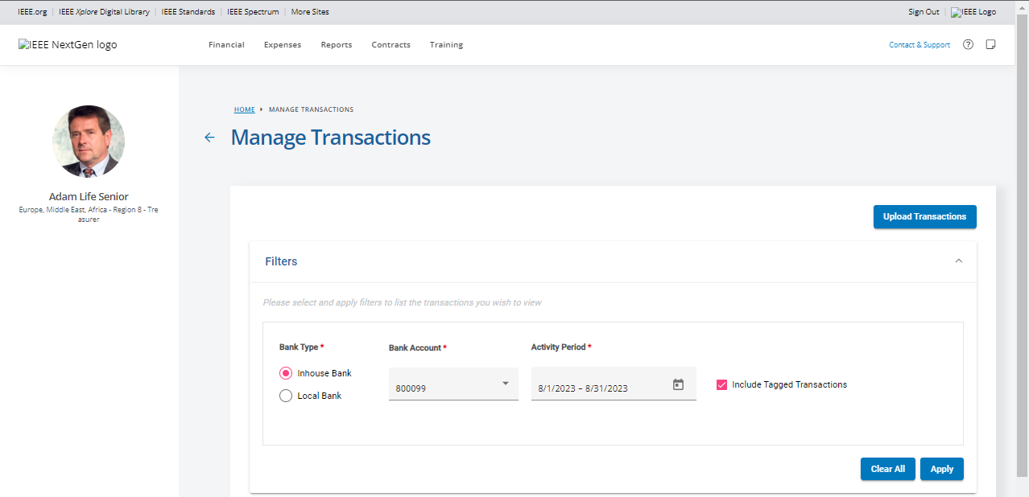

Slide 11
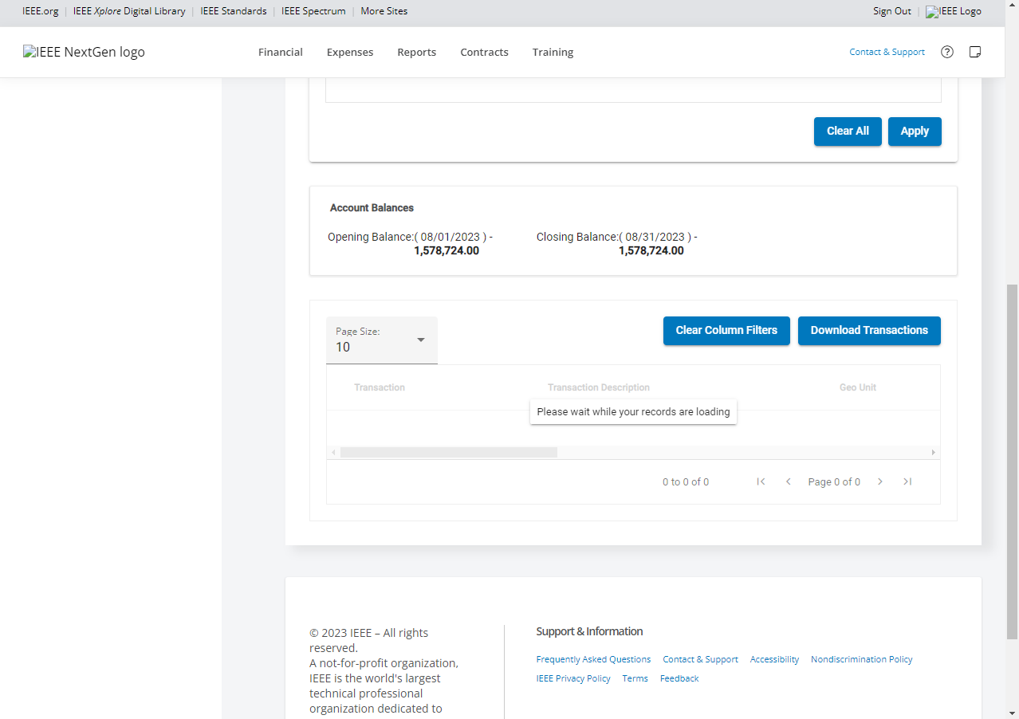

Slide 12
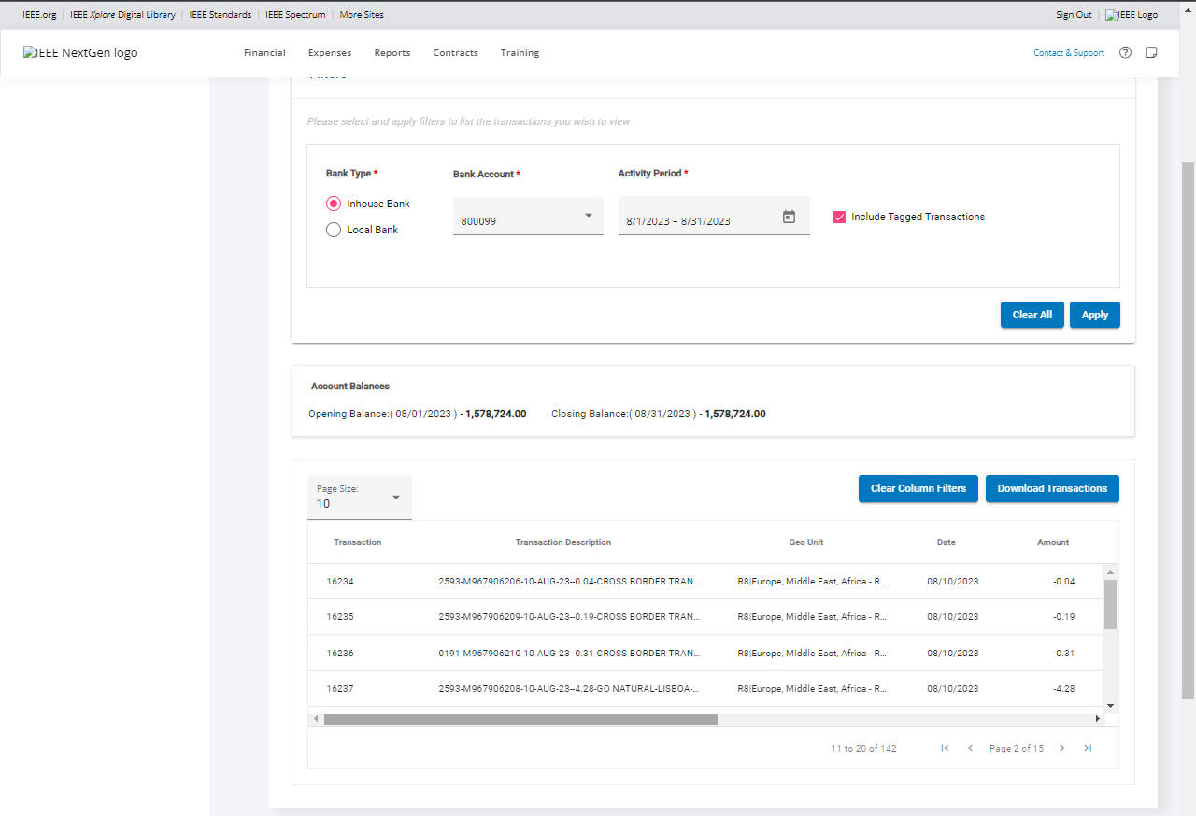

Slide 13
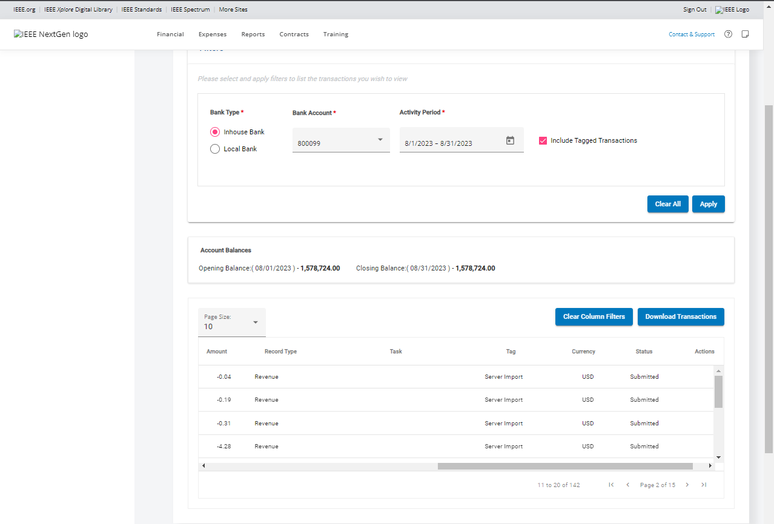

Slide 14
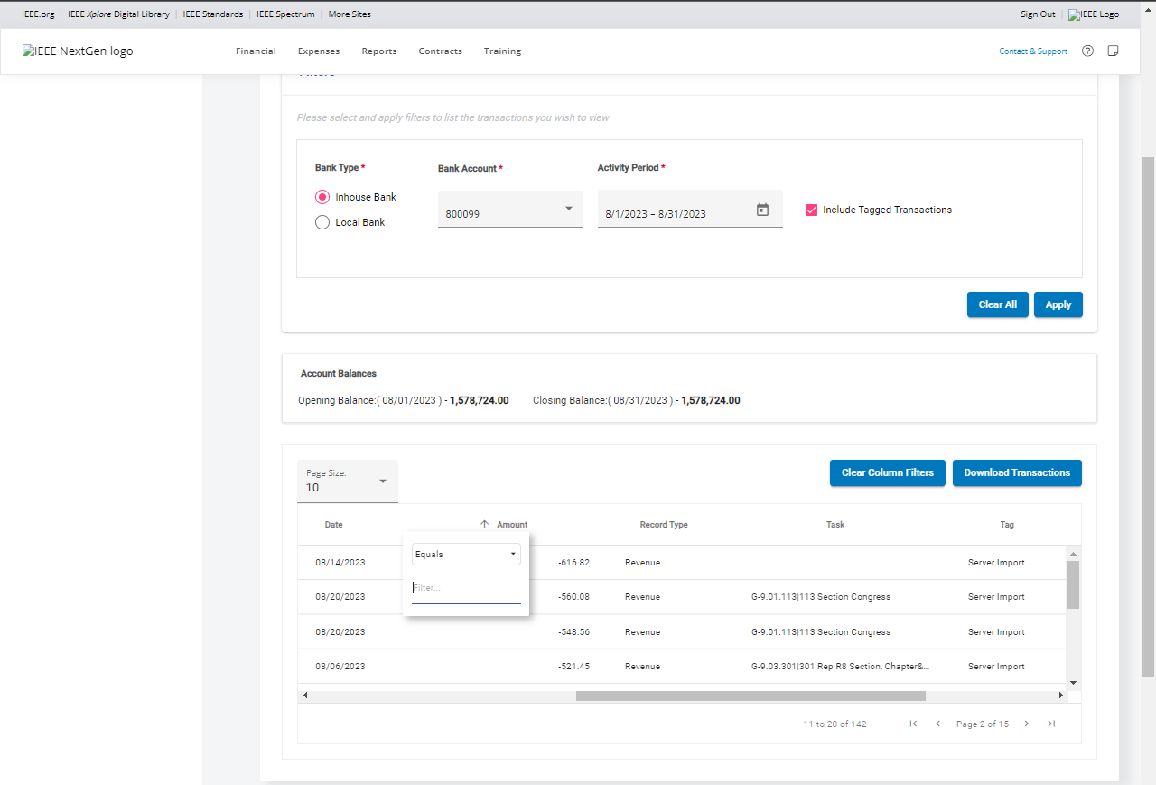

Slide 15
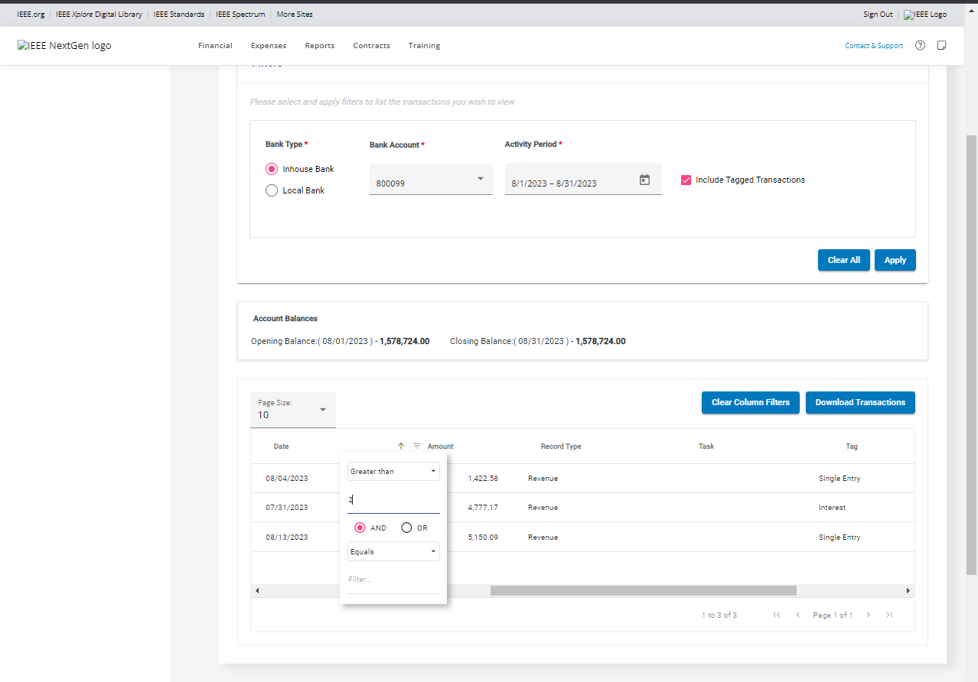

Slide 17
Iteration 2
Uploading tagged and classified (revenue/expense) transactions individually or in bulk (both CB and non-CB accounts)
Viewing and managing uploaded transactions (Staff)
Submitting CB payment requests*
Submitting inter-HOP transfer requests *
Reviewing and approving CB payment requests (Staff) *
* Development work began in Iteration 2 and will be completed in Iteration 3

Slide 18
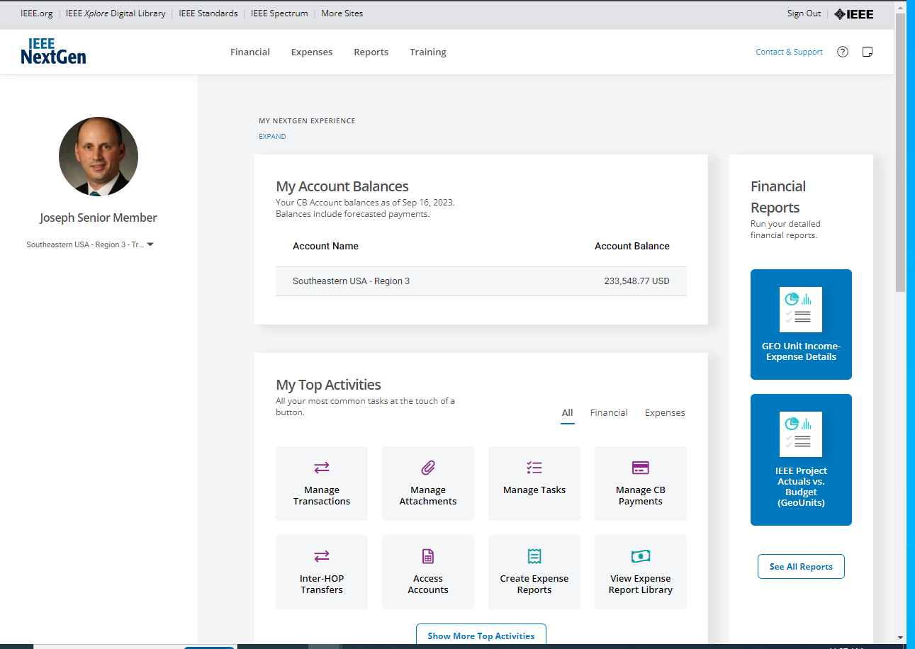
Dashboard after successful login

Slide 19
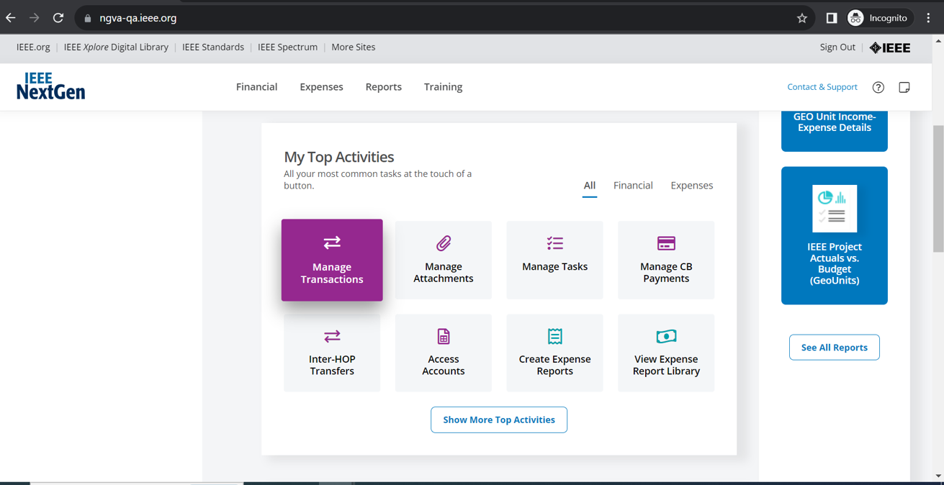
Manage Transactions

Slide 20
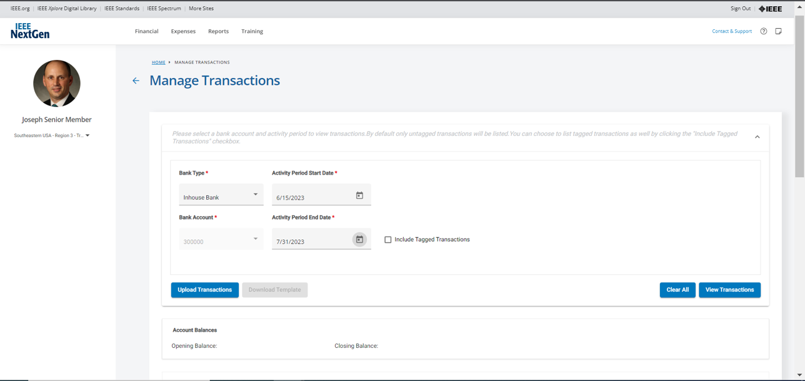
Manage Transactions - Inhouse Account

Slide 21
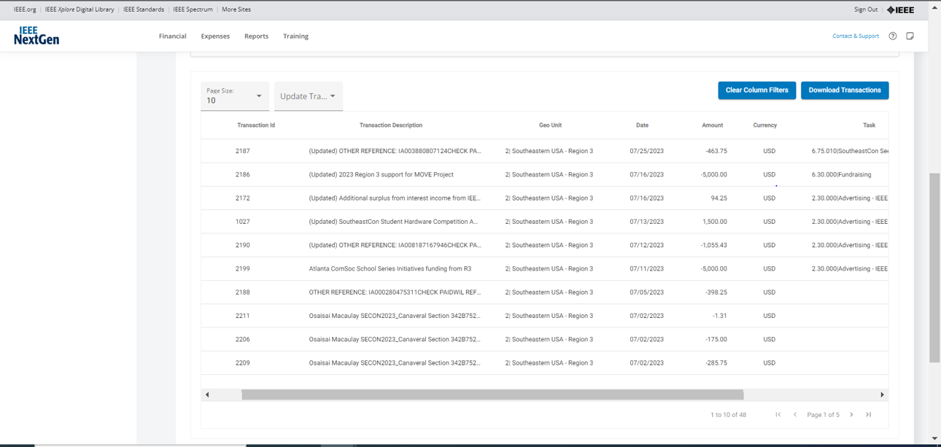
List of Transactions - Inhouse Account

Slide 22
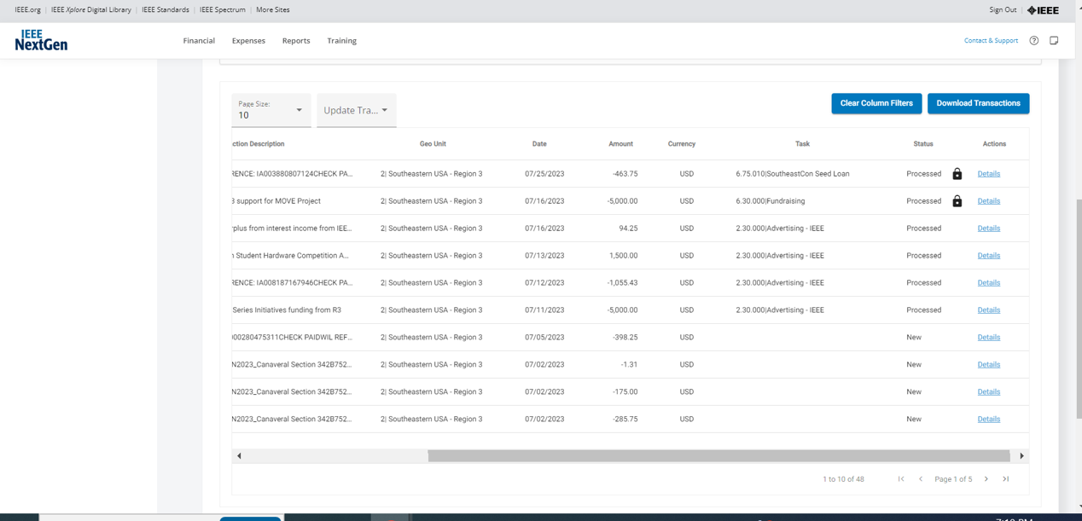
List of Transactions - Inhouse Account

Slide 23
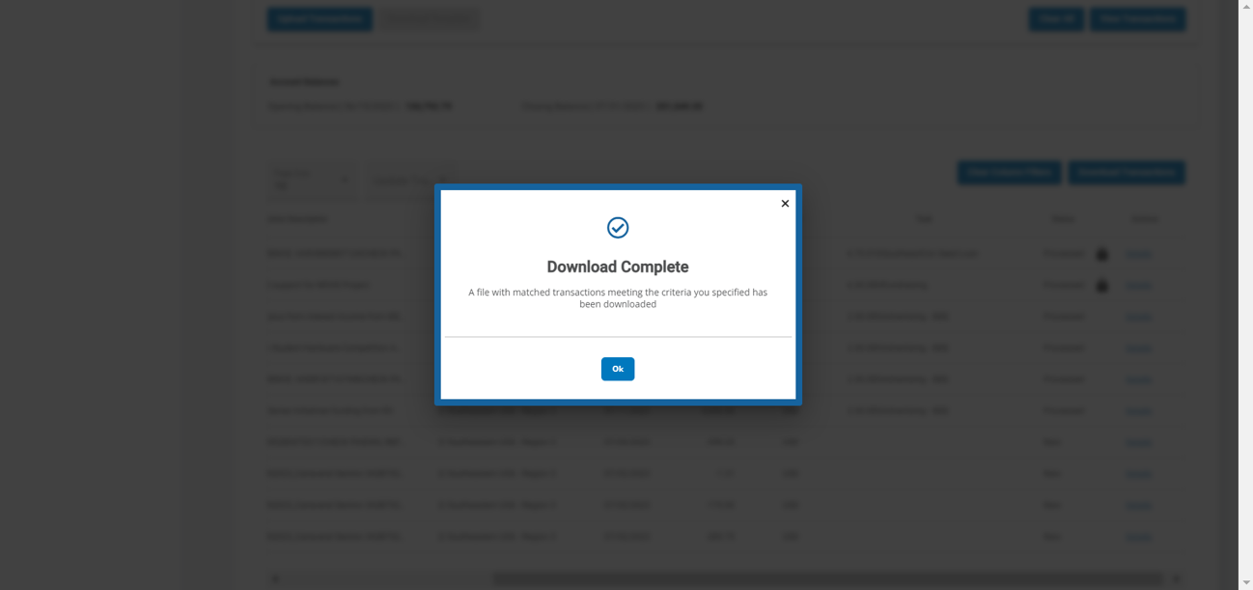
Download Transactions

Slide 24
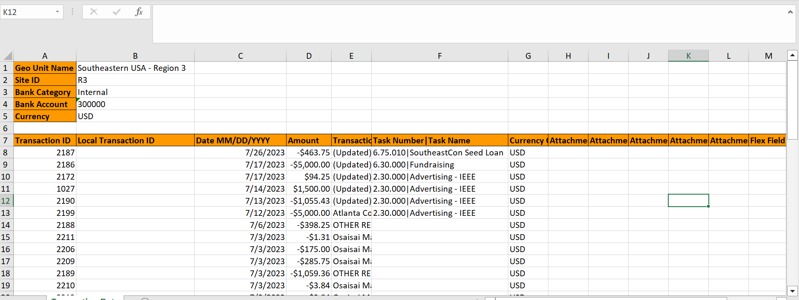
Downloaded Transaction File

Slide 25
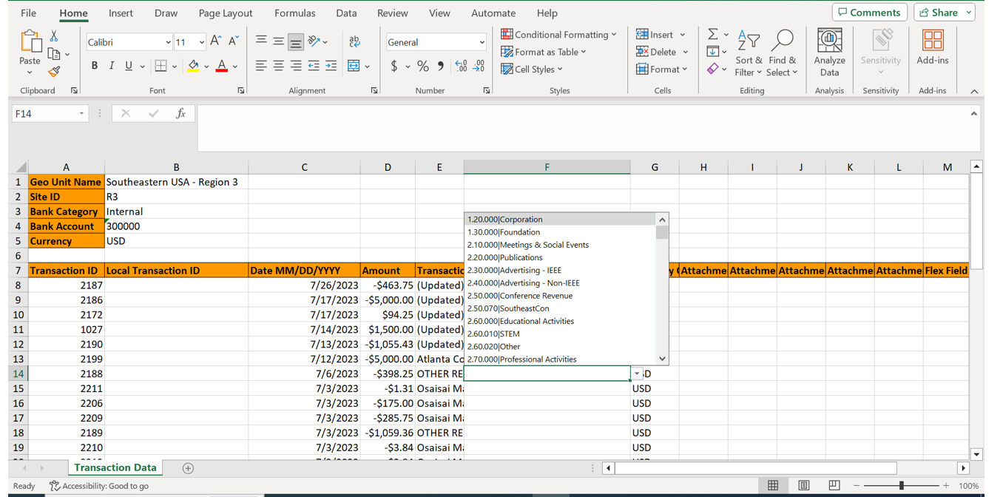
Task Assignment

Slide 26
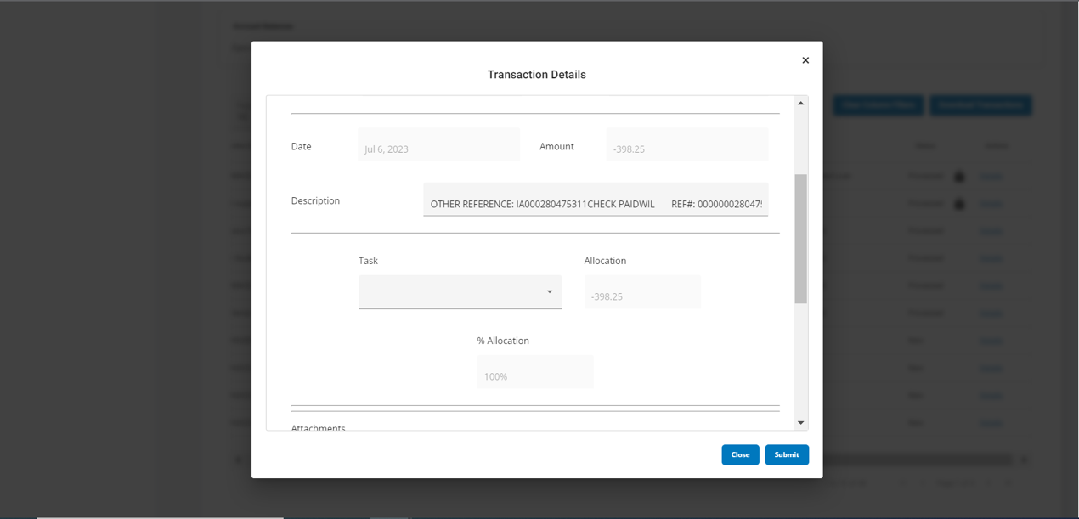
Transaction Details

Slide 27
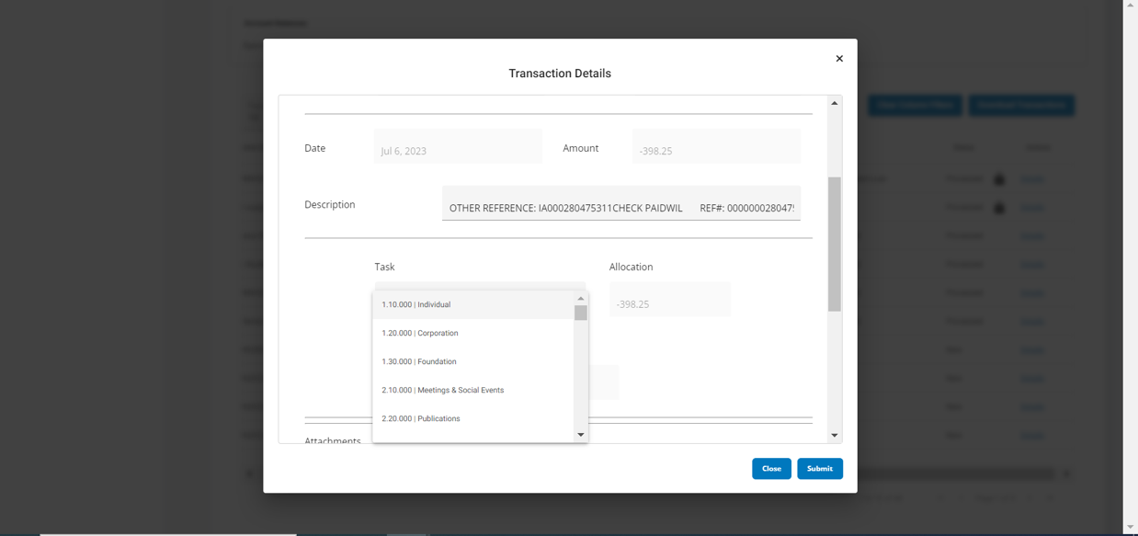
Transaction Details - Update Description & Task

Slide 28
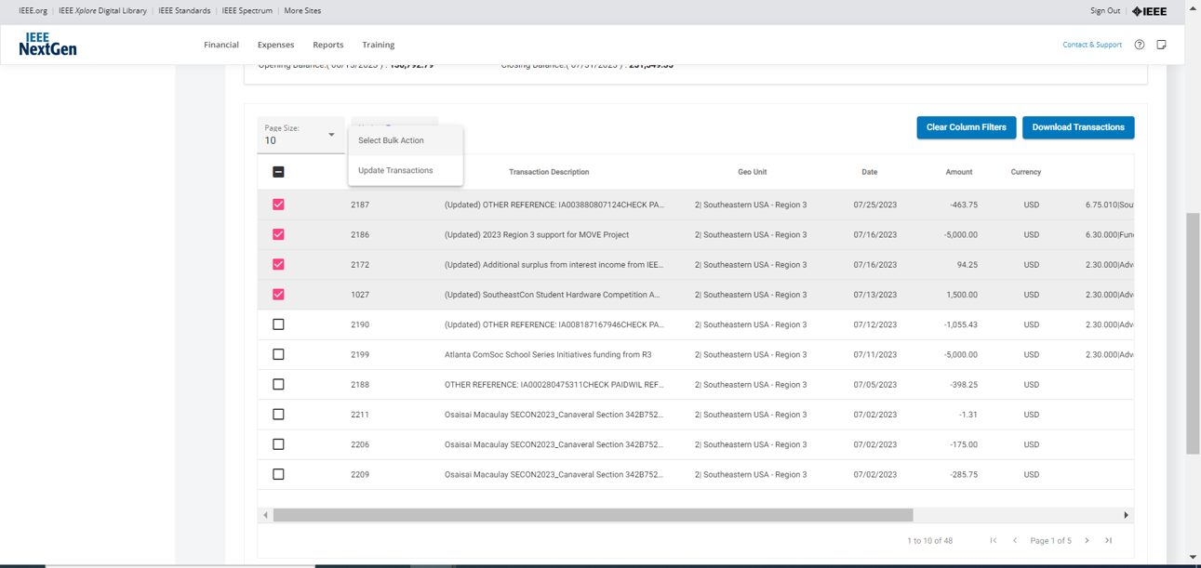
Transactions - Bulk Update

Slide 29
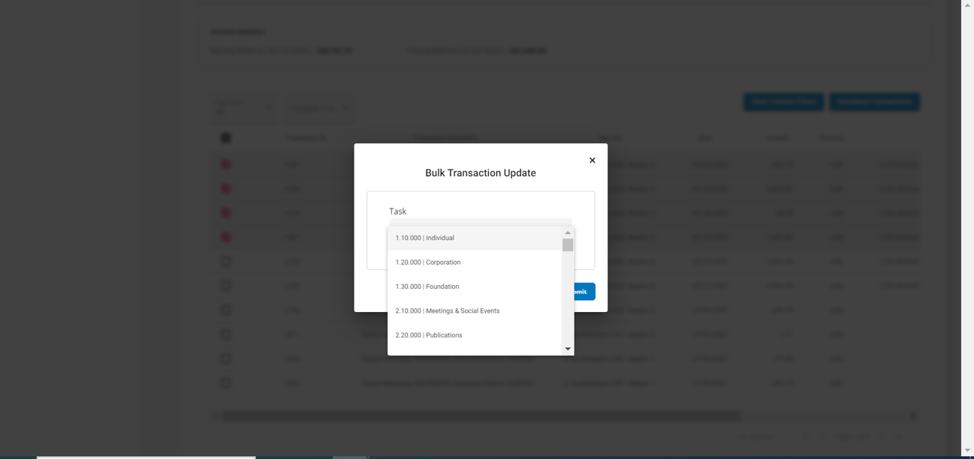
Transactions - Bulk Update

Slide 30
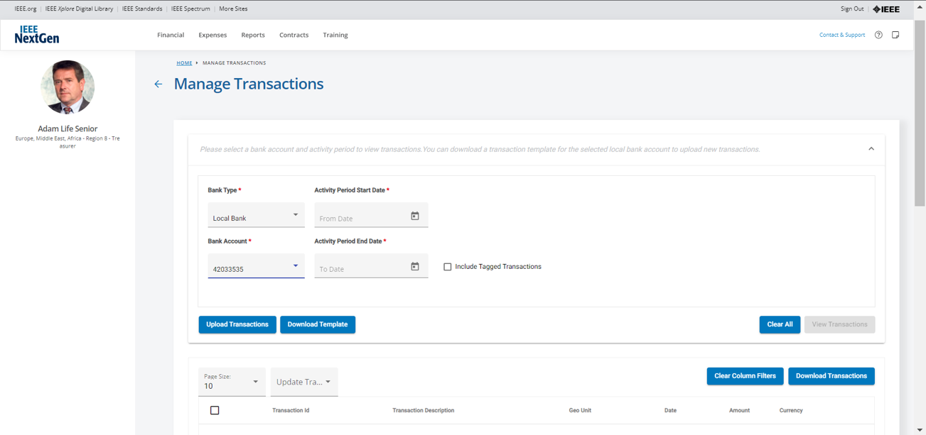
Manage Transactions - Local Bank Account

Slide 31
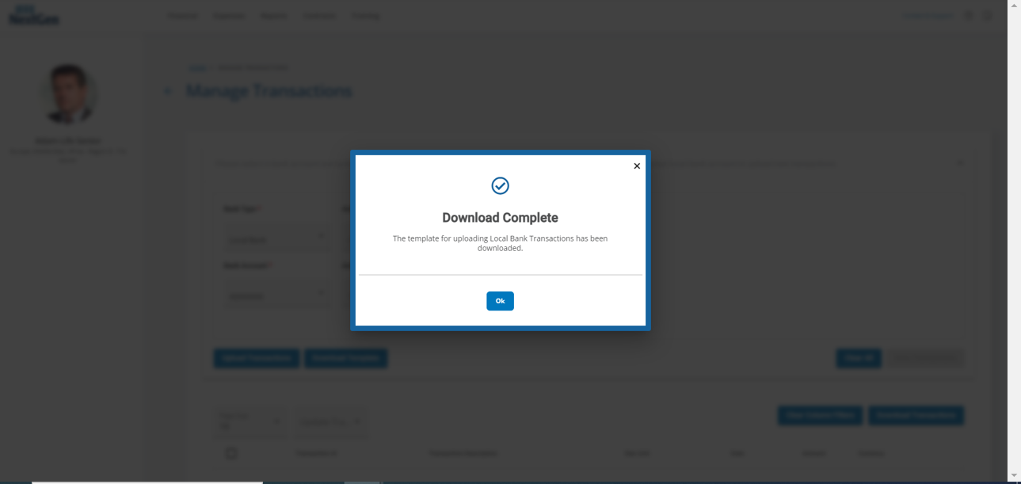
Download Transaction Template for Local Bank Account

Slide 32
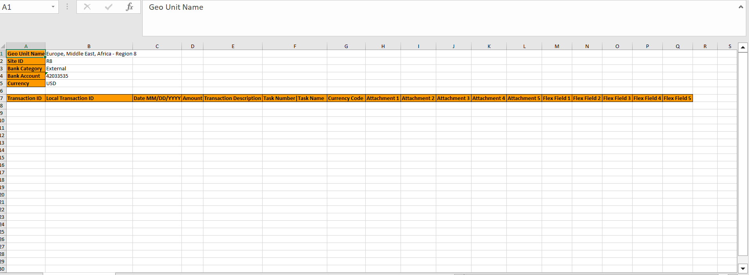
Downloaded Transaction Template for Local Bank Account

Slide 33
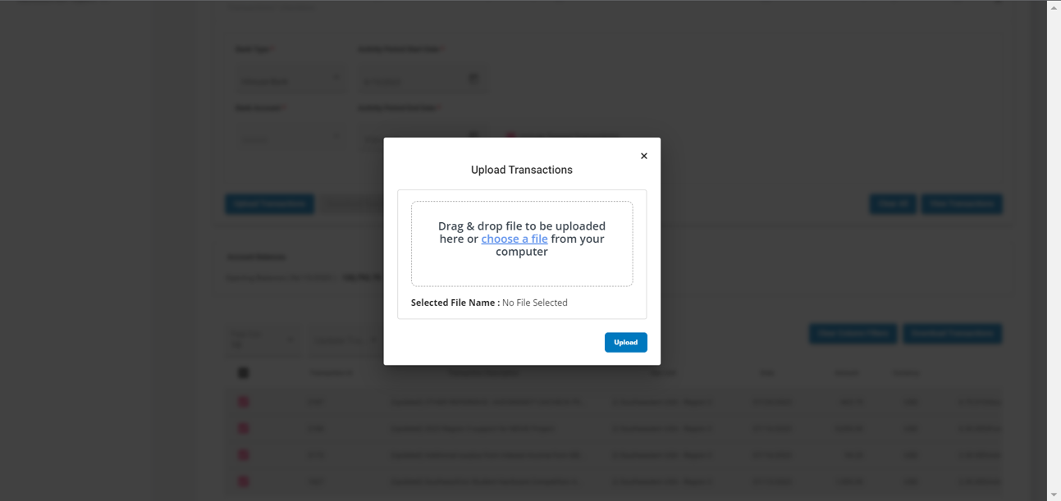
Upload Transactions

Slide 34
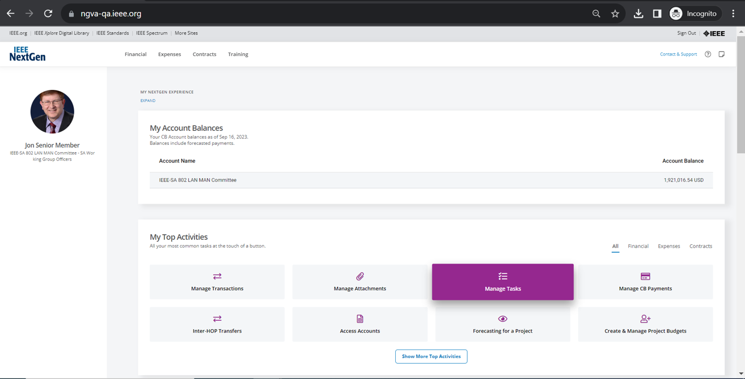
Manage Tasks

Slide 35
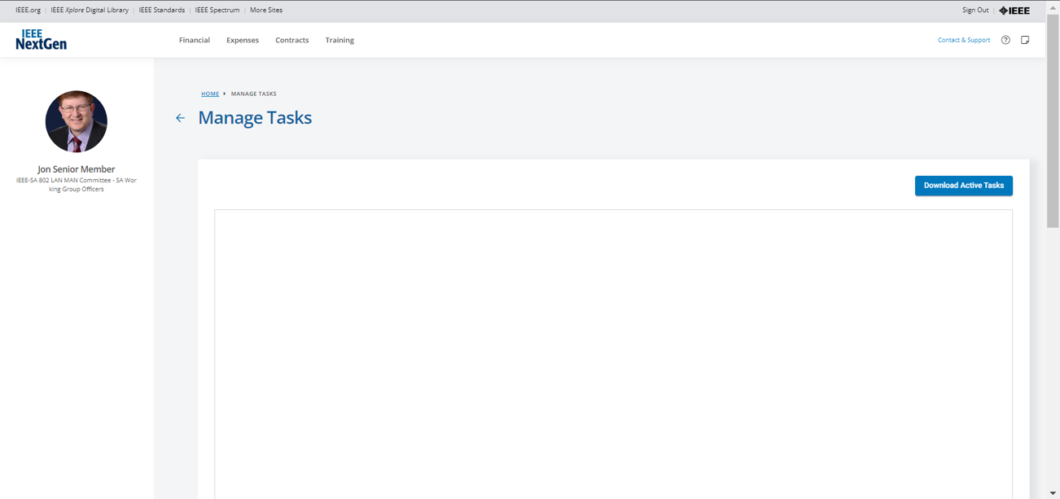
Download Active Tasks

Slide 36
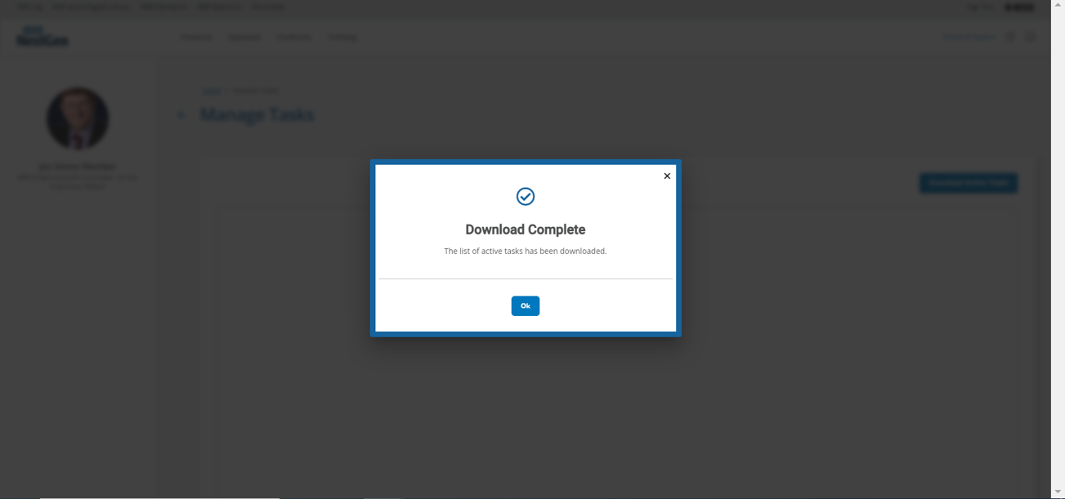
Download Active Tasks

Slide 37
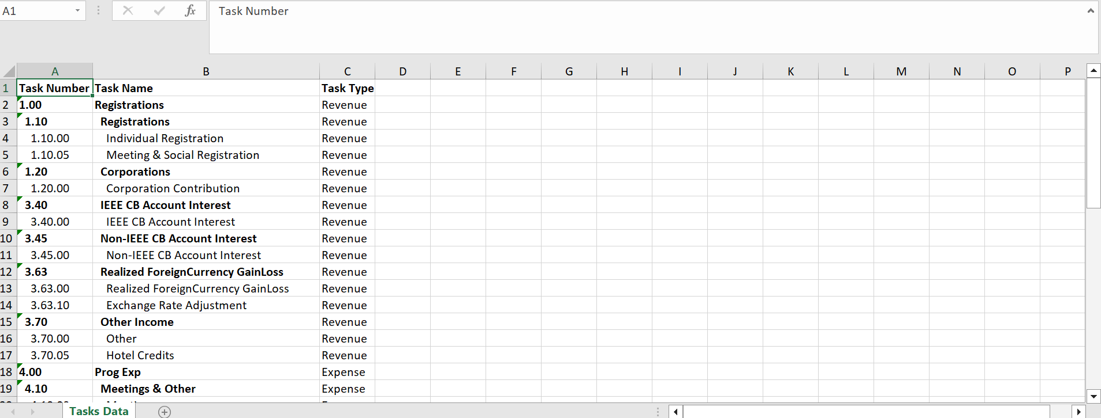
Downloaded Active Tasks for Standards

Slide 38
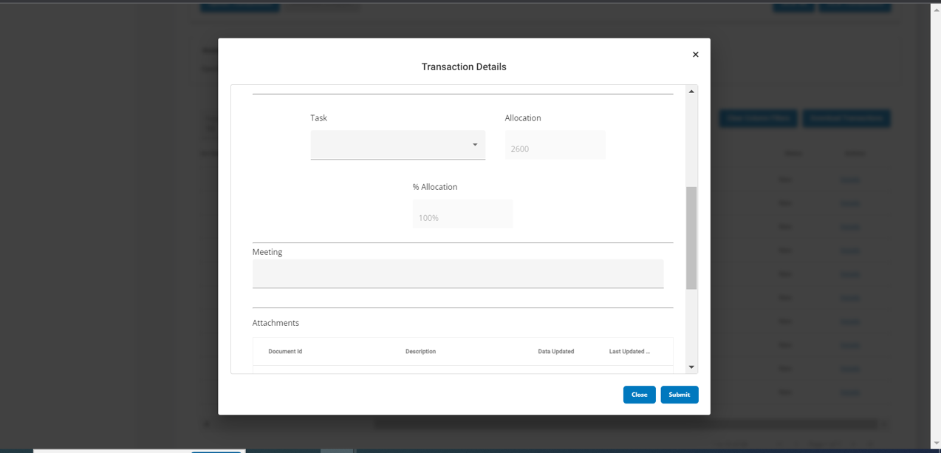
Standards - Flex Fields

Slide 39
Standards - Flex Fields

Slide 40
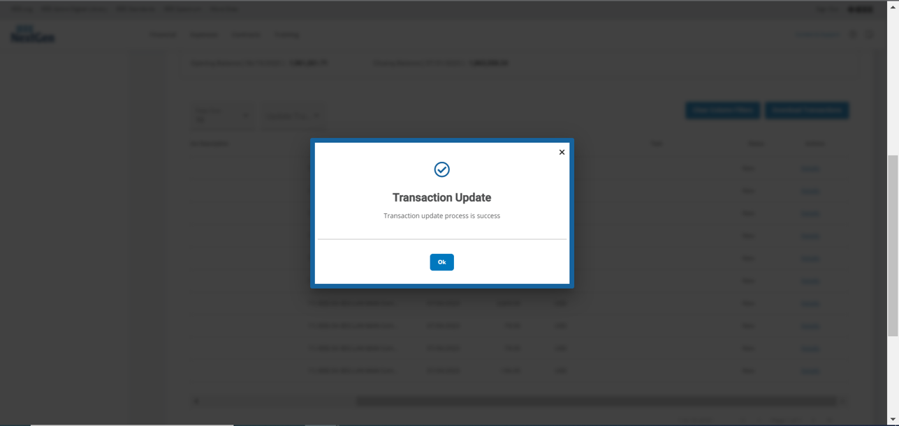
Standards - Flex Fields Update Successful

Slide 41
Iteration 3
Uploading and attaching documents to transactions
Periodic reminder notifications to volunteers to upload transactions in a timely manner
Committing conference and revenue/expenses to PPM
Submitting CB payment requests*
Submitting inter-HOP transfer requests *
Reviewing and approving CB payment requests (Staff) *
* Started during iteration 2

Slide 42
Thank you

