Slide 1



IEEE Membership Marketing
Member & Geographic Activities
Staff Lead: Elyn Perez, Senior Manager, Member Market Development

Slide 2
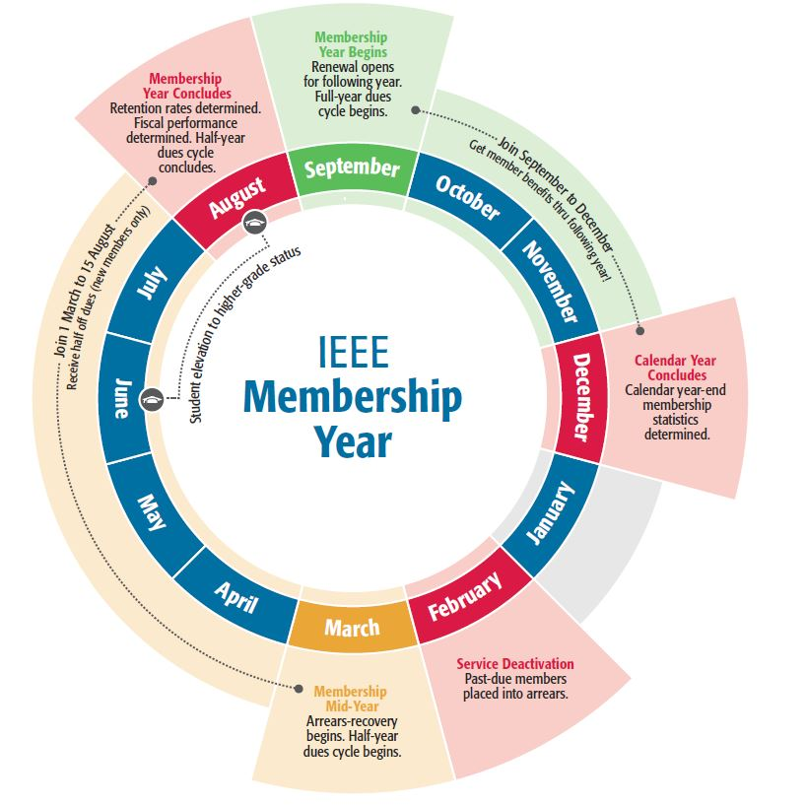
What we will review
Membership year cycle
How membership grows
Membership marketing efforts
MD team programs and support
What’s New in 2024
Member dues revenue trends

Slide 3
Membership Year Cycle
Understanding where we are in the membership cycle helps define our message, for example:
When to promote renewal
How to position joining IEEE in October versus March
When to alert members who haven’t renewed to do so before their benefits are deactivated
Grade elevations

Slide 4
2023 membership year ended with 7.4% growth YoY
Milestone: First time ever that we have surpassed the 400,000 member mark by August, the end of a membership year
Strong recruitment was the main driver
Notes:
We recruited 132,883, or 25.8%, more new members this year compared to last year
Student recruitment drove almost 90% of this, and is up 28.1% YoY
Higher grade recruitment is up 16% over last year
Every Region showing recruitment gains – notable was R1-6, +8.7% and R9, +71.7%
Reinstatement activity ended the membership year up 8.9%, well above the 5% average
Retention of members is the big challenge – students don’t renew as often and has impacted our overall retention results
We managed to retain 3% more students this compared to last year, but not enough to offset a decline in the rate of renewal which for students fell by 5 percentage points
Final overall retention rate was 66.2%, compared to 69.2% last year
HG retention was fairly steady, 78.1% compared to 78.4% last year

Slide 5
How Membership Grows
Retention is the biggest determinant of whether total membership will grow year-over-year
Total membership in August is the renewal opportunity for the following membership year
2023 Renewal Opportunity = 376,128
60% of lost members are first-year
127,084 members lost
2024 Renewal Opportunity
~408,000
2023 Renewals
249,004
New Recruits
132,383
Reinstates
22,490
September thru August

Slide 6
Membership Retention by Tenure - Total
Engagement in the first 3 years is most critical for member longevity
Retention Rate
Cumulative Years of Service
Data: as of 15 August 2023

Slide 7
Membership Development Programs and Support
Membership Development Programs and Support

Slide 8
Membership Marketing Summary
Channel | Tactic
Retention/ Engagement | Standard renewal outreach series Member Benefits Bulletin monthly newsletter SMS text messaging pilot for the US Recent Grad Outreach Elevation Outreaches New member onboarding email series Post-renewal email series Promote auto renewal sign up Loyalty recognition badging Social media
Recruitment | Ongoing direct outreach (internal data sources) Third-party direct outreach (external data sources – new lists) Lead generation and lead nurture programs Digital advertising Programmatic advertising (podcasts, streaming TV) Social media
Reinstatement | Annual direct mail with retargeting digital ad campaign Email series
Areas of special focus and/or segmentation within each tactic:
Students
Recent Grads and YP
US HG membership
Continuing programs that contribute to all channels:
Member-get-a-Member
Gift of Membership
IEEE Day
Notes:
Direct Outreach
Internal – based data and testing, continuous improvement to content, layout, landing pages
Third-Party
First Year Experience
Being re-vamped for 2016 to include additional touchpoints, more focus on a plan that can be executed by local Sections.
Collabratec Community
Digital Advertising
Google AdWords, You Tube, LinkedIn, Gmail, Bing, IHS
Senior Member Elevation upgrades
SM elevations and applications on the rise since September
Volunteer Engagement

Slide 9
Section and Conference MD Support
Monthly membership development webcasts for Section and Region volunteers
  On average, 80 attendees per month
Section Membership Development annual goals and recognition program
  All Sections have unique goals for recruitment and retention based on the 4-5 year historical performance
  Formal recognition for goal achievement – Accredible platform
Virtual and on demand training for section leaders and Section Action Plan development
Printed membership collateral and promotional items to support in-person events
Support for conference organizers and Societies
IEEE Proprietary

Slide 10
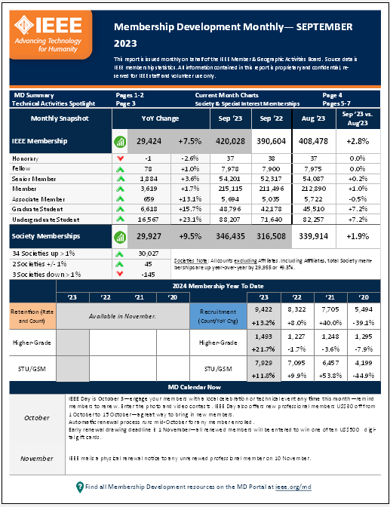
‘MD Monthly’ Statistics and Trends Report
Statistical pulse
Membership Trends
Goal Achievements
MD Calendar guidance
MD-related announcements, activities
Posted in the Membership Development Volunteers Community in Collabratec, and on the MD portal

Slide 11
What’s New for 2024
Initiatives that focus on retaining students, growing HG membership, cost savings

Slide 12

Reducing printed renewal notices and ack packs delivers significant cost savings
Building on digital transformation efforts
Leverage emails to drive renewal activity earlier, thereby reducing the number of mailed statements
  Mid-September: email campaigns commence
First mailed paper notice (‘1st Notice’) to be sent 10 November (was previously 1 October)
  Allow the emails promoting early renewal drawing deadline of November 1 to drive most activity before mailing
  Eliminates one entire print cycle
Second mailed paper notice is sent in early January
Third mailed paper notice is sent 1 April
Update on ack pack cost reduction:
  In 2023, ack pack default was electronic (PDF) only; members had to opt in to receive a printed card
  Just 6% of eligible members requested a printed card
    R9 was the lowest, 2%; US Regions highest, 7+%

Slide 13
Initiatives that focus on expanding the digital transformation and marketing efforts started in 2023
Paper and Postage reduction / Digital Acknowledgement Packages
Upgrade the member experience
  Digital membership card/ mobile wallet
  New design for membership cards uses QR code functionality
Increase automatic renewal enrollment
  Incremental efforts to generate more sign ups
Continue testing new communication channels with our members
  SMS/text
  Ringless voicemail
Advertising campaign launched in September that encompasses digital, social, podcast and video advertising

Slide 14




New membership marketing campaign “With IEEE”
Spanning print, digital, search, social media, and programmatic efforts
Emails, digital ads, streaming TV and podcast audio
Printed materials available to order online
Print-ready PDF’s available for download and local printing
ieee.org/mdsupplies

Slide 15
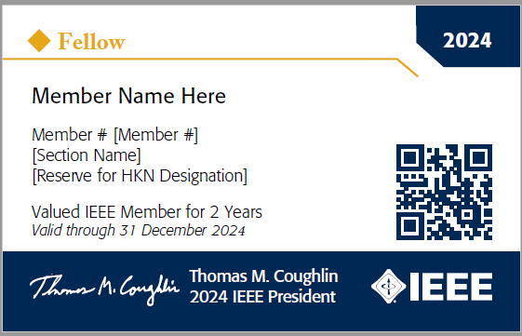

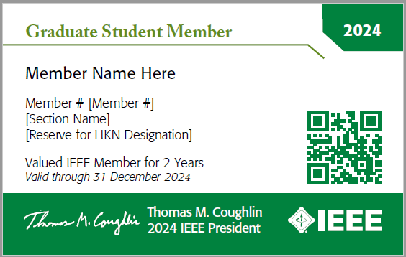
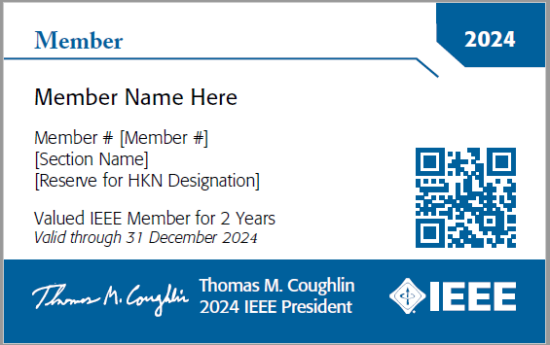

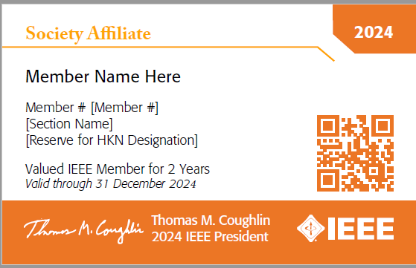

Membership cards get an upgrade and allow for digital wallet functionality
Refreshed design adds more definition and differentiation among grades
QR code functionality will add a member card to a digital wallet
  Limited information - digital cards aren’t designed for visual appeal
  Name, member number, effective dates, Society memberships
  Leveraging work done by the IEEE App team for this

Slide 16
2023 Pilot Initiatives Update
Recent Grad Stepped Dues (2020 Board Motion):
  2023 membership year results showed increased retention with discounted offers
  Although the discounted offers generate higher retention, overall dues revenue is lower than the non-discount Control segment
    2-5PP higher retention rate, but 13% lower revenue
  Using a promotion code approach offsets some of this revenue loss - only half of members take advantage of it
  This pilot is scheduled to run through the end of the 2025 membership year
Multi-Year Membership Option (Sections Congress 2020 Recommendation)
  Choice of a 1-year membership at regular dues, a 3-year membership at a 10% discount, or a 5-year membership at a 20% discount – targeted first-year renewing members in US and Canada
  In the 2023 membership year, 3.6% opted for a multi-year membership discount option
  In 2024, expanding to EU/non-developing nations and conducting a survey to those that took it to understand why

Slide 17
Member Dues Revenue Trends

Slide 18
Total Member Dues Revenue 2013 - 2023
(US$000)
Data as of 15 August annually

Slide 19
Dues Revenue Trends by Category 2013 – 2023
*Data as of 15 August annually. Does not include assessments, society membership dues, etc.

Slide 20
Dues Paying Membership Counts 2013-2023
*Data as of 15 August annually. Does not include Society Affiliates.

Slide 21
Questions?
Contact: Elyn Perez, elyn.perez@ieee.org
Elyn Perez
elyn.perez@ieee.org
MD Portal: ieee.org/md

