Slide 1
MGA and Geo Unit Business Finances
21 October 2023
Lori Keller – Senior Director, MGA Finance
Teresa Sacks – Senior Manager, MGA Finance
IEEE Proprietary

Slide 2
Agenda Topics
Flow of Funds to Geo Units
Allocation Model - MGA to EA & Spectrum
Geo Unit Reserves and Spending Rules
Surplus Process for MGA
Regions & Sections Source & Use of Funds
Collaboration and Key Treasurer Deliverables
Region Allocations, Section Rebates and Region Assessments
Compliance, Internal Audit Overview, Best Practices
Questions and Staff Contacts
Appendix
IEEE Proprietary

Slide 3
Flow of Funds
IEEE Proprietary

Slide 4
MGA 2023 Member Dues Distribution
Net Conference Proceedings & Other Revenue
$25.1M
Member Dues $31.3M
Conference proceedings revenue supplements Member Dues funds allocated to MGA
Spectrum $6.3M
MGA Admin
Information Systems
Region, Section & Chapter Support
Geo Unit Operational Costs
IEEE tv
Affinity Groups
MGA Contact Center/Renewal Ops $5.9M
MGA All Other Areas**
EA $5.2M
MGA Membership $4.2M
Infrastructure
$2.3M
Geo Unit Rebates $3.8M
MGA Support $3.6M
MGA Expenses
FOM 30% Rule - Member Dues contributes 7.5% of dues annually to support 30% rule
* Includes Fellows, YP & Collabratec
IEEE Confidential
IEEE Proprietary

Slide 5
Geo Unit Reserves & Spending Rules
Reserve Balances as of 12/31/22:
Geo Units: $28.0M (Sections) & $8.3M (Regions) = $36.3M
MGA: $40.0M
Spending Rules:
1% Rule: 1% of Reserves on a 3-year average can be used for OU Projects
MGA uses its 1% for Sections Congress
TAB 3% rule for Societies rolls up to 1% for TAB
50% Rule: each major OU can use 50% of prior year Operating Surplus in Current Year Forecast (certain conditions apply)
IEEE Proprietary

Slide 6
MGA Surplus Background (50% Rule)
The calculation is performed by IEEE FP&A and BFS (Business Finance Solutions) after the previous year’s financial results have been audited.
The timing is typically around end of May – beginning of June.
The calculation is based on the change in MGA net assets from the previous year and reduced by investment gains.
This does not include Regions/Sections assets or investment gains.
MGA could utilize 50% of the surplus funds for projects not included in the original Budget.
This surplus could be spent on projects that will be completed by end of the calendar year.
MGA Surplus Funding will not be available for projects after a Sections Congress year.
The request for projects shall be sent to Regions at the February Meeting Series.
IEEE Proprietary Do Not Distribute
IEEE Proprietary

Slide 7
MGA Surplus Process
Guidelines on Requesting MGA Surplus Funding
Project of less than $10,000 shall not be considered
As per the IEEE FOM, cash awards shall not be funded as part of this project
Preference will be given to those projects that include:
Cross Region projects with benefits for multiple Regions and broad groups of members and member retention
Review of Submitted Projects
MGA FinCom shall perform the initial screening of projects
A project evaluation committee shall consist of MGA OpCom and the immediate past Treasurer to review all proposals screened by MGA FinCom
The Project evaluation committee shall rank all projects and recommend projects to MGA Board for approval
Number of projects shall be limited by total fund available for that year
Project Tracking & Reporting
Each project will provide a progress report after 3 months and a final report at year end
IEEE Proprietary Do Not Distribute
IEEE Proprietary

Slide 8
Treasurer’s Deliverables in Collaboration with IEEE Staff
Supporting Schedules and Reports
Schedule of payments to individuals
1099 January 10
Grants & Awards
Compliance forms via online portal
Business Process (by Jan 31)
COI/POBC (Conflict of Interest and Principles of Business Conduct)
Financial Report
NextGen Banking
Banking
Rebate for Unit Operations
Financial Report
Compliance (begins Jan through the year)
MGA Budget
Local Bank Accounts
IEEE Investment
Non-IEEE Investment
PPM Reporting
For Local Accounts
Year End Statements
Updated Signature Card
Current Officers
Meeting Activity
Reporting to be received
By third Friday of February for 10% incentive bonus
Volunteer Meetings
Registration or regulatory actions reported
Audit requirements, all Regions and Sections > $250K plus random
Additional Reviews
Capital assets
Local Bank Accounts not reported
Contributions
NextGen Concentration Banking (available mid January)
By last day of February to receive rebate
Key Deliverables:
1. COI/POBC (Conflict of Interest and Principles of Business Conduct - 31 January
2. NextGen Financial Reports - Last day of February for rebate – Third Friday of February for 10% bonus
3. Audits required by 30 June for Units noted earlier
IEEE Proprietary
Notes:
Check with Teresa any changes

Slide 9
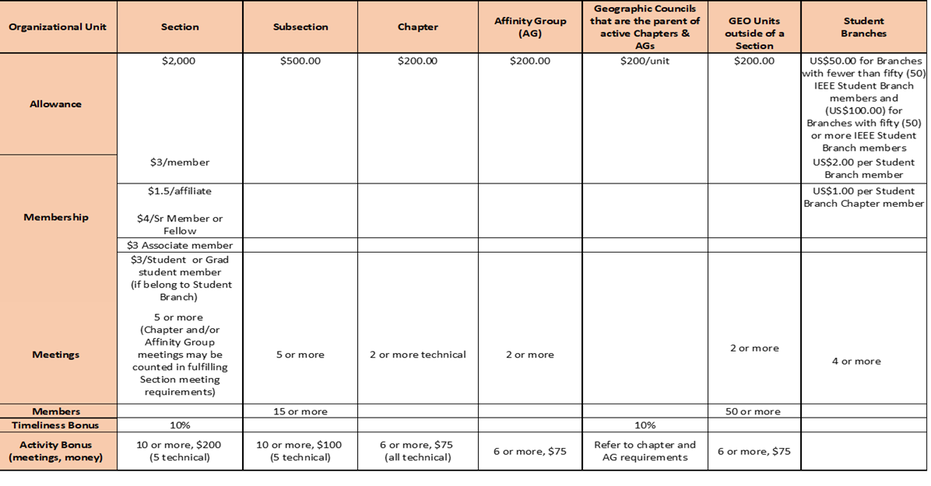
Rebate Grid Updated
Note: Must Comply with annual reporting and activity requirements
IEEE Proprietary

Slide 10
Source Examples of Incoming Funds
Regions may have Section Support programs in place
Societies may have programs to support Section/Chapter activities
Workshops, Tutorials, Conferences
Other IEEE GEO Unit Programs: IEEE-USA, Life Members
External Sources (Industry support)
Contributions & Region Assessments
Reserves and IEEE Spending Rules
IEEE Proprietary

Slide 11
Uses of Funds
Local events
Chapter Support
Student Branch Support
Affinity Group Support: PACE, WIE, YP
Life Members, Sections Congress
Scholarships, Grants, Awards, Distinguished Lecturers (see policy)
Publication and Advertising expense
Travel related to meetings and events
IEEE Proprietary

Slide 12
Region Allocations
Region Allocations:
2010 MGA Fin Com & MGAB Approved a methodology for the 12% IEEE Bylaw & Policies dues allocation to distribute to Geo Units (re-approved in 2014)
12% of Dues distributed to Regions, Sections, Chapters & Student Branches will receive a share based on financials, officer & meeting reports
$3M to Geo Units and Branches and $1M to Regions (approximately)
Allocation Formula to regions (3 part)
Number of Members, Number of Active Sections, Travel Factor in R 7-10
Weighted & used as a methodology to distribute to regions
IEEE Proprietary

Slide 13
Region Assessments
Region Assessments (USD) -Increase request process attached:
R1, R5, R10: $5
R2, R3: $2
R4, R6: $3
R7: $19
R8: $13
R9: $4
1. No Assessments: Life Members, Students & Graduate Students
50% Assessment: Retired, Unemployed, Recent Grad, Min Income
New Members between 1 Mar & 15 Aug = 50% dues & 50% assessment
IEEE Proprietary
Notes:
Teresa sends out funding assessment on monthly basis, Geo Units can reconcile to their accounts.

Slide 14
Audit & Compliance Process
Conflict of Interest/Principles of Business Conduct form is due by Jan 31, Compliance Documents (including local bank account statements) are due by the last day of Feb, Meeting and Officer Reports are due by March 15
IEEE Policy and FOM require annual (internal or external) audit for GEO Units with ≥ $250K revenue, Regions and additional based on Internal Audit Judgmental Selection
External audit firm must be pre-approved by Internal Audit Staff
Other internal audits are performed annually -- Audits are recommended in cases of Leadership Transition
Bank Balances are confirmed independently by IEEE Audit Firm
Controls over cash have been improved & audits are rated based on findings (see Internal Audit Team here today)
IEEE Proprietary

Slide 15
Financial Best Practices
GEO Units should comply with the yearly financial reporting schedule.
Section Chair & Treasurer should periodically review the original monthly statements of account & compare them to recent financial report in NextGen
It is recommended that Treasurers review account activity and tag transactions each month
Good practice for all GEO unit leaders to review account activity
A periodic review with Executive Committee should be standard procedure
More than one person should oversee financial records
IEEE Proprietary

Slide 16
Financial Best Practices
A new bank account (CB or Local Bank Account) should be established for any conference activity and closed when the conference has commenced
Conferences should be registered in ICX (contact the MCE Team for assistance)
Avoid writing and signing a check to yourself/close relation
Demand and keep (itemized) receipts for all purchases
Contracts equal to or greater than $25K should be reviewed by the IEEE Legal & Compliance team through the NextGen Contract System (CMS)
For assistance with a conference or even contract, please contact
MCE Conference Contracts at conference-contracts@ieee.org
For any questions about the CMS system, please contact the MGA Finance Team at finance-solutions@ieee.org
IEEE Proprietary

Slide 17
MGA Finance – Contact Information
Geo Unit Support – MGA Finance Email Alias finance-solutions@ieee.org
Lori Keller (732) 562-3801 l.r.keller@ieee.org
Teresa Sacks (732) 562-3962 t.sacks@ieee.org
Lauren Jesch (732) 562-5321 l.jesch@ieee.org
Vicky Li (732) 562-5596 v.li@ieee.org
Shravana Pandre 080 49 444394 s.pandre@ieee.org
Debbie Coto (732) 562-2662 d.coto@ieee.org
IEEE Proprietary

Slide 18
Appendix – Links for Assistance
Center for Leadership Excellence
https://ieee-elearning.org/CLE/
IEEE Governing Documents
https://www.ieee.org/policies
Sections 11 and 16 of the Policies, and the Bylaws should be reviewed by Chairs & Treasurers
IEEE Financial Operations Manual https://www.ieee.org/content/dam/ieee- org/ieee/web/org/financial-ops-manual.pdf
MGA Homepage
https://www.ieee.org/communities/geographic-activities.html
IEEE Proprietary

