Slide 1
MGA Geo Unit Treasurer Workshop
John DeSimone
Financial Systems Team (NextGen Expense Team)
October 21, 2023

Slide 2
Table of Contents
Concur 2023 Project Deliverables
IEEE Team Responsibilities
Helpful Hints for Report Submitters
Approver Responsibilities
Resources & Contact Information
Questions
Appendix
NextGen Expense Reimbursement (Concur) Overview
New User Interface Snapshots
Additional Training Materials

Slide 3
Concur 2023 Project Deliverables (as of Oct. 13)
New User Interface – (Horizon Fiore)
Transition to updated UI required by Concur - Full activation completed on Oct. 2
additional user appearance selections via profile settings / system settings
Communicated at Sections Congress
Posted in Concur “company notes” and on ieee.org/expense
Web sites and training materials being updated – target completion of Nov. 30
Revert Canada GST Setup from Factor-Based Method to Standard Method
Currently working with Region 7 and Tax Dept.
Target Date: Dec. 2023 to be ready for use in 2024
Travel Booking Request (Region 8)
How can we book travel on behalf of others?
Currently researching solutions

Slide 4
IEEE Teams Responsibilities
Financial Systems Team
Responsibilities Include:
Concur related system maintenance
Expense Report Purpose (ERP) additions
Update Expense Report Approval Flow
System enhancements
Assist with system related Concur questions that are not covered in our documentation on ieee.org/expense or via our NextGen Help Menu located in Concur
Contact Information via email:
NextGenExpense@ieee.org
Finance Solutions Team
Responsibilities Include:
Providing Training Documentation to the Region Treasurers
Region Treasurers cascade down the training materials to the Sections
Financial Systems team partners with Financial Systems team for approver updates
Assist with general expense related questions pertaining to process or which expense report purpose (ERP) should be selected
Contact information via email:
Finance-solutions@ieee.org
Concur 2023 statistics thru Sept.
10,900 total users (9,300 volunteers/members)
8,491 volunteers/members reports processed
3,987 individual volunteers/members processed reports
2,474 volunteers/members submitted 1 report only

Slide 5
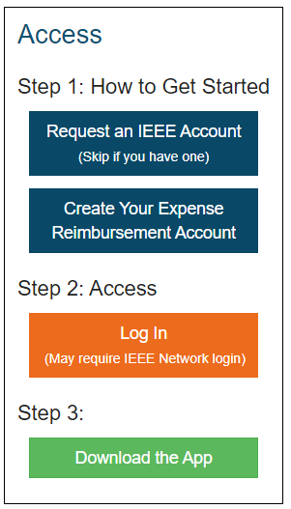
Creating a Concur Account is as Easy as 1-2-3
1. Getting Started
Navigate to: ieee.org/expense
You need an IEEE Account (IEEE username/password) -- hit blue Request button if needed
Log into your IEEE account with your IEEE username & password, then request to have a Concur account created for you.
Account creation takes approximately 24-36 hours. Once your account is created, you will receive an email with log in instructions.
2. Access Concur
Click the orange “Log In” button for direct access to Concur, a username/password are NOT required due to integration with Single Sign On (SSO)
*You will always access Concur with your IEEE credentials via ieee.org/expense by clicking on the orange Log In button. Never attempt to access Concur directly through concur.com*
3. Experience the benefits of the mobile app:
Submit your reports anytime, anywhere
SSO Code is needed: EDDB6G

Slide 6
Helpful Hints & Advanced Features

Slide 7
Helpful Hints for “Report Submitters”
What are the Expense Report Purpose (ERP) Levels for my Region/Section?
They are located on ieee.org/expense under the heading: Expense Report Library
We have them listed in the “resource” section of the NextGen Help Menu in Concur
If you’re unsure which ERP to use, please contact your Region/Section Treasurer and/or your dedicated IEEE Staff Support Contact at Finance-solutions@ieee.org
Complete your “Banking” before submitting your 1st expense report
Depending upon your currency, enter your banking into Concur directly or create a Western Union/Convera account to receive your reimbursement, your enrollment email will inform you where you should enter your banking
Reimbursements are made in user’s local currency, per your country of residence
If your currency is incorrect in your Concur profile and you have already updated your address within your IEEE member profile, please send an email to: NextGenExpense@ieee.org
When Entering Transactions in a Foreign Currency
Use the currency shown on the receipt, Concur automatically converts the transaction to user’s local currency
If the currency conversion calculated by Concur differs from the conversion charged on your credit card, you can submit a separate expense line for Currency Exchange Fees to make your reimbursement whole

Slide 8
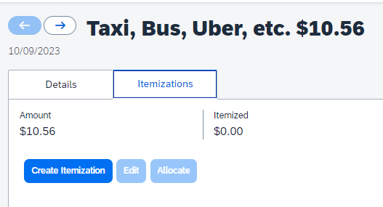
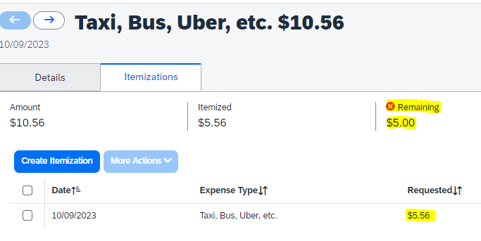
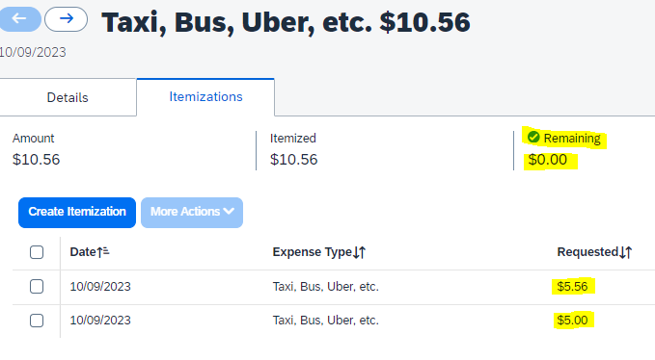
How to “Itemize” an Expense Line
Create expense line and populate the required fields
Click on the “itemizations” tab
Create Itemization, Reselect expense type, enter itemized dollar amount and update your ERP, save itemization. Continue this process until your itemized amount is at $0.00
1
2
3

Slide 9
“Approver” Responsibilities
Provide Demo & Training to all Volunteers/Users who will submit an expense report
Coordinate any training within your Region/Section, etc.
Supporting documentation/training can be found on ieee.org/expense
Become Familiar with the Expense Report Purposes (ERP’s) for your Region/Section
Maintain the approvers/approval flow of an ERP
To make changes to Approver(s) in the system, send an email to: NextGenExpense@ieee.org
ERP Level 4 (WBS Task) changes need to originate in PPM
Locate and view the status of expense reports that you have previously approved
Click Approvals > Reports > View – select your report criteria
Tip: if you do not see a report that you have approved listed in
report view this means the expense report has been returned to submitter

Slide 10
“Approver” – How to Edit a Submitted Report
Click on the “Expense Line” that you would like to Edit
On the Right Hand Side, anything that has a “red vertical bar” can be edited by the approver (highlighted yellow items)
1
2

Slide 11
“Approver” – How to Edit Expense Report Purpose Level
Click on the “Expense Line” that you would like to Edit
On the Right Hand Side, click the drop down arrows by expense report purpose levels 1 – 4 to update
Once updated, click save, then approve the expense report to push to new approval flow
Every expense line will need to be updated individually

Slide 12
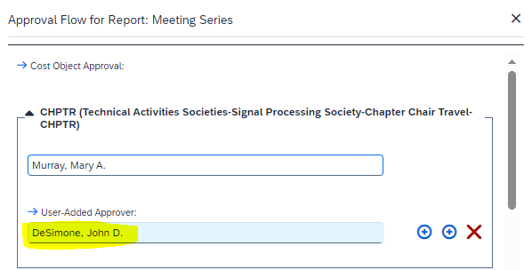
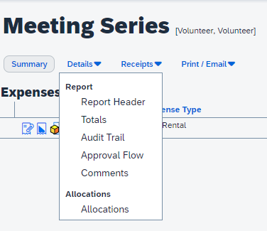
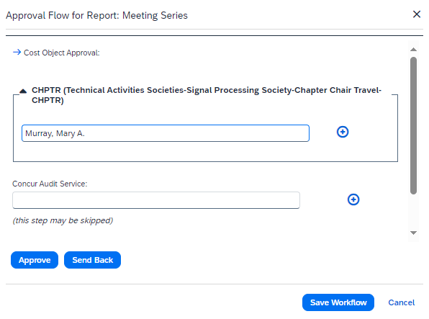
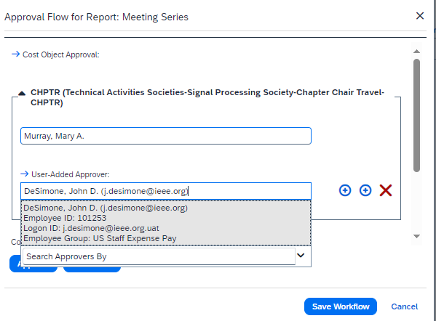
“Approver” – How to Add/Transfer Approval of Expense Report to Another Approver
Open the Expense Report
Click on “Details” then “Approval Flow”
Cost Object Approval Window Opens: click on the down arrow to expand the approval, then click on the + next to your name
Type in the name of the approver you would like to add and click save workflow, then click “approve” in top right-hand corner
1
2
3
4

Slide 13
Resources & Contact Information
NextGen Expense Reimbursement (Concur) resource page
ieee.org/expense
For information such as: training, quick reference, mobile app video, etc.
Email NextGen Expense Reimbursement Questions to:
NextGenExpense@ieee.org
Email MGA Finance Solutions Team:
Finance-Solutions@ieee.org
NextGen Program
ieee.org/nextgen

Slide 14
Questions
Please send all questions, comments, feedback and suggestions to: NextGenExpense@ieee.org

Slide 15
Appendix

Slide 16
Appendix
NextGen Expense (Concur) Overview
NextGen Expense New User Interface Update “Horizon Fiore”
Additional Training Materials
ieee.org/expense
Logging into NextGen Expense is Easy as 1-2-3 & Concur Sample Enrollment Emails
Mobile App – Access Anytime, Anywhere
Concur “User” Profile
Combine Expense Reports using MOVE Command
What’s the Status of my Expense Report?
Audit Trail
Delegates
Missing Receipt Declaration
Expense Report Life Cycle, Concur & Western Union Payment Processing & Payment Currencies Supported by Concur
Tiered Expense Report Purpose (ERP) Levels
My NextGen Experience “Dashboard”
Self Service Featuring “ NextGen Help Menu”, NextGen Help Menu & NextGen Task Menu
Currency Exchange Fee
Verify Receipt Date = Transaction Date

Slide 17
NextGen Expense (Concur)
Overview

Slide 18
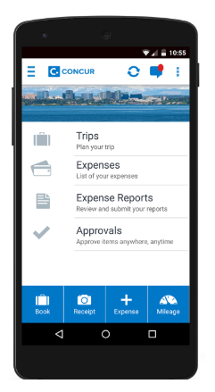
NextGen Expense Reimbursement (Concur) Introduction
What is NextGen Expense Reimbursement?
Cloud based expense management application, including electronic receipt integrations and secure mobile access
Benefits of Using NextGen Expense
Fully integrated with NextGen Finance (Projects) and NextGen Banking
Expense Tagging transactions (ERP level 4/WBS) happens automatically between Concur - Coupa
The Concur Mobile app expands accessibility to create & approve expense reports anytime/anywhere
When to Use NextGen Expense
IEEE will reimburse for travel and non-travel related expenses such as office supplies, shipping, dues/membership, registration fees, etc.
For personal “Out of Pocket” and “IEEE Corporate Card” (if applicable) expenses
When Not to Use NextGen Expense
CB Card transactions do not get processed/entered in Concur
Local bank account activity

Slide 19
NextGen Expense (Concur) Documentation
ieee.org/expense (Appendix A)
One stop shopping for NextGen Expense related documentation and training
How to Log in to Concur (Appendix B)
NextGen Expense Reimbursement Checklist
View a checklist of items needed prior to creating your 1st expense report in addition to tips on submitting your report
Concur Mobile App (Appendix C)
View a comprehensive video on how to log into the mobile application on your cellular device
Training & Quick Reference
Review self paced training
View recorded training sessions from previous training events
Expense Report Purpose (ERP) Library
Frequently Asked Questions (FAQs)

Slide 20
Report Submitter Responsibilities
Complete your Concur Profile (Appendix D)
Click Profile > Profile Settings. Personal information, verify email address, notification preferences & enter banking if required, etc.
Submit Your Expenses for Reimbursement
Submit your expenses for reimbursement within 60 days of being incurred or at completion of your trip, in accordance with the IEEE Travel & Expense Reimbursement Guidelines (when appropriate)
Expense reports should be consolidated as much as possible (Appendix E)
Multiple ERPs on a single report is permitted/encouraged – each transaction can utilize separate ERPs
When possible, combine various trips and transactions and submit 1 expense report per month
Delete/Remove any old expense reports in your Concur profile

Slide 21
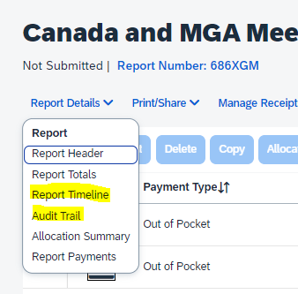
Report Submitter “Self Service” Features
View the Status of your Expense Report (Approval Flow & Audit Trail) (Appendix F, G)
Real-time audit/status tracking visible to the submitter
To view the status of your expense report after it’s submitted
Report Details > Click on “Report Timeline” or “Audit Trail”
Delegate Responsibility (Appendix H)
Users can designate a delegate to submit/approve expense reports on their behalf
A missing receipt declaration cannot be submitted by a delegate (Appendix I)
A delegate cannot change profile information i.e., bank info, address, etc.
Receipt Options
Email receipts to: receipts@expenseit.com, they will automatically upload
into your Concur Profile (must verify email in Concur for this to work)
Integration with 3rd party applications (e.g., Uber, Lyft, etc.) which results
in electronic receipt creation

Slide 22
Approver Responsibilities
Provide Demo & Training to all Volunteers/Users who will submit an expense report (Appendix J)
Coordinate any training within your Region/Section, etc.
Supporting documentation/training can be found on ieee.org/expense
Become Familiar with the Expense Report Purposes (ERP’s) for your Region/Section (Appendix K)
Maintain the approvers/approval flow of an ERP
To make changes to Approver(s) in the system, send an email to: NextGenExpense@ieee.org
ERP Level 4 (WBS Task) changes need to originate in PPM
Locate and view the status of expense reports that you have previously approved
Click Approvals > Reports > View – select your report criteria
Tip: if you do not see a report that you have approved listed in
report view this means the expense report has been returned to submitter

Slide 23
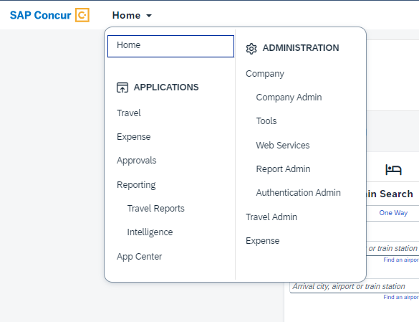
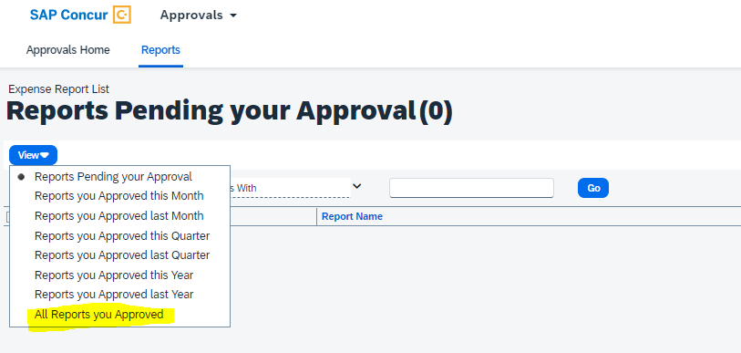
Approvers - View all Expense Reports You’ve Approved
View the expense reports that you have previously approved
Click Approvals > Reports > View – select your report criteria
Tip: if you do not see a report that you have approved listed in
report view this means the expense report has been returned to submitter

Slide 24
NextGen Expense
New User Interface Update
“Horizon Fiore”

Slide 25
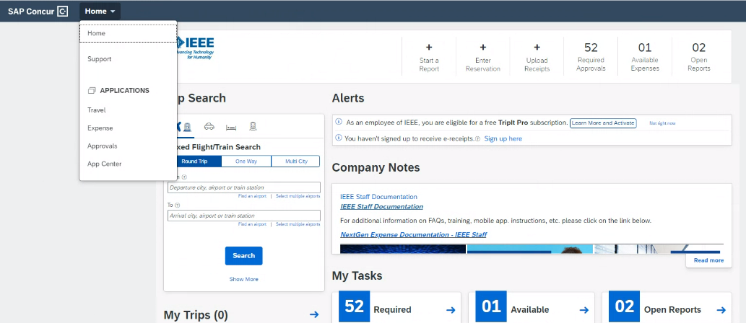
Horizon Fiore – “Home Menu”
All menu items such as travel, expense, approvals, etc. are located under the expandable “home” drop down menu

Slide 26
Horizon Fiore – “Profile Section”
The “Profile” section is no longer titled “Profile” but has been replaced with a symbol of a person.
TIP: If you have delegate access on behalf on another user, please expand the menu to select the user

Slide 27
Horizon Fiore – “Help Section”
The “Help” section is not longer titled “Help” but has been replaced with a question mark symbol

Slide 28
NextGen Expense (Concur)
Additional Training Materials

Slide 29
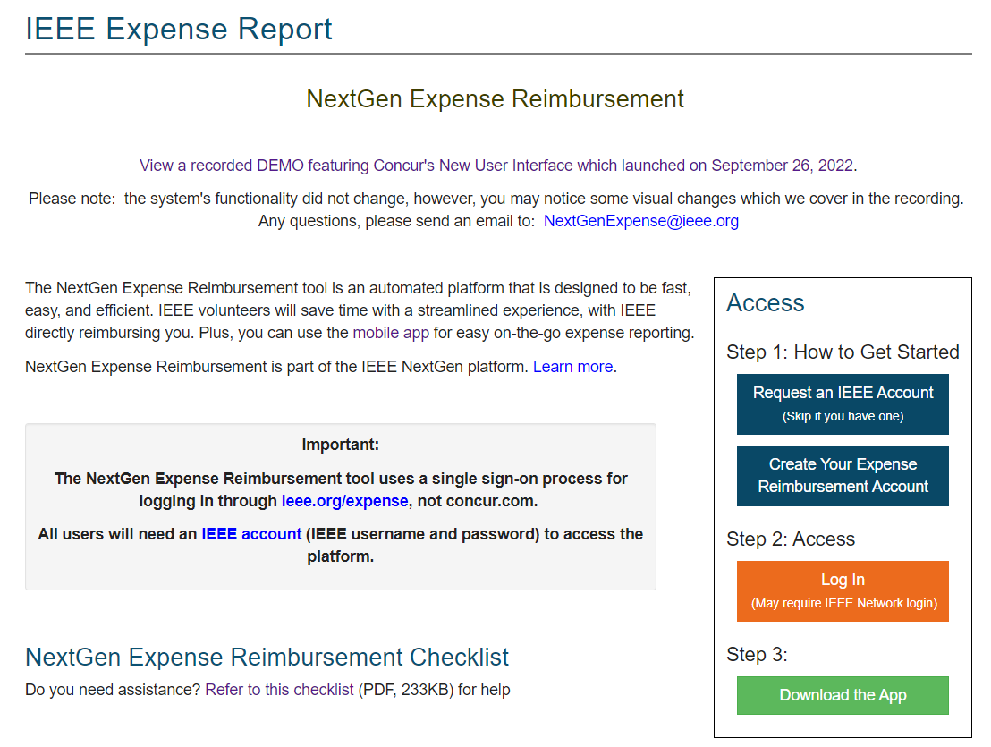
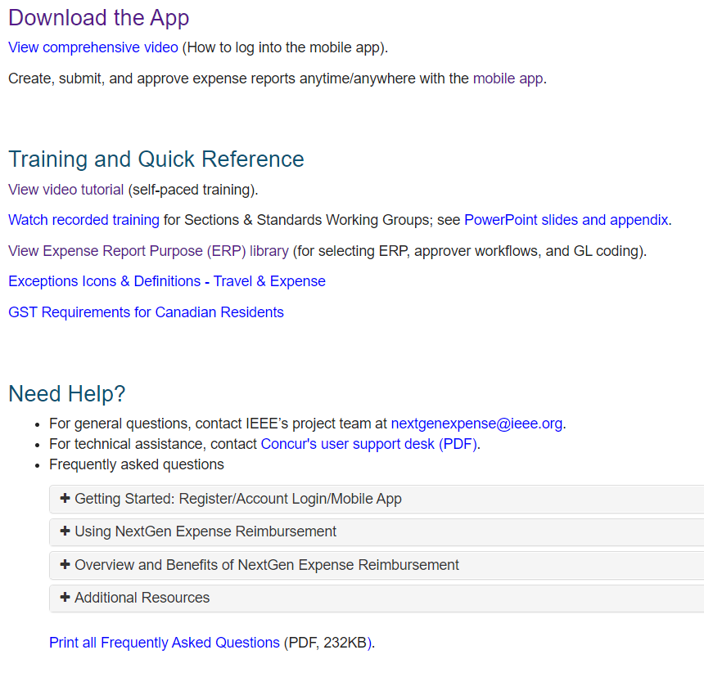
ieee.org/expense
Appendix A

Slide 30
Logging into NextGen Expense is as Easy as 1-2-3
Appendix B (page 1)
*Always access Concur with your IEEE credentials via ieee.org/expense. Never attempt to access Concur directly through concur.com*
1. Getting Started
Navigate to ieee.org/expense
You need an IEEE Account (IEEE username/password) -- hit blue Request button if needed
Log into your IEEE account with your IEEE username & password, then request to have a Concur account created for you.
Account creation takes approximately 24-36 hours. Once your account is created, you will receive an email with log in instructions.
2. Access Concur
Click the orange “Log In” button for direct access to Concur, a username/password are NOT required due to integration with Single Sign On (SSO)
3. Experience the benefits of the mobile app:
Submit your reports anytime, anywhere

Slide 31
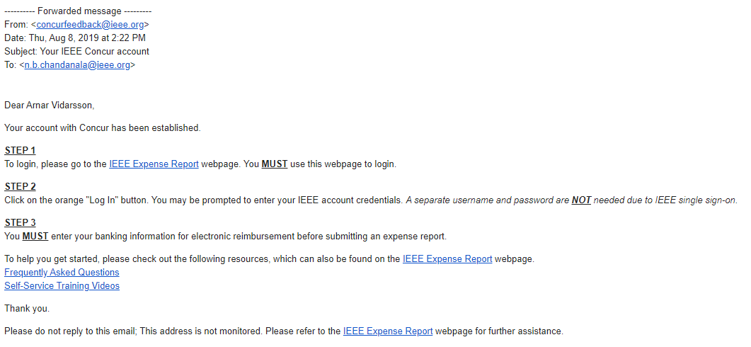
Concur Sample Enrollment Email (reimbursement in USD, CAD, EUR, INR, and JPY)
Appendix B (page 2)

Slide 32
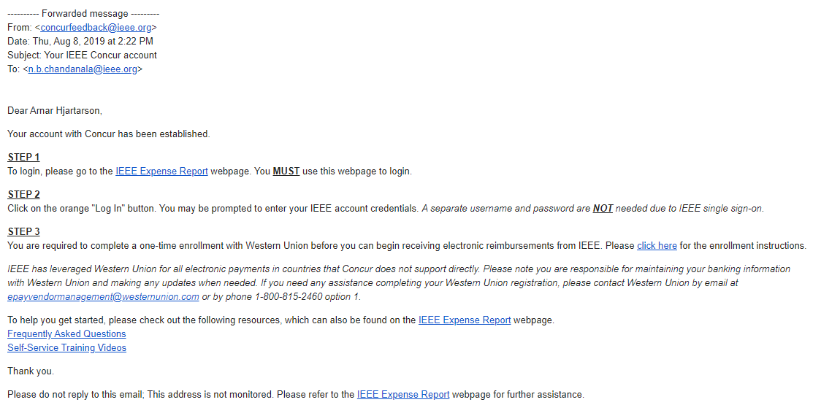
Western Union/Convera Sample Enrollment Email (all currencies except USD, CAD, EUR, INR, and JPY)
Appendix B (page 3)

Slide 33
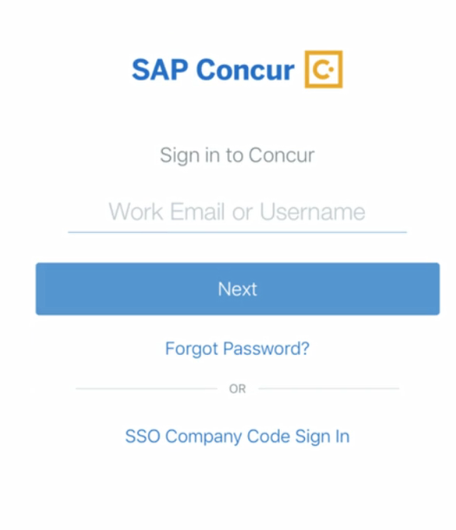
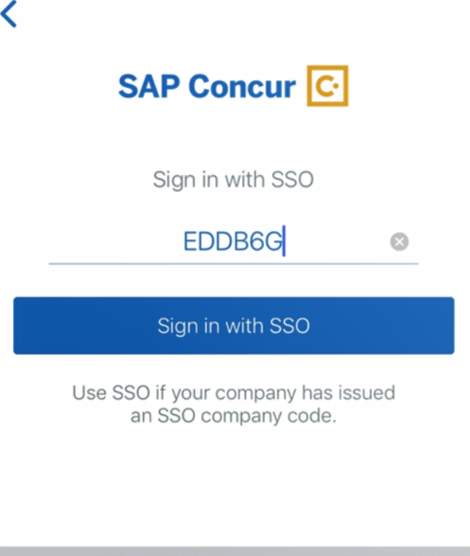
Mobile App – Access Anytime, Anywhere
Appendix C
Log into the mobile app securely using IEEE’s Single Sign On (SSO) passcode (EDDB6G):
Use the ExpenseIt feature to upload a receipt image directly into your Concur profile as seen below:

Slide 34
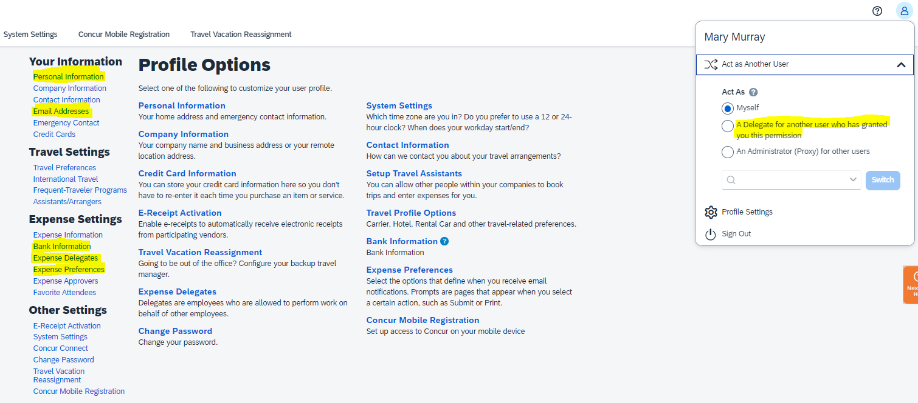
Concur “User” Profile
Appendix D

Slide 35
Combine Expense Reports using MOVE command
Appendix E
How to “Move” an expense line to another expense report
Please check the expense line(s) that you would like to move
Click the blue “Move to” box
Select the report that you would like to move the expense(s) to: New Report, Sections Congress or Region Meeting – New Jersey

Slide 36
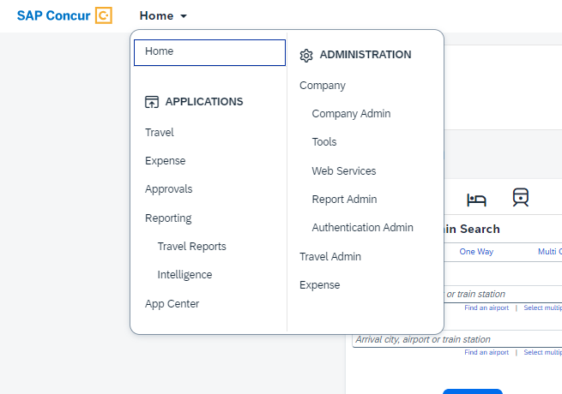
“What’s the Status of my Expense Report?” Approval Flow/Report Timeline
Appendix F (page 1)
Step 1 – Click on Home > Expense
Step 2 – Change the “View” in Report Library
*Please note: You can only see the approval flow/report timeline after the report has been submitted*

Slide 37
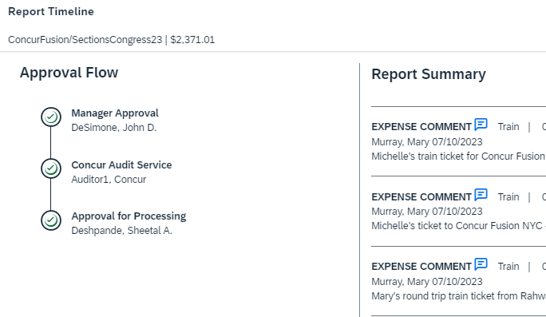
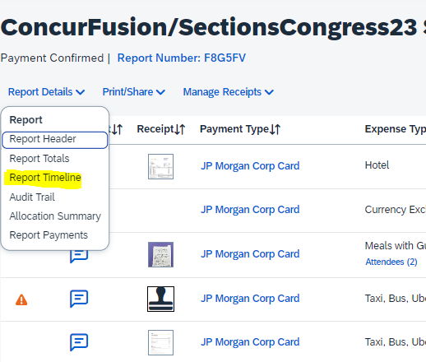
“What’s the Status of my Expense Report?” (cont.) Approval Flow/Report Timeline
Appendix F (page 2)
Step 3: Open Report, Click on Report Details > Report Timeline
Step 4: Review Report Timeline to see Status
*Please note: You can only see the approval flow/report timeline after the report has been submitted*

Slide 38
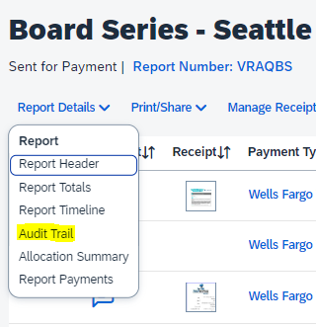
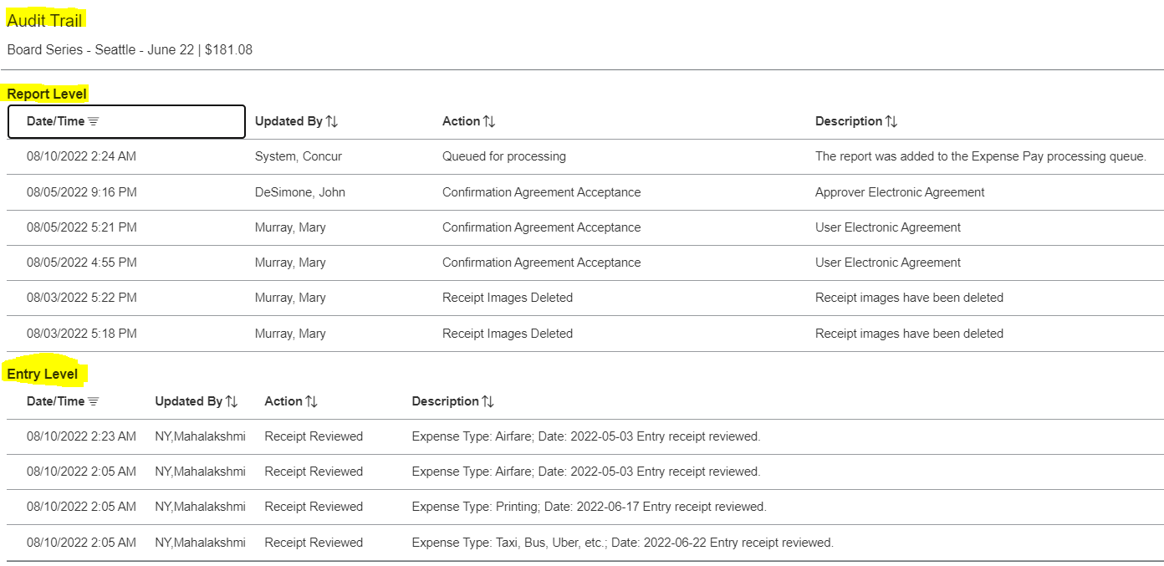
Audit Trail
Appendix G
Step 1 - How to Navigate
Step 2 – Click on Audit Trail
*Please note: You can only see the audit trail after the report has been submitted*

Slide 39
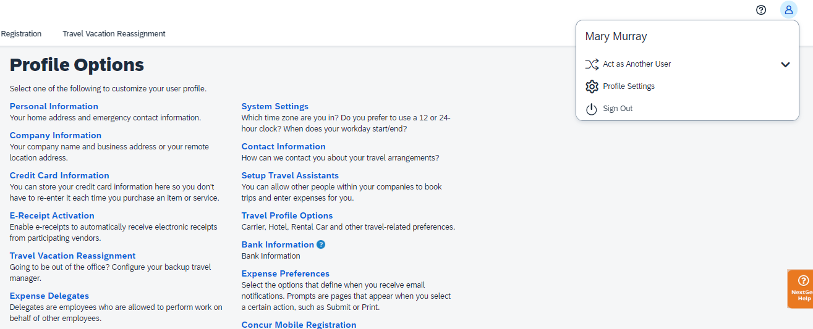
Delegates
Appendix H
Step 2 – How to Add Delegate
Click Add > Type in Users Name > Select the Desired Check Boxes > Save
Step 1 - How to Navigate
Profile > Profile Settings > Expense Delegates

Slide 40
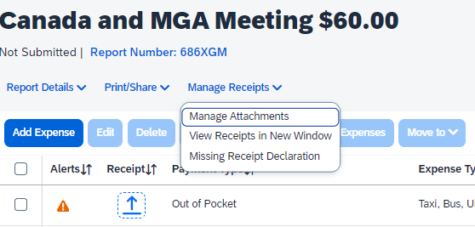
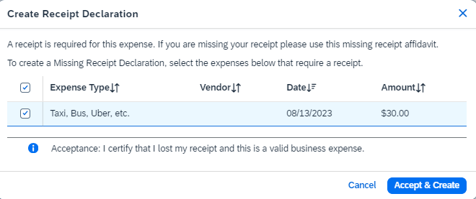
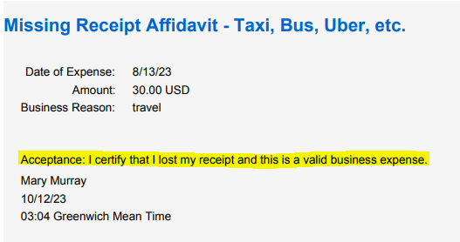
Missing Receipt Declaration
Appendix I
Step 1 - How to Navigate
Step 2 - Select Transaction
Step 3 - Final Confirmation

Slide 41
Expense Report Life Cycle
Appendix J (page 1)
Create Expense Report
Volunteers/Members select 4-tiered Expense Report Purpose (ERP) Levels & Expense Type, which generates the:
Approvers
IEEE financial accounting and CB Account/HOP # for NextGen Banking
ERP Level 3 = Oracle PPM Project # and Project Name/Description
ERP Level 4 = Oracle PPM WBS Task # and Task Description
Expense Report Processes through “Approval Flow”
Approver(s) – Treasurer (at a minimum)
Best Practice is to have 2 Approvers per expense report purpose
To change an Approver of an ERP, please send an email to: NextGenExpense@ieee.org
The NextGen Expense team will make the system change and notify the Finance Solutions team via email
Following approvals, Concur audit and payment processing begins
Report is Processed for Payment
Payment is made electronically directly to your bank account via Concur or Western Union
Standard Concur audit, IEEE review and payment processing typically takes 3-5 business days

Slide 42
Concur & Western Union (Convera) Payment Processing
Appendix J (page 2)
Concur or Western Union (aka Convera)?
The reimbursement currency in your Concur profile is based on your Country of Residence. If you reside in a Country where the local currency is USD, EUR, CAD, JPY or INR you must enter your banking information directly into Concur.
All other currencies require the user to enroll in Western Union, this is a one-time enrollment
Additional benefit of Western Union is more flexibility to choose your bank (e.g. use your US bank even if your main country of residence is perhaps the UK)
Payment cannot be completed until banking information is provided
Western Union Contact Information:
Phone: 1-800-815-2460, option # 1
Email: Vendormanagement@convera.com
Security of Banking Information
Personal information entered in the profile is secure and can only be managed by the user
Concur and Western Union meet ISO, SSAE, and PCI Compliance standards, ensuring the utmost in security measures
Note: IEEE and Concur abide by OFAC regulations; in some cases, users may not be granted access to Concur

Slide 43
Payment Currencies Supported by Concur
Appendix J (page 3)
EURO Countries Supported by Concur
Austria | Ireland
Belgium | Italy
Finland | Luxembourg
France | Netherlands
Germany | Portugal
Greece | Spain
in addition to USD, CAD, INR, and JPY
(otherwise, payment completed via Western Union)

Slide 44
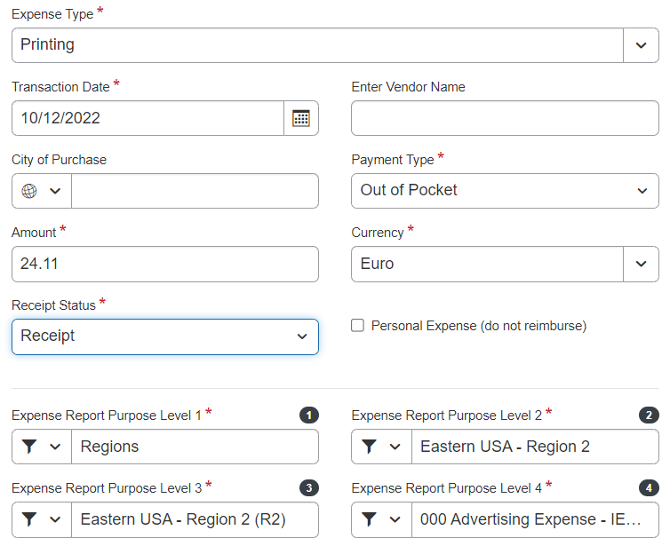
Tiered Expense Report Purpose (ERP) Levels
Appendix K
Report Header
Expense Line Entry
ERP 3 = Oracle
PPM Project
ERP 4 = Oracle
PPM Task/WBS

Slide 45
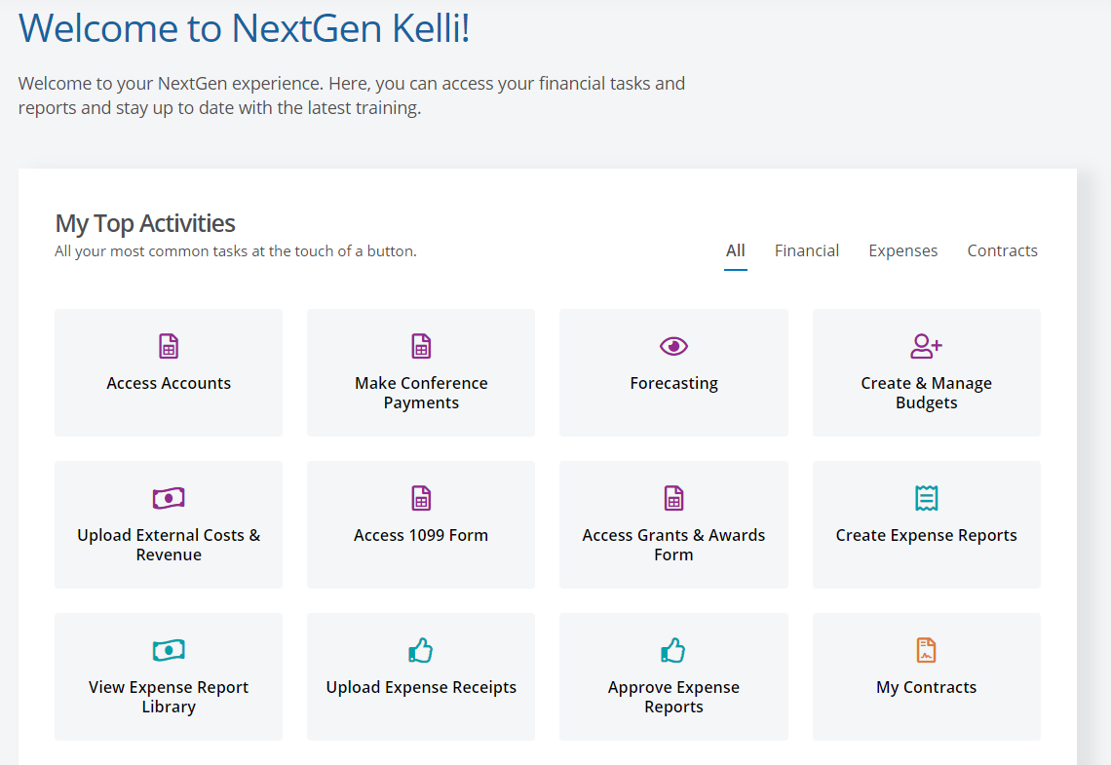
My NextGen Experience “Dashboard”
Appendix L
Log into NextGen Expense via the “My NextGen Experience Dashboard” or ieee.org/nextgen
User audience is limited (e.g. Treasurers and Chairs of the Geo Unit). Access is driven based on your vTools profile title.
If you are having an issue with one of the NextGen Expense buttons going through the Dashboard, please log into Concur using the instructions in the previous slide and contact the IEEE Contact Center for further assistance.
IEEE Contact Center
Email: contactcenter@ieee.org Phone: +1 800 678 4333 (USA and Canada)
Phone: +1 732 981 0060 (Worldwide)

Slide 46
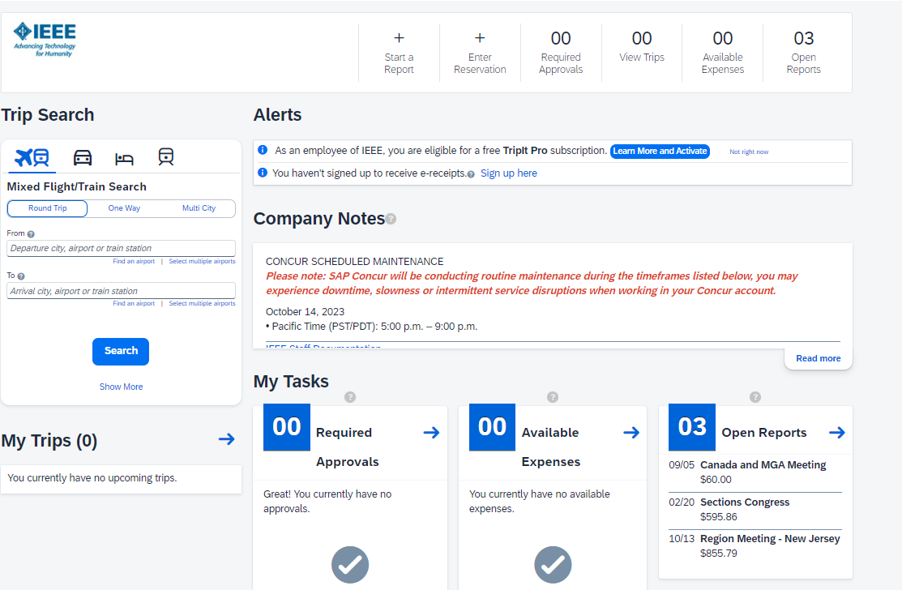
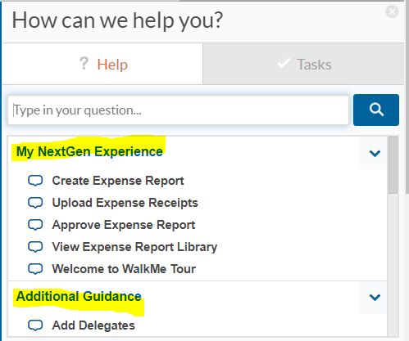
Self Service Featuring “NextGen Help Menu”
Appendix M (page 1)
Click on Menu to Expand
Expanded Menu (3 Sections)
Assistance from NextGen Help (WalkMe)
Walkthroughs (step-by-step guided learning)
Smart Tips (helpful hints)

Slide 47
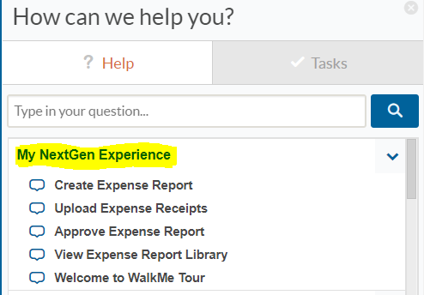
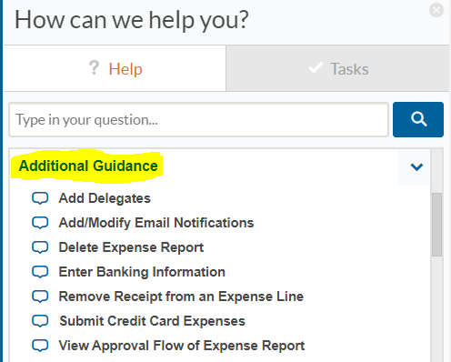
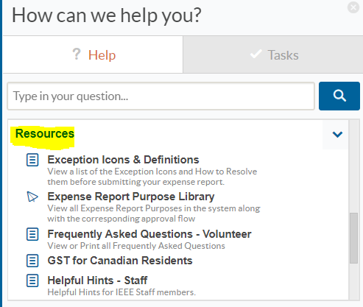
NextGen Help “Help Menu”
Appendix M (page 2)
NextGen Help – Help Menu
Consists of 3 Sections:
My NextGen Experience
Additional Guidance
Click on items listed to experience step-by-step guided learning
Resources
Click on items for additional documentation/information

Slide 48
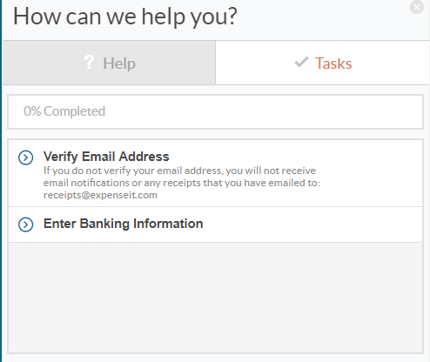
NextGen Help “Tasks Menu”
Appendix M (page 3)
NextGen Help – Tasks Menu
Suggested tasks to complete before using Concur
Verify Email Address
Needed for:
Email Notifications
Using receipts@expenseit.com
Enter Banking Information
Concur requirement if you are receiving your reimbursements via Concur

Slide 49
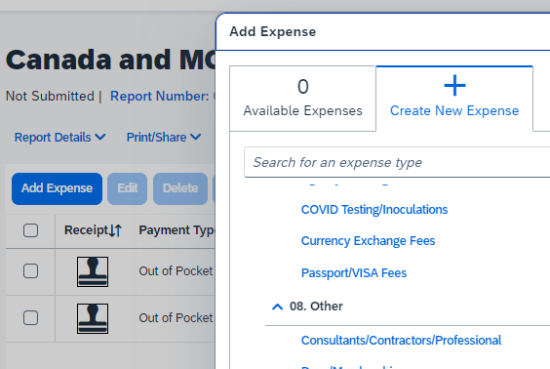
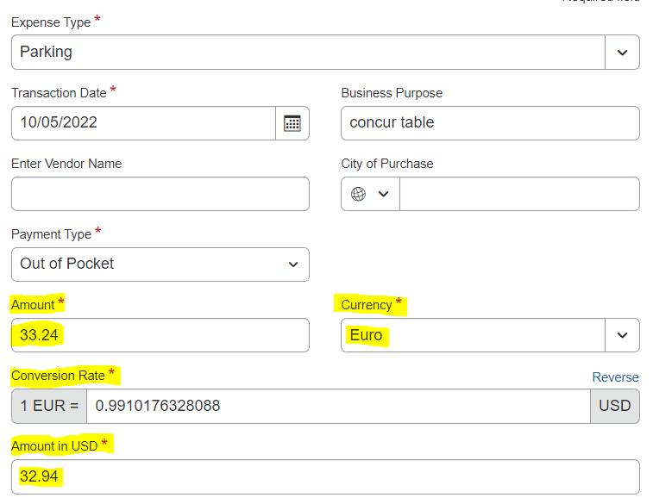
Currency Exchange Fee
Appendix N
Sample Expense Line
DO NOT change Conversion Rate
Expense Type
When Entering Transactions in a Foreign Currency
Use the currency shown on the receipt, Concur automatically converts the transaction to user’s local currency
If the currency conversion calculated by Concur differs from the conversion charged on your credit card, you can submit a separate expense line for Currency Exchange Fees to make your reimbursement whole

Slide 50
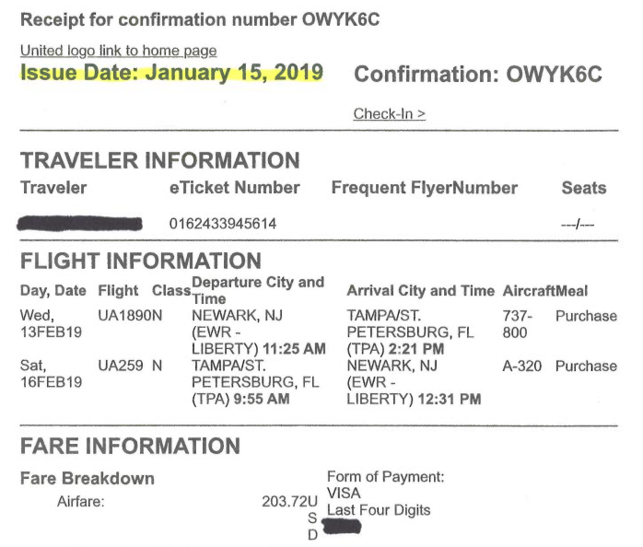
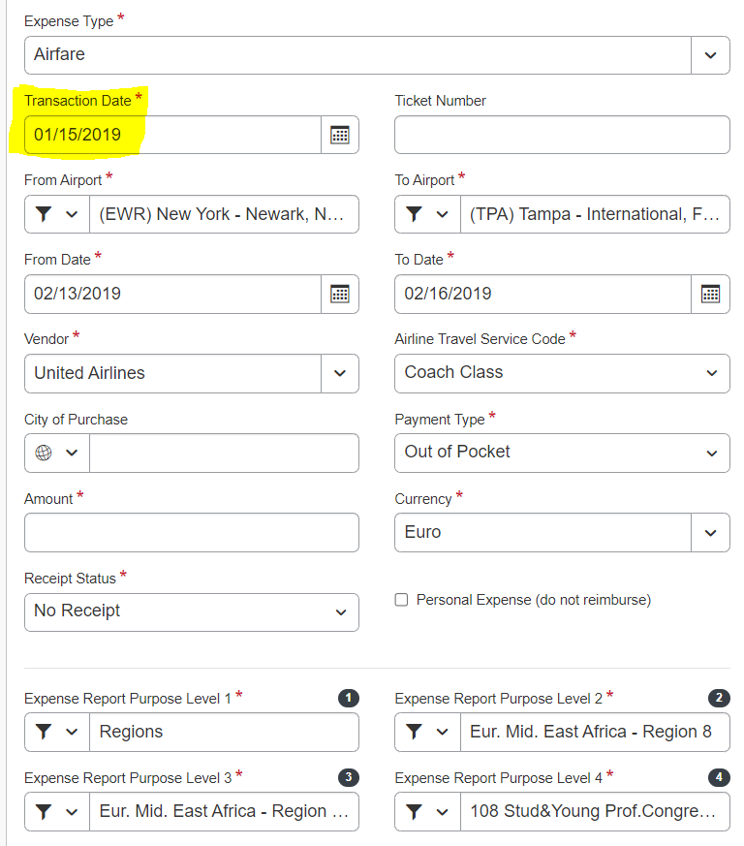
Verify Receipt Date = Transaction Date
Appendix O

