Slide 1
MGA Treasurer Training
MGA Geographical Unit –
Audit Process Overview
IEEE Internal Audit Department
October 21, 2023

Slide 2
I must insist on a receipt for my Auditor!!

Slide 3
MGA Treasurer Training
Agenda
Background & Objectives
Overview of the Audit Process
Best Practices & Recommendations
Sprinkled with Quizzes ☺

Slide 4
Background and Objectives
Purpose
IEEE is a Not-for-profit entity incorporated within the State of New York
501(c)(3), tax exempt organization
IEEE Policy
To protect assets and
Provide guidance to members, staff and the Board of Directors
Purpose of Geo Unit Audits
Add value by providing services & feedback in a consultative manner to volunteers and management
Serve as a control to mitigate key reputational, legal, financial and operational risks
Ensure operations are in line with governing documents
Serve as a control to assure the Audit Committee that is responsible to the Board of Directors with respect to matters involving the accounting, auditing, financial reporting, risk management, regulatory and compliance, and internal control functions of IEEE

Slide 5
Which geographic units are subjected to an audit as per IEEE policy?
All IEEE Regions
Geo Units with revenues or expenses over $250K USD
Randomly selected Geo Units
All of the above

Slide 6
Which geographic units are subjected to an audit as per IEEE policy?
All IEEE Regions
Geo Units with revenues or expenses over $250K USD
Randomly selected Geo Units
All of the above

Slide 7
Background and Objectives
IEEE Audit Requirements
IEEE Policy & Financial Operations Manual
Geo Units with revenues or expenses equal to or greater than $250,000 USD
Geo Units with revenues or expenses of less than $250,000 will be audited on a rotational basis
Judgmental Sample Selected by IEEE
Each year Internal Audit conducts audits of units that report below the $250,000 threshold
As needed or recommended
Review by Geo Unit Committee members
Geo Units that are not selected for audit are encouraged to have members of the Committee (of a non-financial decision-making capacity) perform a review of the financial activities

Slide 8
Who can perform the audit for Geo Units?
A qualified independent external auditor
IEEE Internal Audit
A committee of the Geo Unit
A or B

Slide 9
Who can perform the audit for Geo Units?
A qualified independent external auditor
IEEE Internal Audit
A committee of the Geo Unit
A or B

Slide 10
What is the most cost-effective audit approach?
IEEE Internal Audit
An Independent External Audit Firm

Slide 11
What is the most cost-effective audit approach?
IEEE Internal Audit
An Independent External Audit Firm

Slide 12
True or False?
Independent Auditor’s Memorandum of Agreement needs to be submitted for review and approval by IEEE before commencement of work.
External Auditor needs to perform the testing in accordance to the “IEEE Geo Unit Agreed Upon Procedures”

Slide 13
True or False?
Independent Auditor’s Memorandum of Agreement needs to be submitted for review and approval by IEEE before commencement of work. - TRUE
External Auditor needs to perform the testing in accordance to the “IEEE Geo Unit Agreed Upon Procedures”- TRUE

Slide 14
Overview of the Audit Process
Selecting an Auditor
If you qualify or are selected for an audit by IEEE
Audit Notifications are issued after the financial year end close
You may select IEEE Internal Audit or a Qualified external audit firm
IEEE Internal Audit
The majority of Geo Unit Region and Section audits are conducted by IEEE Internal Audit Department.
Our fee is subsidized. It is 0.6% of the revenues or expenses, whichever is higher, and capped at $6,000 USD.
Qualified External Audit firm
Pre-approved external firms are available upon request
Their work are in line with the industry standard

Slide 15
Overview of the Audit Process
External Audit Requirement
Memorandum of Agreement (MOA)
Must be reviewed and approved by IEEE Internal Audit before entering any agreement or commencement of work
Copy of the Chartered Accountant or Certified Public Accountant license (outside of USA)
The credentials/license of external auditor will be verified
Agreed Upon Procedures
External auditor should perform the testing in accordance to the Geo Unit Agreed Upon Procedures
Workpapers should be provided when requested
Non-adherence may result in non acceptance of the external report
May require an audit by IEEE Internal Audit

Slide 16
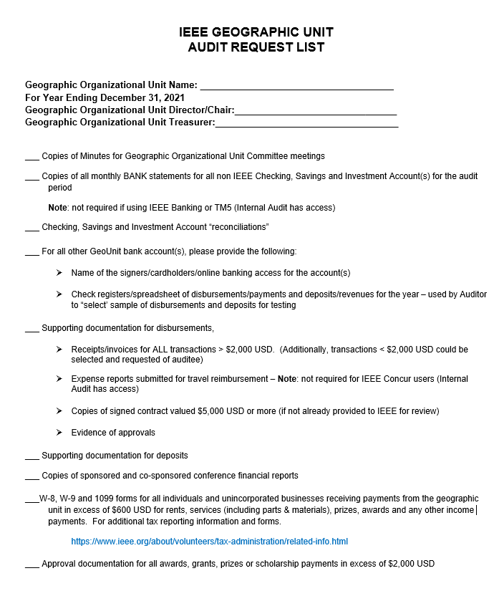
Overview of the Audit Process
Geo Units Audit Request List
A Geo Unit Audit Request List
Provides a detail list of items needed for audit
Can be used as a guide in organizing your audit material
By completing the Audit Request List, we know what documentation you have and what you don’t have.

Slide 17
What details should meeting minutes include?

Slide 18
1) Name of attendees
2) Date, time, and location of the meeting
3) Key topics/ issues discussed
4) Motions proposed or voted on
5) Decisions made, approval, etc.

Slide 19
Overview of the Audit Process
Meeting Minutes
Minutes for Geographic Unit Executive Committee meetings
Permanent record of the meeting proceedings and resolutions made
Documented evidence of decisions
It should also include the name of the attendees, date, time, and location of the meeting

Slide 20
Which documents below are NOT required to be submitted to IEEE for the annual audit?
Monthly bank statements for IEEE bank accounts
Monthly bank statements for local / external bank accounts

Slide 21
Which documents below are NOT required to be submitted to IEEE for the annual audit?
Monthly bank statements for IEEE bank accounts
Monthly bank statements for local / external bank accounts

Slide 22
Overview of the Audit Process
Bank Details
Required for non-IEEE (external/local) bank accounts’ only
Names of all the authorized signers or bankcard holders for each account with verification from the financial institution (bank)
Copies of all monthly statements for Checking, Savings, Term-Deposits, and Investment account(s)
-Proof of bank account closure from the financial institution

Slide 23
Overview of the Audit Process
Supporting Documents for Receipts / Bank Deposits
Revenue support required for audit purposes includes:
Rebate and Assessments from IEEE
Society-supported initiatives
Registration Revenues from workshops, tutorials, conferences, etc.
Other IEEE Program funds: IEEE-USA, Life Members, Humanitarian Activities Committee or “HAC”, etc.
Contributions (corporation or individual)
Investment or Interest Income
Loans and Transfers
Backup documents includes:
Receipts/invoices, statements from the bank, email approvals, funding spreadsheets from payor, and other related supporting documents

Slide 24
Overview of the Audit Process
Supporting Documents for Disbursements / Bank Withdrawals
Disbursements expenses support required for audit purposes includes:
Contracts
Signed agreements for goods or services valued at $5,000 USD or more;
Note that contracts valued greater than $25,000 USD require IEEE Legal approval and must be signed by an authorized signatory from IEEE prior to the service start date; Similarly, all high-risk contract agreements must be reviewed and approved by IEEE
Itemized receipts/invoices

Slide 25
Overview of the Audit Process
Supporting Documents for Disbursements / Bank Withdrawals
Disbursements expenses support required for audit purposes includes (cont’d):
Wire transfer or electronic payment requests (i.e. transfer receipt, email back-up explaining nature of transaction, etc.)
Expense Reports and Approvals submitted for travel and out-of-pocket reimbursement claims (not in Concur)
NextGen Expense Reimbursement claims in Concur will be independently verified
Petty Cash and payment from personal account should be avoided as a best practice

Slide 26
Overview of the Audit Process
Other Documents
Conference or Meeting financials
Copies of sponsored and co-sponsored conference/meeting/projects, etc. financial reports
Backup for loans and surplus distributed or received
Tax Reporting Requirements
A record for all individuals and unincorporated businesses receiving payment(s) from the Geo unit for rents, services (including parts & materials), prizes, awards and any other payments, generally applicable to US entities, please confirm with IEEE Tax
Awards, Prizes, Grants, or Scholarships
Approval documentation for all awards, grants, prizes or scholarship payments in excess of $2,000

Slide 27
Who needs to complete the Conflict of Interest form for the Geo Units?
Chair
Treasurer
Geo Unit officer who makes business decisions
All of the above

Slide 28
Who needs to complete the Conflict of Interest form for the Geo Units?
Chair
Treasurer
Geo Unit officer who makes business decisions
All of the above

Slide 29
Overview of the Audit Process
Conflict of Interest
Completion requirements of the Principles of Business Conduct and Conflict of Interest or POBC/COI reporting, by Chairs and Treasurers, validated during the annual audit process
By or before January 31 of term year or,
Within the first 30 (thirty) days of his/her term’s commencement date

Slide 30
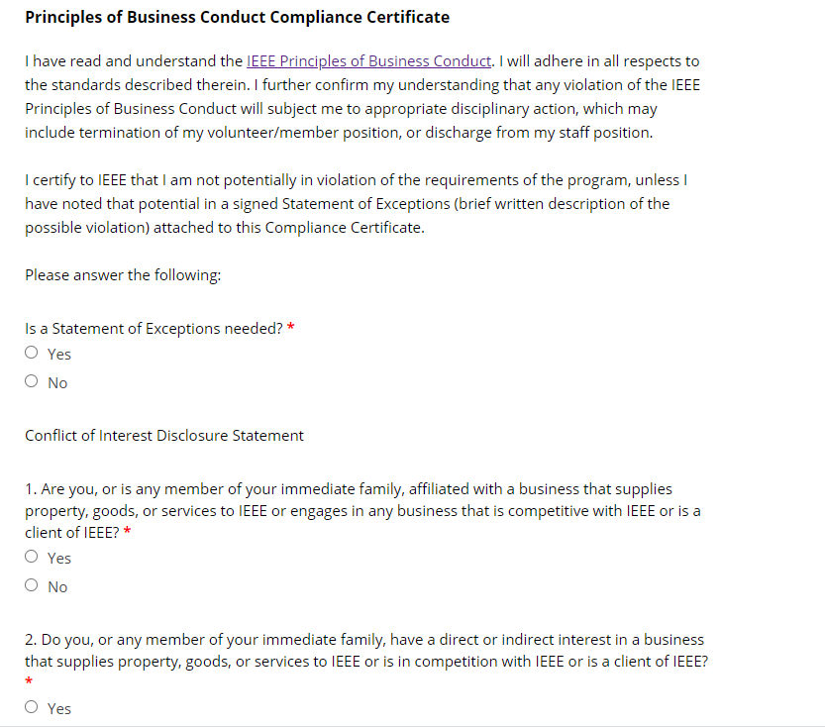
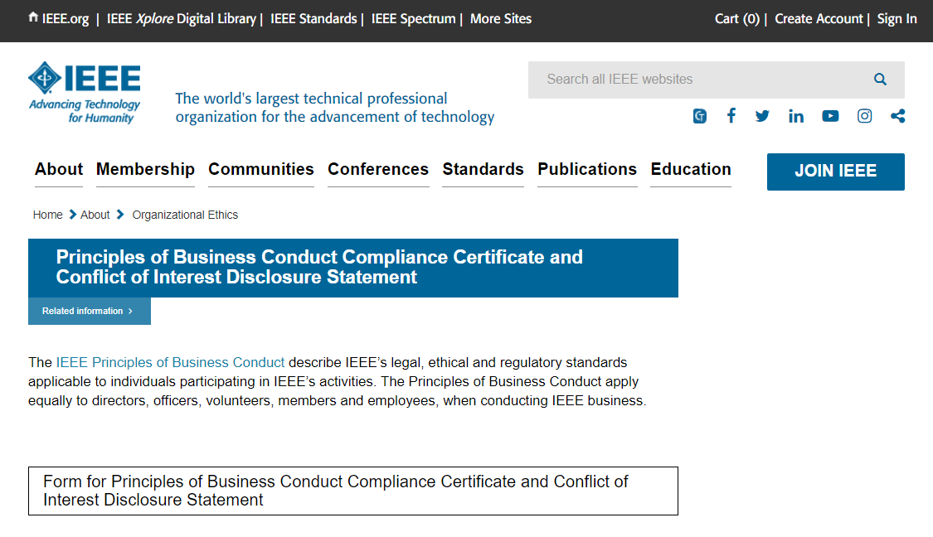
Overview of the Audit Process
Conflict of Interest Form

Slide 31
Overview of the Audit Process
Internal Audit Report
Audit Issues noted via Draft report
Review results with Officers and guide them on policies for future
Allot a week for comments or feedback
Publish final reports with findings and recommendations
External Audit Reports are to submitted to IEEE Internal Audit within 45 days after MOU is signed

Slide 32
Test Your Knowledge - Quiz
In which scenario listed below do we not require a signed contract?
Total payment $5,000 USD or more
High-risk contract valued at $3,000 USD
Total payment over $25,000 USD
Giveaways purchase totaling to $2,000 USD

Slide 33
Test Your Knowledge - Quiz
In which scenario listed below do we not require a signed contract?
Total payment $5,000 USD or more
High-risk contract valued at $3,000 USD
Total payment over $25,000 USD
Giveaways purchase totaling to $2,000 USD

Slide 34
Test Your Knowledge - Quiz
Which contract needs to be submitted to IEEE for review and approval by an authorized IEEE signer?
High-risk contract valued at $5,000 USD
Audio visual agreement totaling to $4,000 USD
Accounting service contract valued at $20,000 USD
All of the above

Slide 35
Test Your Knowledge - Quiz
Which contract needs to be submitted to IEEE for review and approval by an authorized IEEE signer?
High-risk contract valued at $5,000 USD
Audio visual agreement totaling to $4,000 USD
Accounting service contract valued at $20,000 USD
All of the above
Options B and C should utilize IEEE Contract Templates

Slide 36
Test Your Knowledge - Quiz
Which item(s) below should be obtained for recordkeeping and made available when requested by IEEE
All monthly banking statements for IEEE Bank account(s)
All monthly statements for local bank account(s)
Itemized receipts over $25 USD
B and C

Slide 37
Test Your Knowledge - Quiz
Which item(s) below should be obtained for recordkeeping and made available when requested by IEEE
All monthly banking statements for IEEE Bank account(s)
All monthly statements for local bank account(s)
Itemized receipts over $25 USD
B and C

Slide 38
Test Your Knowledge - Quiz
True or False?
Bank accounts are required to have at least 2 bank signers
Agreement/Contracts valued over $25,000 USD can be signed by Geo Unit Chair or Treasurer
Conflict of Interest forms need to be completed by Chair and Treasurer only

Slide 39
Test Your Knowledge - Quiz
True or False?
Bank accounts are required to have at least 2 bank signers-True
Agreement/Contracts valued over $25,000 USD can be signed by Geo Unit Chair or Treasurer-False
Conflict of Interest forms need to be completed only by Chair and Treasurer -False

Slide 40
Test Your Knowledge - Quiz
What is a best practice?
A. Reconcile your bank statements at the end of the year
B. Reconcile your bank statements at the end of the month

Slide 41
Test Your Knowledge - Quiz
What is a best practice?
A. Reconcile your bank statements at the end of the year
B. Reconcile your bank statements at the end of the month

Slide 42
Best Practices & Recommendations
Leverage IEEE services and software solutions designed to increase efficiencies and enhance controls
IEEE banking (where available)
Expense reporting software solutions (NextGen Expense Reimbursement aka Concur)
MGA Compliance portal
IEEE NextGen Dashboard (tax reporting)
Financial Reporting tools supported by MGA Finance team
IEEE MGA Contract Staff
IEEE Contract templates approved by Legal and Compliance

Slide 43
Best Practices & Recommendations
Classify transactions according to the MGA guidelines for tasks in the Work Breakdown Structure (WBS) for consistency in accounting
Record transactions as they take place and complete bank reconciliation on a regular basis to detect errors and unrecorded transactions
Consult with MGA Finance team for opening and closing of bank accounts. Any external bank accounts opened in the name of the geo unit should be disclosed to IEEE.
Provide verification of the bank account authorized signers (Signature Card verification) on an annual basis, or when a change in signers is made (only for non-IEEE bank accounts)
A separate bank account should be opened for the specific conference’s transaction activities to ensure no commingling of funds with the geo unit
Avoid petty cash and payment from personal accounts

Slide 44
Best Practices & Recommendations
Adhere to MGA financial reporting requirements and record retention guidelines for revenues and expenses
Perform an independent review with another member(s) of the Committee during the year (for Geo Units not selected for audit)
Take advantage of the training provided by the MGA Finance team
Consult MCE early in the conference-planning process; Geo Unit-sponsored versus Society conferences have specific accounting guidance and treatment to follow
Ensure adequate documentation is maintained and available to support the reported revenues and expenses (usually 7 or 10 years, depending on the material) https://legal.ieee.org/compliance/record-management

Slide 45
Best Practices & Recommendations
Approval from the IEEE Board of Directors is required in advance before any lease or purchase of real property (IEEE Policy 11.3.A.4).
Any leased or purchased real property used during the year should be disclosed in the IEEE MGA Compliance Portal.
Transfer of funds between the Section’s accounts should be recorded under 3.95 Bank Account Transfer (incoming) and 6.95 Bank Account Transfer (outgoing).
Please contact IEEE MGA Finance team for assistance in account classification and financial reporting.

Slide 46
Best Practices & Recommendations
Visit the IEEE Internal Audit Services website
For more information and forms to assist in gathering the required documentation for an effective, reliable audit
A glossary of common financial terminology
A list of helpful financial reporting guidelines
IEEE Internal Audit Department Contacts
https://www.ieee.org/about/volunteers/internal-audit.html

Slide 47
Please contact Internal Audit
For any additional Internal Audit Services in your Region or Section
Suggestions, concerns, or questions for the department
Send an email to ops-audit@ieee.org

Slide 48
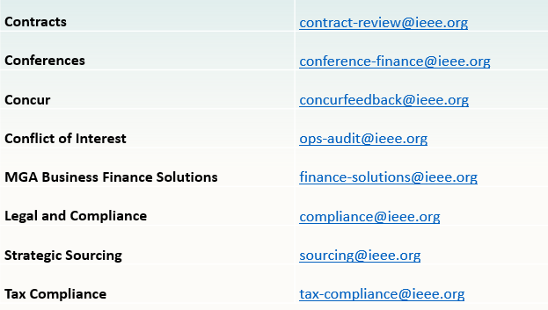
Additional Contact Information
Notes:
Here is a list of additional IEEE Contacts for reference.
At this point, we are finished with our presentation and look forward to any questions you may have.

Slide 49
Questions?

Slide 50
Thank you!

