Slide 1
IEEE OU Analytics - Introduction

Slide 2
IEEE OU Analytics
Powered by Tableau
Tableau is an Online Business Analytics tool that allows users to view and further define visualizations based on IEEE data.
Tableau uses the same data source used by SAMIEEE, IEEE Renewal, Collabratec, the vTools Applications….
This training will show users how to access OU Analytics and interact with the Landing page and six dashboards.
Begin at http://www.ieee.org/ouanalytics

Slide 3
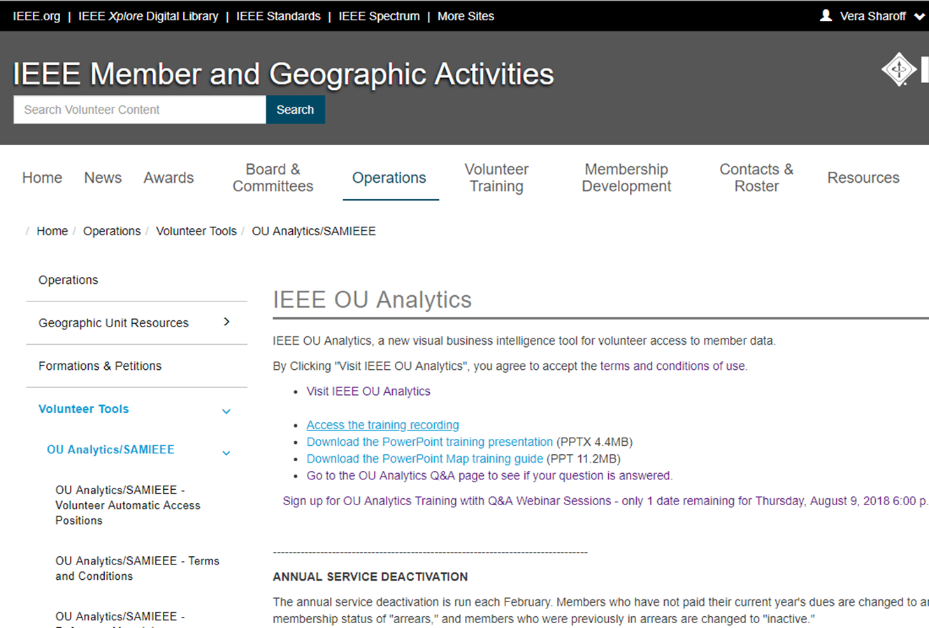

Slide 4
IEEE OU Analytics
http://www.ieee.org/ouanalytics
Access is based on the volunteer position and Organizational Unit (OU) ie: Section, Chapter, Society, region etc…
A list of authorized volunteer positions is available from http://www.ieee.org/ouanalytics

Slide 5
IEEE OU Analytics - Terms and Conditions
Conditions of data availability and use
IEEE member data is released for use only by IEEE members, officers, and committee members. Member information may not be furnished, with or without compensation, to outside entities, or be used by IEEE members for any other than approved IEEE business.
It is the responsibility of the volunteer to keep informed of IEEE Policies governing mailings and the use of labels and email addresses, including the regulations governing electioneering for IEEE offices. The information is found in Section 14.1 of IEEE Policies published every January and is available on request or from the IEEE Governing Documents website.
It is also the responsibility of the volunteer to keep informed of the IEEE member Privacy and Security policies and Email Terms and Conditions.

Slide 6
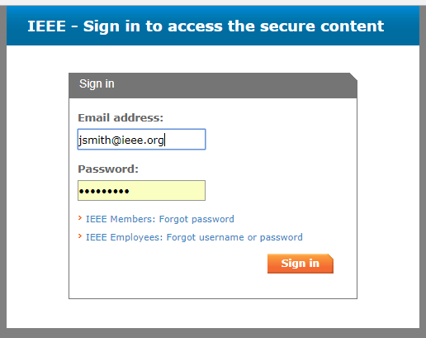
IEEE OU Analytics
Sign in
IEEE web Account User Name and Password

Slide 8
IEEE OU Analytics
The landing page is divided into six areas
Members and Affiliates
Member Lookup* by Region, Section and Subsection, contact information, grade, gender, HKN status.
Memberships, Subscriptions and More … Memberships, subscriptions, and Technical Committee participations
Region, Section, Subsection, grade, gender, years of service and renewal category*.
Students
An overview of attending students (all grades) by Section and School.
* New feature

Slide 9
IEEE OU Analytics
The landing page is divided into six areas
Doublet
IEEE wide view of overlapping memberships
Volunteer Positions
Current OU volunteers and volunteer history.
Map
Geographic display of organizational units and counts

