Slide 1
IEEE OU Analytics Memberships, Subscriptions and More Dashboard

Slide 3
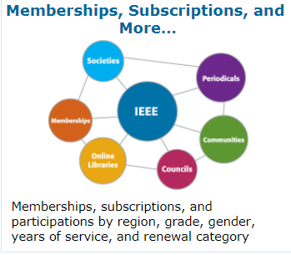
IEEE OU Analytics
Memberships, Subscriptions, and More… - Dashboard
Membership, Subscriptions, and More… Dashboard provides information for memberships, subscriptions and participations by region, grade, gender, years of service, and renewal category.
Society, Council, Community, Chapter and Affinity Group users access information for their specific group using filter options available. Filter by Product Type (memberships, councils, periodicals, etc.), Product Name (selection viewed is based on product type chosen), Region, Grade, and Status.

Slide 4
IEEE OU Analytics
Memberships, Subscriptions, and More… - Dashboard
There are five (5) tab options available:
Product Dashboard
Product Summary by Region by Grade
Renewal Category Dashboard
Renewal Summary by Region by Grade
Detail
Filtering is available for Product Type; Product Name, Region, Grade and Status

Slide 5
IEEE OU Analytics
Memberships, Subscriptions, and More… - Product Dashboard
The Product Dashboard – contains four (4) visualizations.
Summary by Product by Region (data table) – provides a summary of the product selected, using Filters. For example, Product Type Memberships is preselected; select Product Name (e.g. a specific Society or Affinity Group Membership. Affinity groups include Consultants Network, WIE, and YP). Click to apply and view the total membership count. Hover over count to view tool tips with statistical information. Click View Details to view individual member information.
Count by Grade (pie chart) – provides count of members by grade. You can modify results through Filters or clicking within visualizations. Hover over pie slices to view tool tip with statistical information. Click on a grade slice within pie to select a specific grade. Click View Details to view individual member information.

Slide 6
IEEE OU Analytics
Memberships, Subscriptions, and More… - Product Dashboard
Count by Gender (pie chart) – provides count of members by gender. Hover over pie slices to view tool tip with statistical information regarding gender count. Click on a gender slice within pie to select gender type. Click View Details to view member information for selection.
Count by Grade and Years of Service (bar chart) – Chart displays count of members by grade and years of service. Hover over chart to view tool tip with statistical information for a specific grade and year(s) selected or use Filters. To obtain member detail, click on a specific grade within bar chart, hover over to view Tool Tip and click. Select View Details. You can also click on the Years of Service count to View Details for a full list of members by grade for those “Years of Service”.
Note for Joint Chapter Chairs: Membership counts displayed may contain duplicates due to members belonging to more than one society. Pie charts (Grade and Gender) provide unique member counts.

Slide 7
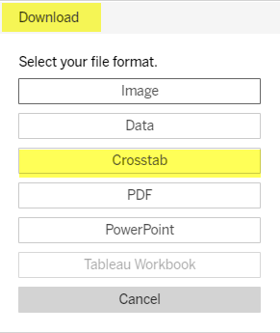
IEEE OU Analytics
Memberships, Subscriptions, and More… - Product Summary
Product Summary by Region, by Grade Dashboard– provides a data table to view counts by grade for memberships, communities, councils, online libraries and periodicals. Filter down by Product Type (Memberships is preselected), Product Name, Region, Grade and Status.
Region can be expanded to include counts by Section and Subsection by selecting the “expand” button on the Region field title.
Hover over counts to view tool tips with statistical information. Click View Details to view individual member information
To view and download individual member information, click on View Details from Tool Tip. Click on table title, select Download on the top right of screen. Select Crosstab. Download will provide additional detail information for the members selected.

Slide 8
IEEE OU Analytics
Memberships, Subscriptions, and More… - Renewal Dashboard
Renewal Category Dashboard – provides product renewal information based on filters selected. Renewal categories provided are: Renew, First Year Renewed, New, Reinstated and Not Yet Renewed.
Filters provided are Product Type, Product Name, Region, Grade, Renewal Category and Status.
Overview of Product Renewals (bar chart) – provides a breakdown by renewal categories. Hover over to view additional statistical information. Click within bar chart and Click View Details to view individual member information.

Slide 9
IEEE OU Analytics
Memberships, Subscriptions, and More… - Renewal Dashboard
Product Summary by Region by Renewal Category (data table) – provides a count of members by Region by Renewal Category. Expand Region to view counts by Section and Subsection by selecting the “expand” button on the Region field title.
Hover over counts to view additional statistical information and Click on count to view Tool Tip and select View Details for individual member information.
Recommendation: Downloading Column and Row Totals default to “Grand Total” counts, which can be significant and provide excess data. Use Filters to refine data per OU.

Slide 10
IEEE OU Analytics
Memberships, Subscriptions, and More… - Renewal Summary Dashboard
Renewal Summary by Region by Grade – provides a data table containing counts by renewal category. It is further defined by Grade.
Filters provided are Product Type, Product Name, Region, Grade, Renewal Category and Status.
Expand Region to view counts by Section and Subsection by selecting the “expand” button on the Region field title.
Hover over counts to view tool tips with statistical information.
Click View Details in Tool Tip to view individual member information. Download details for additional member information displayed in view.
Recommendation: Downloading Column and Row Totals default to “Grand Total” counts, which can be significant and provide excess data. Use Filters to refine data per OU.

Slide 11
IEEE OU Analytics
Memberships, Subscriptions, and More… - Detail Dashboard
Detail View – provides details of the members/participants for memberships, communities, councils, online libraries and periodicals.
Refine data using filters available (Product Type, Product Name, Region, Grade, Status, Gender, Years of Service, Renewal Category, Member #, First Name and Last Name).
Table includes breakdown by Region and Section.
Other than member details displayed, there are additional member details available in download option.
To download full list, click on table title line (gray shaded). Then select Download on top right of screen, and select download to Crosstab.

Slide 12
IEEE OU Analytics
Questions & Assistance
If you have any questions regarding the new tool or need further assistance send an email to ouanalytics@ieee.org
Here are additional contacts:
GEOGRAPHIC ORG UNITS CONTACTS
Helen Shiminsky (primary)
Email: h.shiminsky@ieee.org
+1 732 562 5517
Vera Sharoff (alternate)
Email: v.sharoff@ieee.org
+1 732 552 5509
SOCIETY ORG UNITS CONTACTS
Mary Curtis (primary) Tina Cordeiro (pimary)
Email: m.curtis@ieee.org t.cordeiro@ieee.org
+1 732 562 3904 +1 732 562 5329
Rosanne Loyal (alternate)
Email: r.loyal@ieee.org
+1 732 562 3903

