Slide 1
CLE Presentation
2023 MGA Treasurers Training
October 21, 2023

Slide 2
Effective Training is Important
Improves member engagement
Reassuring guidance to the new officer
Enhances Section Vitality
Increases member value to industry
Supports leadership succession

Slide 3
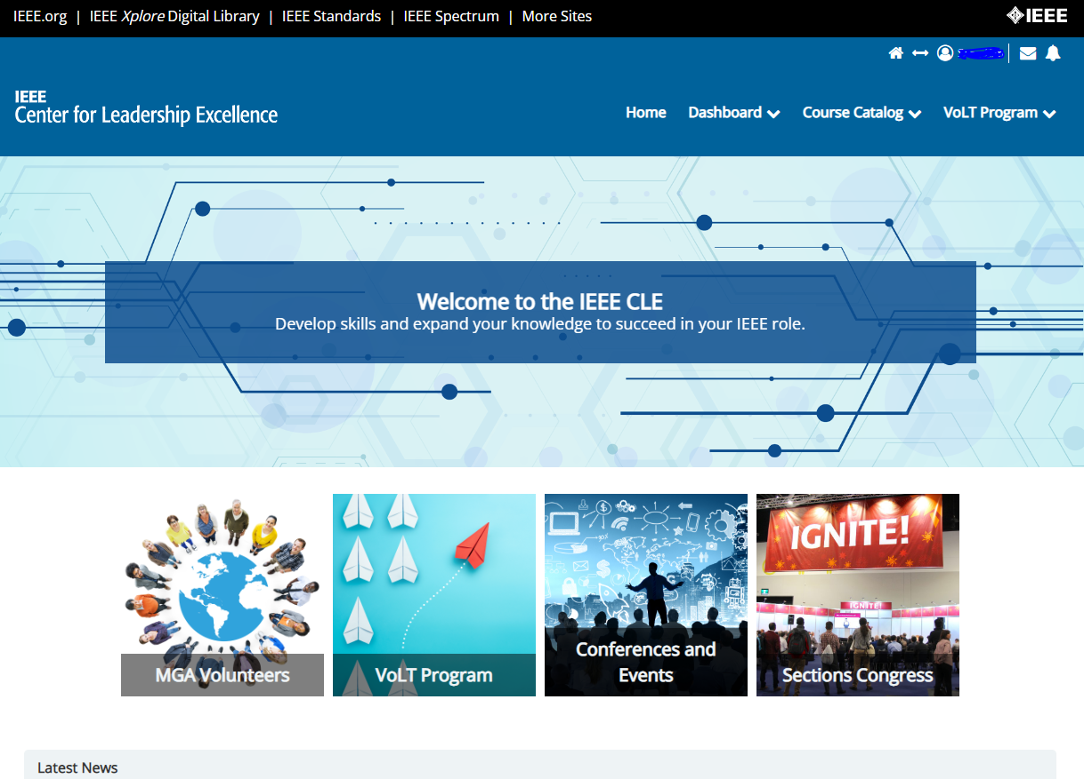
Center for Leadership Excellence
The Center for Leadership Excellence (CLE) is IEEE’s training platform for:
MGA volunteers
Prospective candidates for IEEE VoLT Program
Conference/event planners
Open to all IEEE volunteers and members
Self-paced and on demand content and materials
Included with your IEEE membership - access the CLE with your IEEE account!

Slide 4
Financial and Treasurer Training in the CLE
NextGen Training
MGA Geo Unit Financial Reporting
Section Treasurer
Role Description | Action Plan | Recommended Training
Chapter Treasurer
Role Description
Region Treasurer
Role Description
Student Branch Treasurer
Role Description | Action Plan | Recommended Training

Slide 5
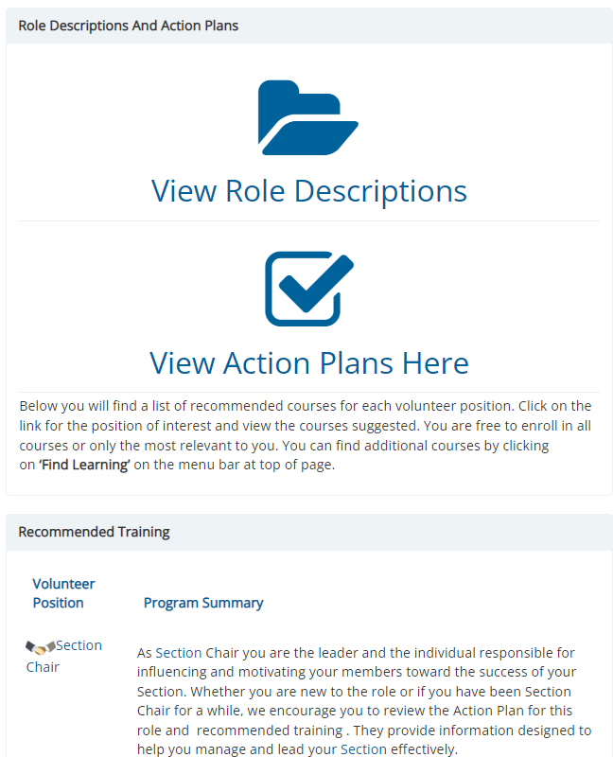
Content Available in the CLE
Action Plans for over 20 volunteer roles including:
First 30 Days Action Plan
Yearly Activities
Key Administrative Items
Volunteer role descriptions
Descriptions available for positions in Student Branches, Sections, Chapters, Affinity Groups, and Regions
Courses recommended for volunteers
IEEE 101 courses
Prerequisites for applying to the the VoLT Program

Slide 6
Sections Congress, Historical Content Available in the CLE, from 2017

Slide 7
Sections Congress 2023: Breakout Sessions Sampling

Slide 8
Sections Congress 2023: Ignite Sessions Sampling

Slide 9
Volunteer Leadership Training Program
The IEEE MGA Volunteer Leadership Training (VoLT) Program prepares IEEE volunteers for leadership roles in their local units and beyond.
Program goals:
Accelerate learning of the IEEE’s organization
Increase volunteer engagement
Create a foundation that develops future IEEE leaders
2013
Pilot Year
498
Graduates
Creating the Leaders of Tomorrow
10
Regions
160+
Sections

Slide 10
What You’ll Get Out of the VoLT Program
More knowledge of the IEEE
Soft Skills like: Leadership; Time & Stress Management; Communications; Dealing with Difficult People.
Hard Skills like: vTools; Collabratec; Entrepreneurship; Social Media; Ethics.
Awareness of key IEEE resources and tools you’ll use as an IEEE volunteer
Networking opportunities with your peers, mentors, staff, and IEEE leaders

Slide 11
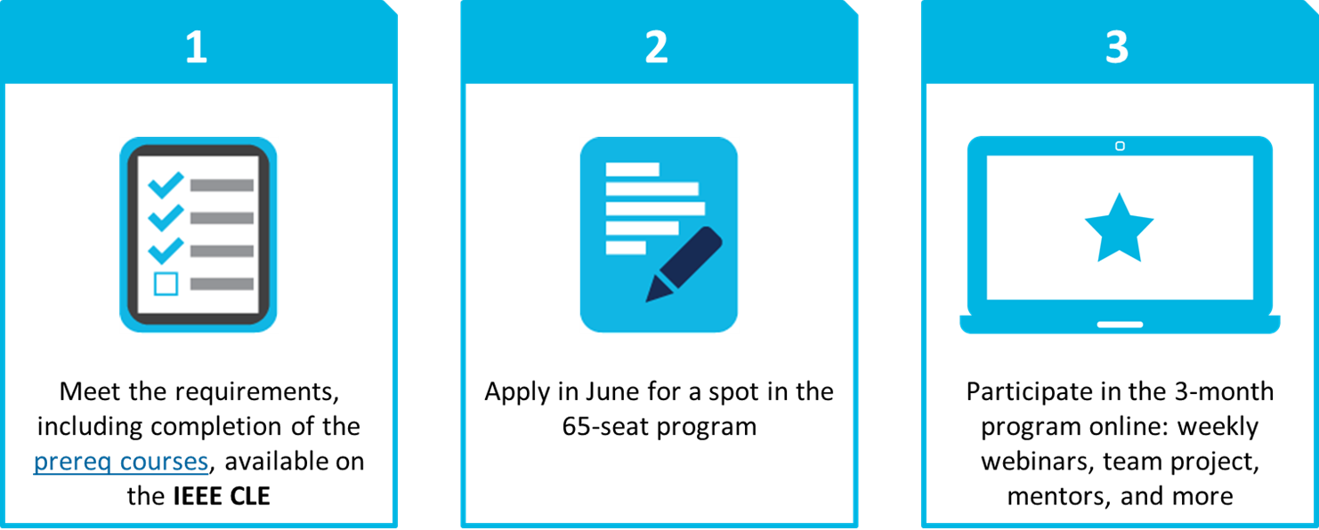
Application Process

Slide 12
Website & Staff Contact Information
IEEE Center for Leadership Excellence
https://ieee-elearning.org/
Stephen Torpie, Program Specialist Volunteer Experience
s.torpie@ieee.org
Christie Giambalvo, Director Geographic Activities
c.giambalvo@ieee.org
VoLT Program
volt@ieee.org

