Slide 1
5th MGA Treasurers Training Workshop
Gerardo Barbosa, MGA Treasurer
Lori Keller, Senior Director Business Finance Solutions
21 October 2023
Jersey City, NJ

Slide 2
MGA Treasurers Training 2019-2023
2019: 1st MGA Treasurers Training – New Brunswick, NJ
Deb Cooper (2017-2019), Mary Ellen Randall (2020) – 2019 MGA VP Francis Grosz
2020: 2nd MGA Treasurers Training – Virtual
Mary Ellen Randall (2020), Gerardo Barbosa (2021) – 2020 MGA VP Kukjin Chun
2021: 3rd MGA Treasurers Training – Virtual
Gerardo Barbosa (2021, 2022) – 2021 MGA VP Maike Luiken
2022: 4th MGA Treasurers Training – Hoboken, NJ
Gerardo Barbosa (2021-2023) – 2022 MGA VP David Koehler
2023: 5th MGA Treasurers Training – Jersey City, NJ
Gerardo Barbosa (2021-2023), Greg Gdowski (2024) – 2023 MGA VP Jill Gostin

Slide 3
Welcome
5th MGA Treasurers Training Workshop
21 October 2023
Jersey City, NJ

Slide 4
Introductions
5th MGA Treasurers Training Workshop
21 October 2023
Jersey City, NJ

Slide 5
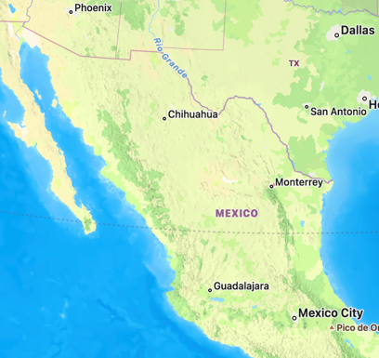
Gerardo Barbosa, MGA Board Treasurer
IEEE-HKN Senior Member, Computer Society Member
Co-founder and Managing Partner at CLOUDCOM
Current volunteer positions
Chair, MGA Finance Committee*
Chair, Ad Hoc Committee on NextGen Volunteer Adoption
Member of
IEEE Finance Committee*
IEEE New Initiatives Committee
IEEE Strategy and Alignment Committee
MGA Operations Committee*
MGA Strategic Planning Committee*
FinCom/NIC Ad Hoc Commitee on Enabling IEEE Strategic Investments (new)
Previously
MGA: VC-IM & ITCO Committee Chair, vTools Committee Member
REGION 9: Treasurer, Regional Conference Coordinator
MONTERREY SECTION: Chair, Treasurer, YP Founding Chair
* Indicates MGA Treasurer Positions

Slide 6
Agenda Topics & Presenters
5th MGA Treasurers Training Workshop
21 October 2023
Jersey City, NJ

Slide 7
Agenda Topics & Presenters (1 of 4)
MGA Treasurer Remarks & Agenda Review
MGA & Geo Unit Business Finances
Lori Keller, Senior Director, MGA Finance
Teresa Sacks, Senior Manager, MGA Finance
Geo Unit Financials and Compliance – NextGen
Lauren Jesch, Financial Analyst, MGA Finance
Vicky LI, Financial Analyst, MGA Finance
NextGen Volunteer Adoption
Gerardo Barbosa, MGA Treasurer

Slide 8
Agenda Topics & Presenters (2 of 4)
IEEE Financials
Eric Sheier, Accounting Manager – Finance & Administration
Banking / Financials and Compliance - Concentration Banking (CB) and non-CB Bank Accounts
Susan Manno, Senior Treasury Analyst, Treasury Operations
Marlene Singh, Financial Services Analyst, Treasury Operations
Geo Unit Risk Analysis Assessment
Lori Keller, Senior Director, MGA Finance

Slide 9
Agenda Topics & Presenters (3 of 4)
Conferences
Samantha Capista, Manager, Conference Finance
Concur Overview
John DeSimone, Director, Financial Systems, F&A
Mary Murray, Financial Systems Analyst, F&A
Audit Process Overview
Rupa Paranjabe, Senior Director, Internal Audit
Caitlyn Chow, Internal Audit Manager, Internal Audit

Slide 10
Agenda Topics & Presenters (4 of 4)
MGA Training Update
Stephen Torpie, Program Specialist Volunteer User Experience, MGA Geographic Activities
MGA Membership & Contact Center
Elyn Perez, Senior Manager, Member Market Development
Yolanda Quinones, Senior Manager, IEEE Contact Center
MGA Event Tool & Google Accounts
Vera Sharoff, Senior Director, MGA Information Systems
Round Table Discussion
Closing Remarks & Adjournment

Slide 11
Business Finance Solutions Support Staff for MGA – Contact Information
Lori Keller (732) 562-3801 l.r.keller@ieee.org
Debbie Coto (732) 562-5508 d.coto@ieee.org
Teresa Sacks (732) 562-3962 t.sacks@ieee.org
Lauren Jesch (732) 562-5321 l.jesch@ieee.org
Vicki Li (732) 562-5596 v.li@ieee.org
Shravana Pandre 080 49 444394 s.pandre@ieee.org

