Slide 1
IEEE Contact Center
Treasurer Training
Presented by: Yolanda Quiñones
21 October 2023
Serving our members and volunteers around the world!

Slide 2
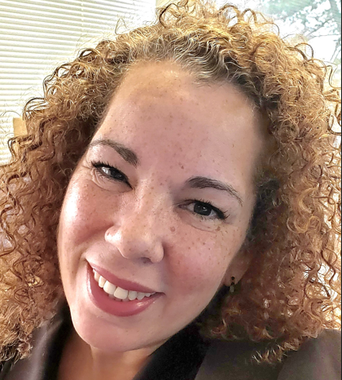
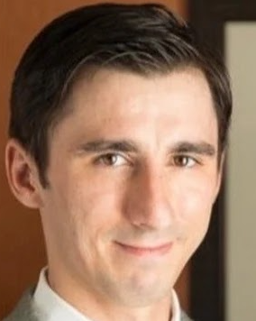
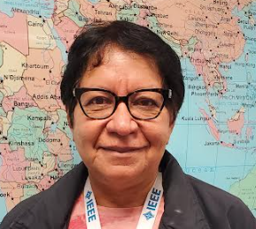
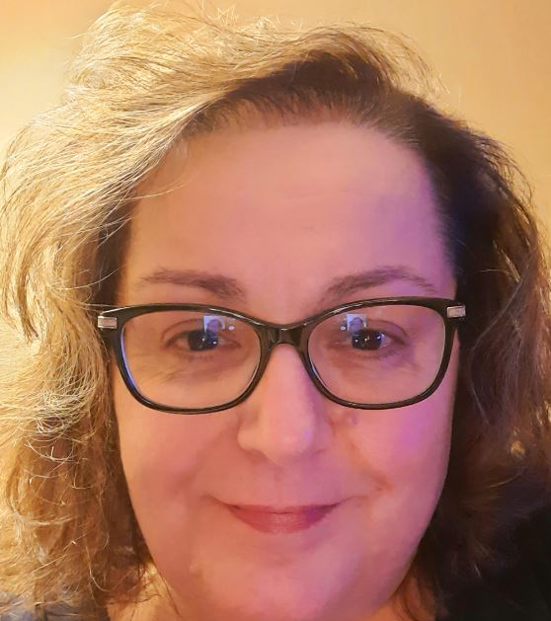
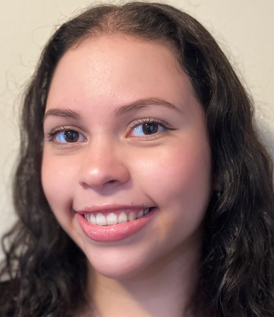
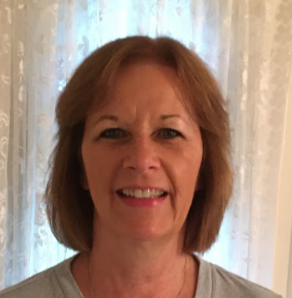
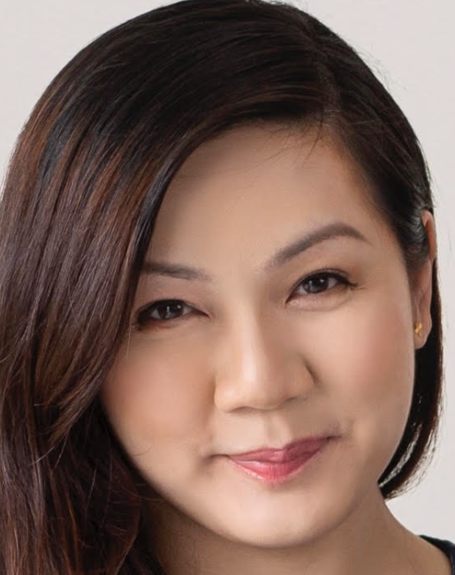
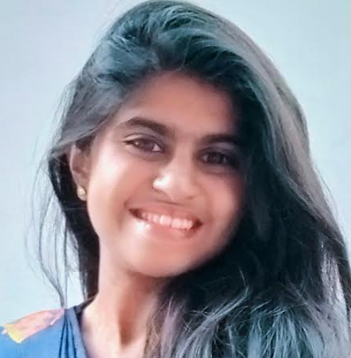
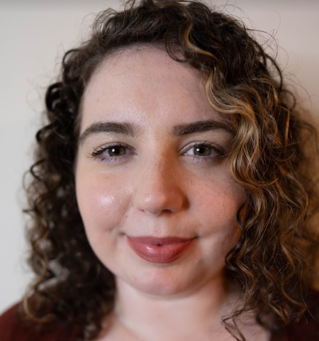
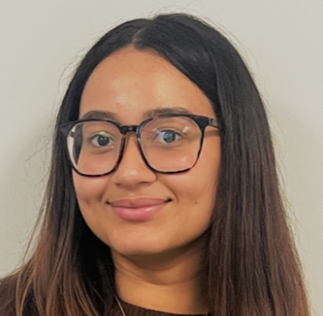
Meet the Team
Darnell Ragland
Supervisor, USA
Yolanda Quiñones
Sr. Manager, USA
Vil Zeimys
Supervisor, USA
Anita Mercado
Associate, USA
Karen Jongeleen
Associate, USA
Amy Asencio
Associate, USA
Maureen Hemmerly
Associate, USA
Kashonda Mauldin
Associate, USA
Karen Lim
Associate Singapore
Mable Rajakumar Associate, India
Desiree Geis
Associate, USA
Thomas Powell
Associate, USA
Khristy Rosales
Associate, USA

Slide 3
IEEE Contact Center
Our primary goals are to:
Create strong relationships by providing exceptional service on the first contact and deliver a highly satisfied experience to our members, volunteers and non-member constituents
Ensure our agents are well trained and knowledgeable of all facets of IEEE so they can achieve goal #1

Slide 4
Advancing the Member experience through knowledgeable, accessible and timely Member support
Educating on member value through phone connection and conversation - outbound calls to Members annually to apprise on benefits relevant to them and encourage renewals
Provision of world-class customer relationship management support - through Oracle Service Cloud (OSC) - enabling live chats, a self-service knowledgebase and real-time analytics
Actively contribute to IEEE program support - renewal readiness, testers of system functionality, Tier-1 support for NextGen and other products, programs and services
Directly contribute to member retention and revenue – outreach to members in arrears each year and assist in renewing their IEEE Membership

Slide 5
Global Operation and Methods of Communication
Global Support in the United States, India and Singapore.
Self Service Knowledgebase available 24hrs, 7 days a week, 365 days a year, where you can find the answers, you need at your convenience
Chat widgets embedded on several IEEE.org webpages to provide our members easy access for support to the Contact Center
Join/Renewal pages
Collabratec Website Chat
Coming soon – November 2023
Student Member Facebook Page - Messenger
Women In Engineering Website Chat

Slide 6
Voices of the “Customer”
Satisfaction and Quality Scores (January to June 2023)
Customer satisfaction (CSAT) scores are measured by highly satisfied (HS) and satisfied (S) to a metric of 90%
First contact resolution (FCR) – 90% goal
Quality monitoring (QM) scores are conducted weekly for each associate – Our goal is 90% satisfaction
Post interaction surveys help us to identify opportunities for improvement
Email inquiries are resolved within 24 hours
FCR – 85%
Data Source: Oracle Service Cloud
Data from January – September 2023

Slide 7
IEEE Self-Service Support Center
2022 Full Year / 2023 Projection
The IEEE Self-Service Support Center (www.ieee.org) is a one-stop platform for members and volunteers to get answers to their questions at their convenience
There are over 1,300 FAQ’s across all facets of IEEE available to our members and volunteers available 24hrs, 7 days a week and 365 days a year
Data Source: Oracle Service Cloud
Data from January – September 2023
Notes:
2021 - 1.1 visits, 182k answers viewed
Collabratec – 37 chats
Join – 643 chats
Renew – 262 chats

Slide 8
NextGen Support

Slide 9
NextGen
Contact Center Support - Tiered Approach
Self-Service Support | Provides Volunteers and Staff quick access to tools and information to get started using NextGen through FAQ’s on the IEEE Support Center and NextGen sites.
Tier 1 and Tier 1+ Contact Center Support | Tier 1 provides support for general inquiries received via email, telephone, web form or live chat. Tier 1+ provides access to our own subject matter experts providing an additional level of support for more complex inquiries.
Tier 2 Business Unit Liaison Subject Matter Expert | When an inquiry is received and the Contact Center cannot answer the question, the inquiry is escalated to the appropriate business expert for resolution. The answers are provided back to Contact Center who will respond to the volunteer and close the inquiry.
Other Support | All conference related inquiries that the Contact Center receives are directly routed to MCE for resolution and tracking. IEEE staff that receive direct inquiries will blind copy the Contact Center on their responses for training and tracking purposes.

Slide 10
NextGen
Contact Center Support
We support our volunteers with their NextGen needs using our tiered service model
The Contact Center provides Tier 1 support via chat, email and phone
In addition, we use Oracle Service Cloud, (Client Relationship Management System) (CRM), as the tool for escalating to business leaders for a 360-degree view into any inquiry
Staff received multiple hours of training across the NextGen platform, and we began servicing volunteers on 3 May 2021
Our goal is to provide a resolution within one business day

Slide 11
Nextgen Support – Activity Since Launch
Contact Center Support – Top Inquiries
Since May 3rd, 2021, the IEEE Contact Center has resolved a total of 3,858 NextGen inquiries
With new volunteers using NextGen the most popular inquiry continues to be “how do I get reimbursed”
The top three topics are as follows:
Expense Reimbursement – 2,792
Banking - 698
Ping ID - 170
Data Source: Oracle Service Cloud
Data from January – September 2023
Notes:
Expense topics range from;
How do I use concur
Log in is not working
Submitting vouchers before receive grant funding
Etc..
Banking
Browser issues
Log in issues
How to set up an account
Etc..
Ping
How to generate a Ping ID Changed devices and it doesn’t recognize
Etc..

Slide 12
NextGen Support YTD
Inquiries Resolved by Tier Support
Inquiries by Source
Data Source: Oracle Service Cloud
Data from January – September 2023

Slide 13
My Contact Information:
Yolanda Quiñones
Sr. Manager, Contact Center
T: +1 732.562.5497 E: y.quinones@ieee.org
Thank you!

