Slide 1
Accounting Update
IEEE MGA Treasurer Training
Srivathsava Madhugiri,
Director Corporate Accounting October 21, 2023

Slide 2
Agenda
Financial Statements Overview
  Statement of Financial Position
  Statement of Activities
  Statement of Cash Flows
2

Slide 3
Financial Statements Diagram
Activity Between Periods
Balance Sheet (PY)
AT December 31, 2021
Balance Sheet (CY)
AT December 31, 2022
Income Statement (Activity For Period Ended 2022)
Statement of Cash Flows (Activity For Period Ended 2022)
3

Slide 4
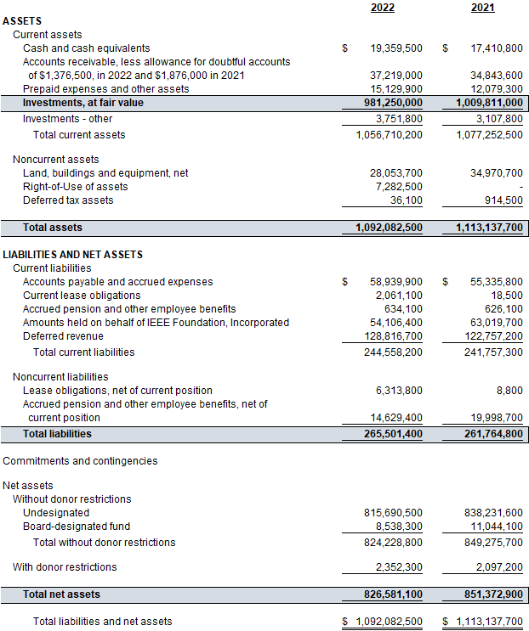
IEEE Consolidated Statement of Financial Position
4

Slide 5
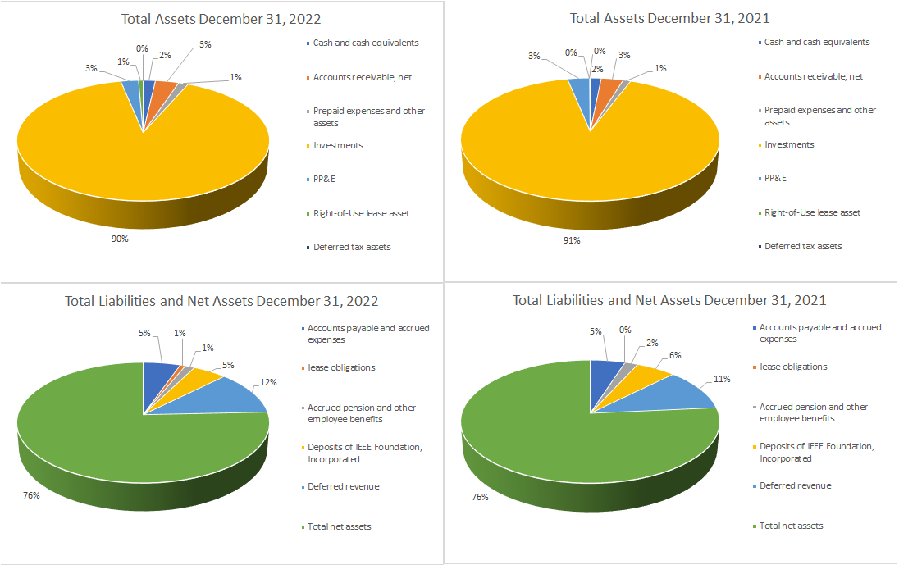
IEEE Statement of Financial Position
Total Assets, Liabilities, and Net Assets as of December 31, 2022 and 2021
5

Slide 6
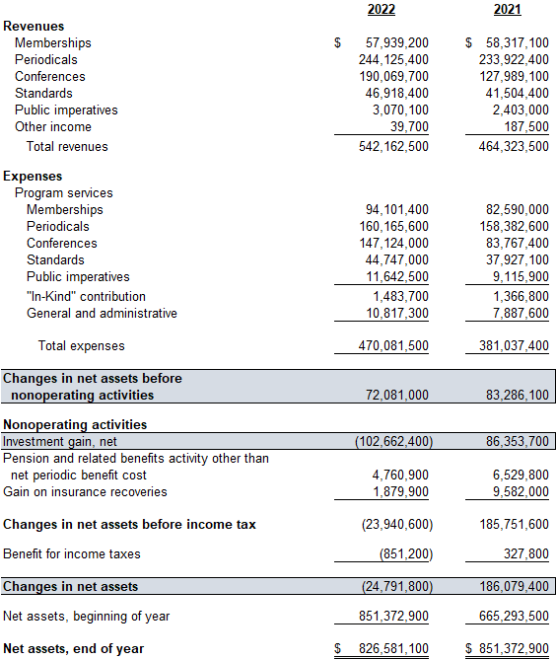
IEEE Consolidated Statement of Activities
6

Slide 7
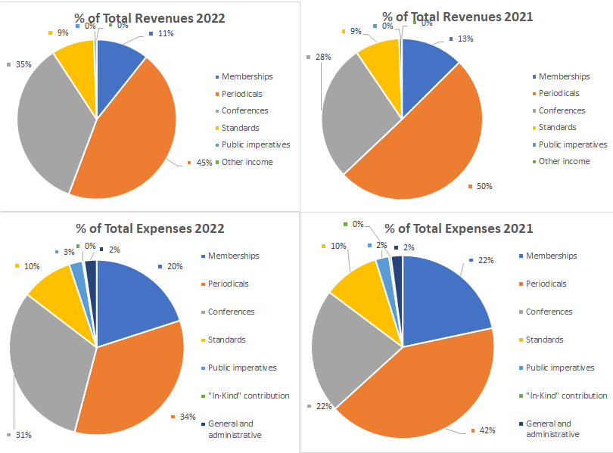
The Statement of Activities: Line of Operations (“LoO”) Format
7

Slide 8
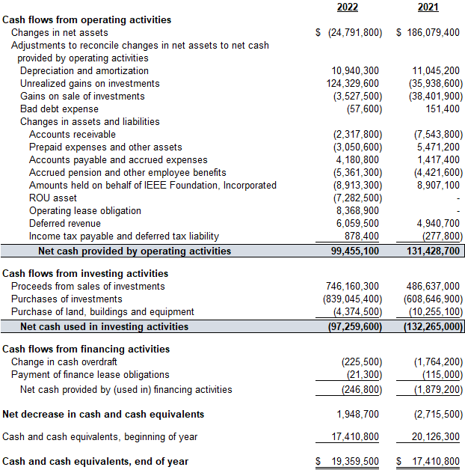
IEEE Consolidated Statement of Cash Flows for the Year Ended December 31, 2022 and 2021

Slide 9
Appendix
Complete financial statements are included as part of the Annual Report on the Institute’s website
https://17ieee.sharepoint.com/sites/InsideIEEE/SitePages/2022-IEEE-Annual-Report-Now-Available.aspx

Slide 10
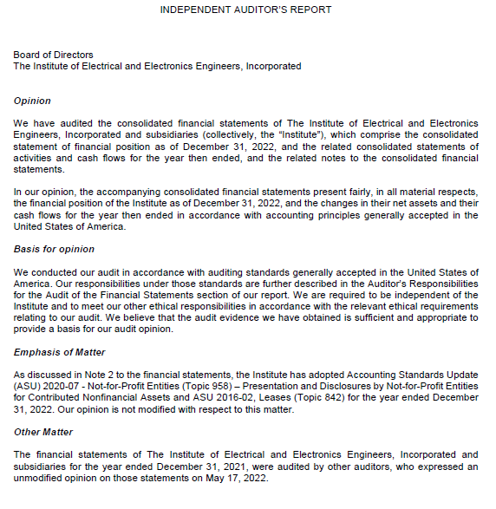
2022 Auditors Opinion (Crowe LLP)

Slide 11
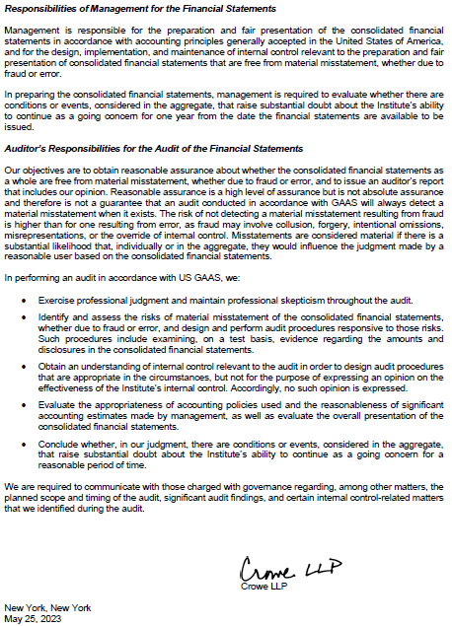
2022 Auditors Opinion cont.…

Slide 12
Questions?

